Slide 1


THE MISSION ISN’T DONE:
Translating Evidence into Decisive Action to Reduce Delaware’s Breast Cancer Burden
Scott D Siegel, PhD, MHCDS
Director of Cancer Control & Population Sciences
Cawley Center for Translational Cancer Research
Helen F. Graham Cancer Center & Research Institute
ChristianaCare

Slide 2

A story about Tameka and Angela…

Slide 3

Tameka
Diagnosed clinically with advanced triple-negative breast cancer at age 38
Strong family history of cancer, including her mother who was diagnosed at 30
Has 2 children, whom she could not breastfeed because of return to work
Not formally assessed for family history or other risk factors prior to diagnosis

Slide 4

Angela
Diagnosed with stage 3b breast cancer at age 47 on first mammogram
No prior screening because of insurance gaps and barriers to accessing other programs
Drinks alcohol regularly to “unwind” and because “heard it’s good for heart”

Slide 5

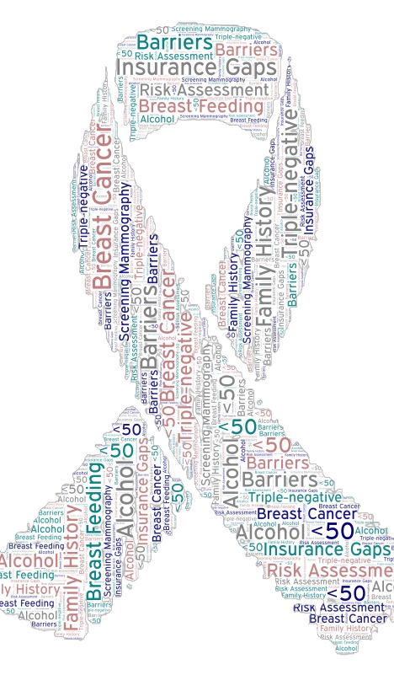
The Burden of Breast Cancer in Delaware
Elevated incidence and mortality
Early onset breast cancer
Triple-negative breast cancer (TNBC)
Alcohol-attributable breast cancer

Slide 6
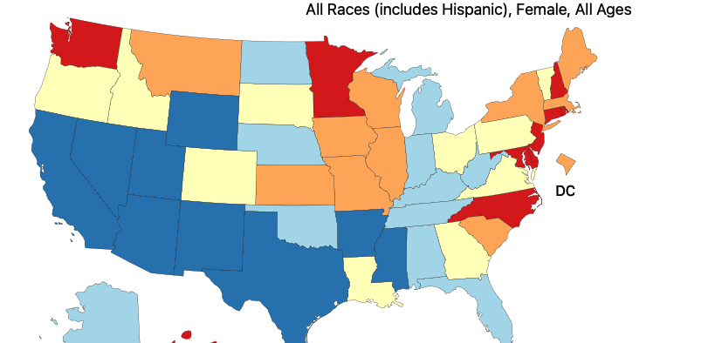
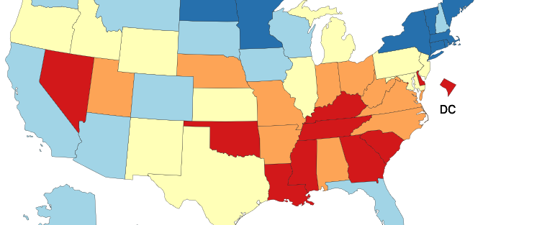
Breast Cancer in Delaware:
#2 for Incidence
#3 for Mortality
https://statecancerprofiles.cancer.gov/index.html

Slide 7
Breast Cancer in Delaware:
#2 for Incidence
#3 for Mortality
#1 for late-stage breast cancer in women <50
https://statecancerprofiles.cancer.gov/index.html

Slide 8
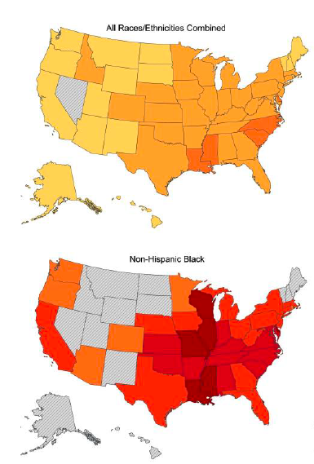
Triple-Negative Breast Cancer in Delaware:
#3 in US for incidence
#1 among Black women
Sung et al. (2023) JAMA Oncology
﻿10.1001/jamaoncol.2022.7835

Slide 9
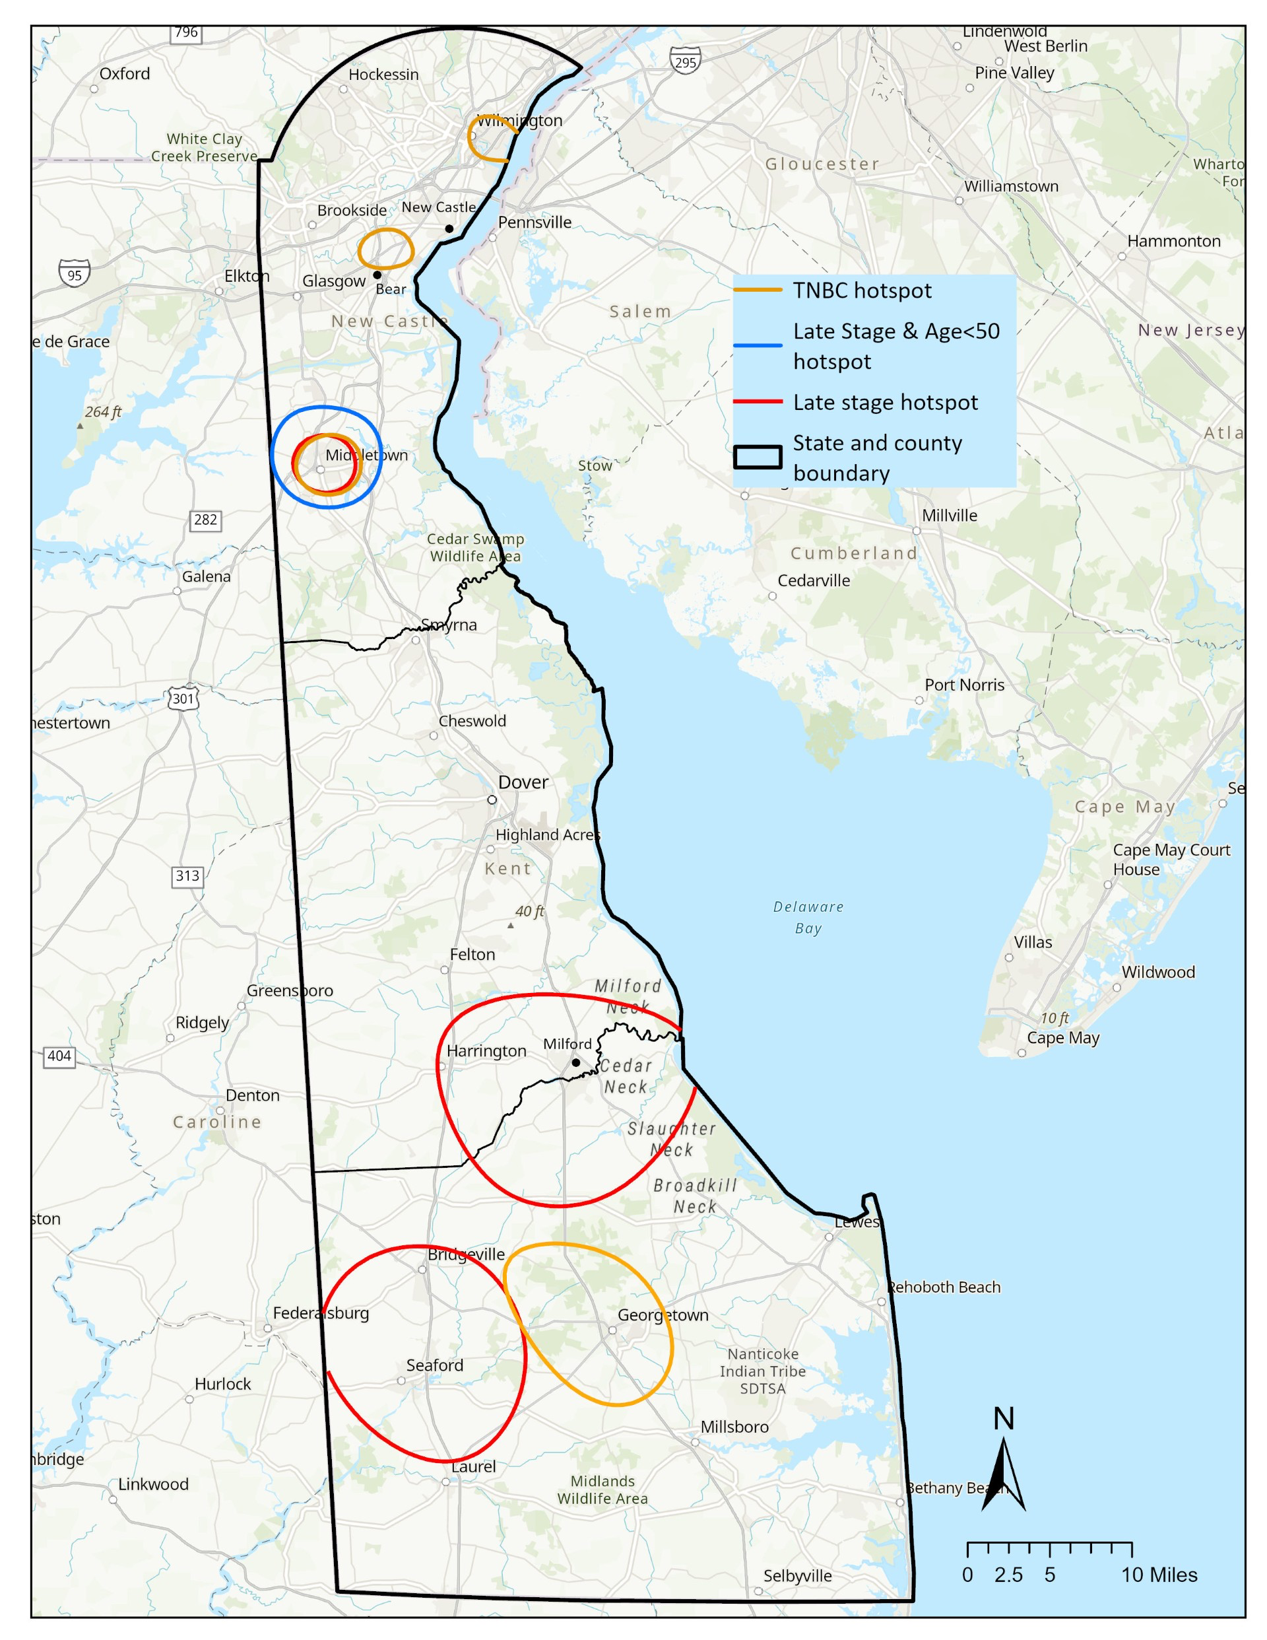
Breast Cancer in Delaware
The burden is STATEWIDE with hotspots across urban, suburban & rural communities in all three counties

Slide 10
Alcohol and Breast Cancer Risk
In the US, alcohol accounts for about 12% of breast cancers
In Delaware, alcohol accounts for about 19% of breast cancers
#1

Slide 11
Breast Cancer
Delaware
#2 for incidence
#3 for mortality
#1 for late-stage <50
#3 TNBC (overall)
#1 TNBC (Black women)
#1 for alcohol-attributable

Slide 12

From statistics to focusing on our neighbors…
What can we do to reduce the burden of breast cancer in Delaware?

Slide 13
Continuum of Cancer Care
Prevention
Diagnosis
Treatment
Life after Primary Treatment
2/3rd of breast cancer preventable adverse outcomes are determined before diagnosis
Silber et al. (2018) Milbank Quarterly
﻿10.1111/1468-0009.12355
Notes:
About 10 years ago, for a variety of reasons, I wanted to focus more on prevention, including early detection. This was for personal reasons as well as my growing interest in population health.

Slide 14

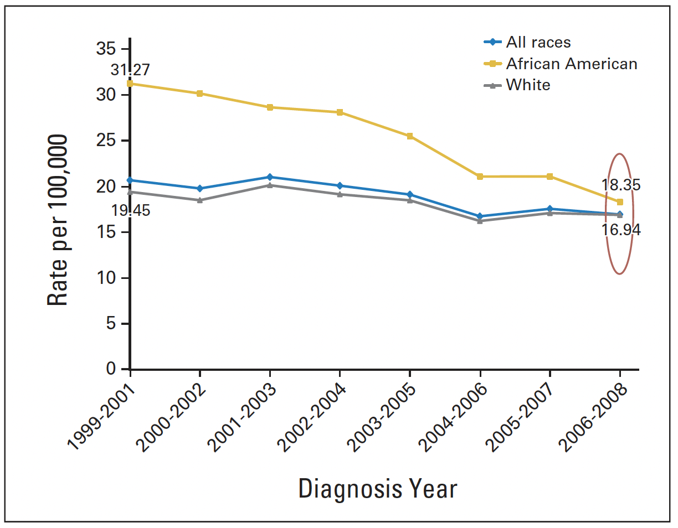

Slide 15
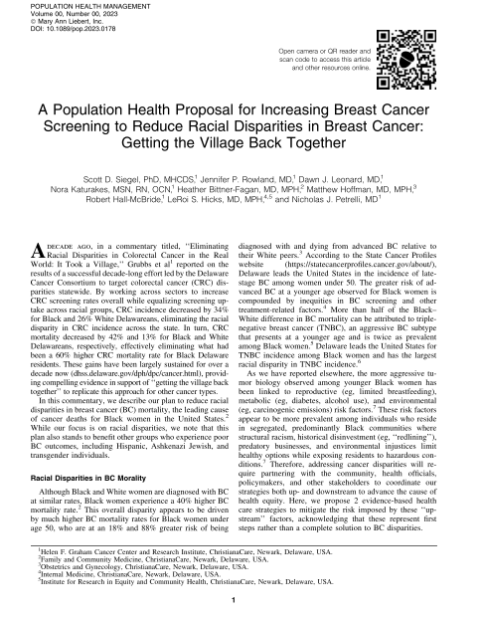
“Getting the Village Back Together”
Strategy #1: Screening
Average risk women should initiate annual screening mammography at age 40, with targeted approaches for women with barriers
Strategy #2: Risk Assessment
Conduct formal breast cancer risk assessments for all women beginning at 25

Slide 16
Breast cancer screening may be more resource intensive
Feature | Colorectal Cancer Screening | Breast Cancer Screening
Screening modality | Colonoscopy | Mammography
Screening interval | Every 10 years (average risk) | Every year
Prevention type | Primary and secondary | Secondary only Per 1000 mammograms: 100-200 will need follow-up 5-7 will be diagnosed
Coverage | Insurance, Screening for Life | Same, but with new eligibility complexities

Slide 17
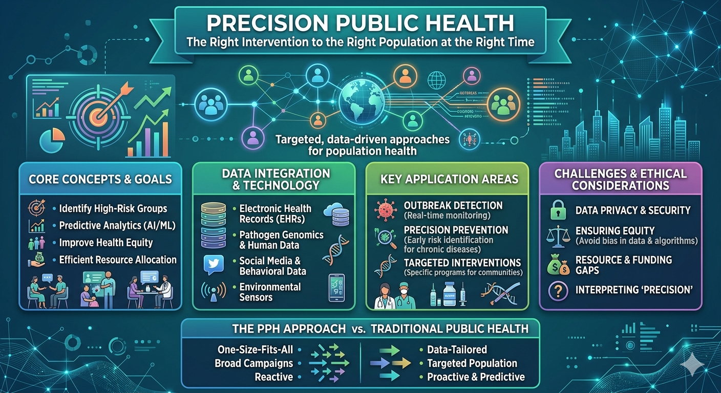

Slide 18
Piloting a precision public health approach for Angela, Tameka, and their communities…

Slide 19
Angela
Screening Challenges
1st mammogram not until 47
Insurance/coverage gaps
Thought not important until 50
Unaware alcohol a risk factor

Slide 20
Angela
Screening Challenges
1st mammogram not until 47
Insurance/coverage gaps
Thought not important until 50
Unaware alcohol a risk factor
Potential Interventions
Awareness and education on screening and risk factors
Assistance accessing coverage
Options beyond insurance and Screening for Life

Slide 21

Tameka
Risk Assessment Challenges
Diagnosed before screening age
Mother at 30 and other family history
Other risk factors
No risk assessment before her diagnosis of TNBC
70% of BRCA1/2 carriers who develop breast cancer have TNBC

Slide 22
Tameka
Risk Assessment Challenges
Diagnosed before screening age
Mother at 30 and other family history
Other risk factors
No risk assessment before her diagnosis of TNBC
70% of BRCA1/2 carriers who develop breast cancer have TNBC
Potential Interventions
Risk assessment at age 25
More recent research supports BRCA1/2 testing in high-risk groups without known family history

Slide 23
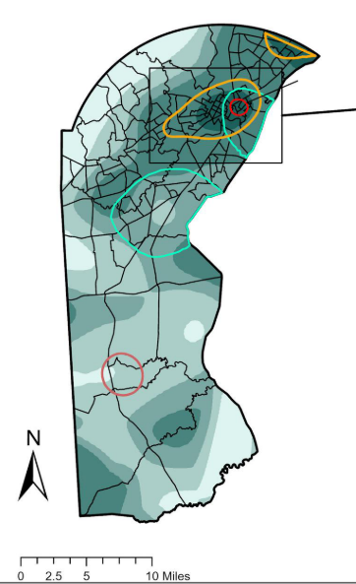
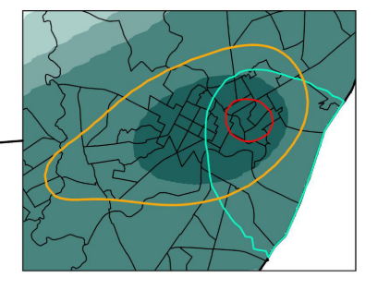
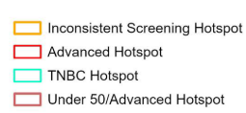
Employing Geospatial Analytics to Pilot a
Precision Public Health Strategy

Slide 24
Employing Geospatial Analytics to Inform a
Precision Public Health Strategy
55% advanced stage
28% TNBC
55% diagnosed clinically
Current on screening:
  28% biennial
  12% annual
33% 1st degree family hx

Slide 25
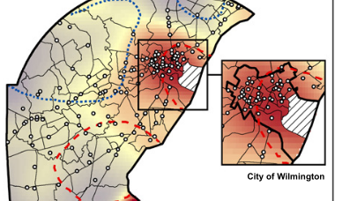
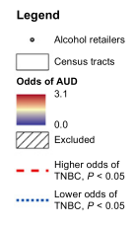

Slide 26

Consider policy interventions in high-risk communities

Slide 27

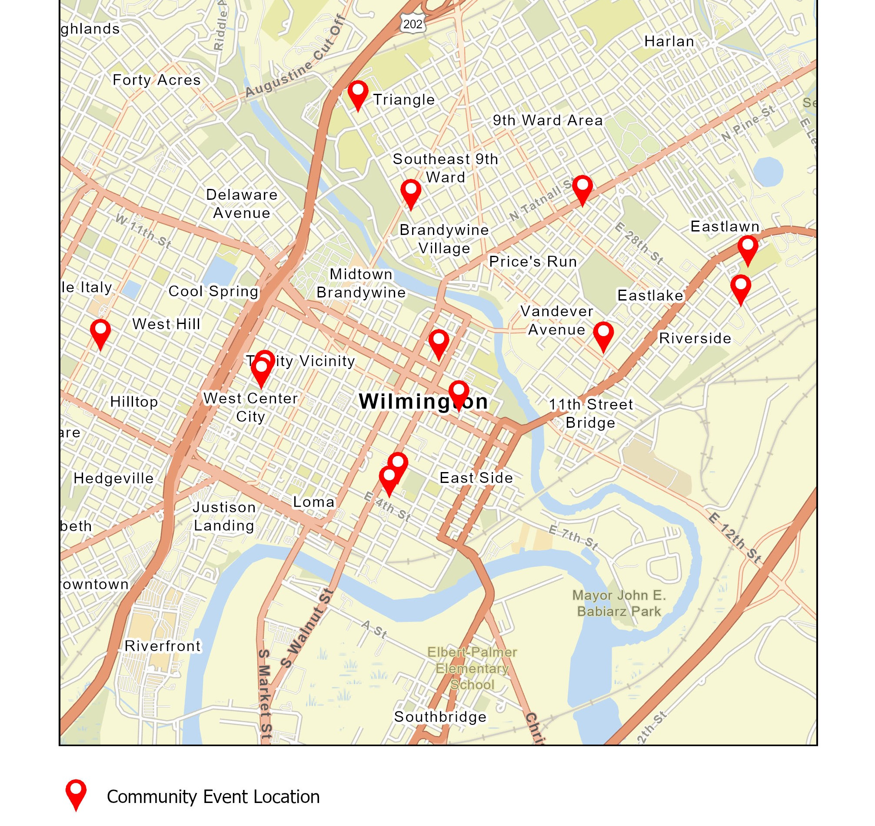
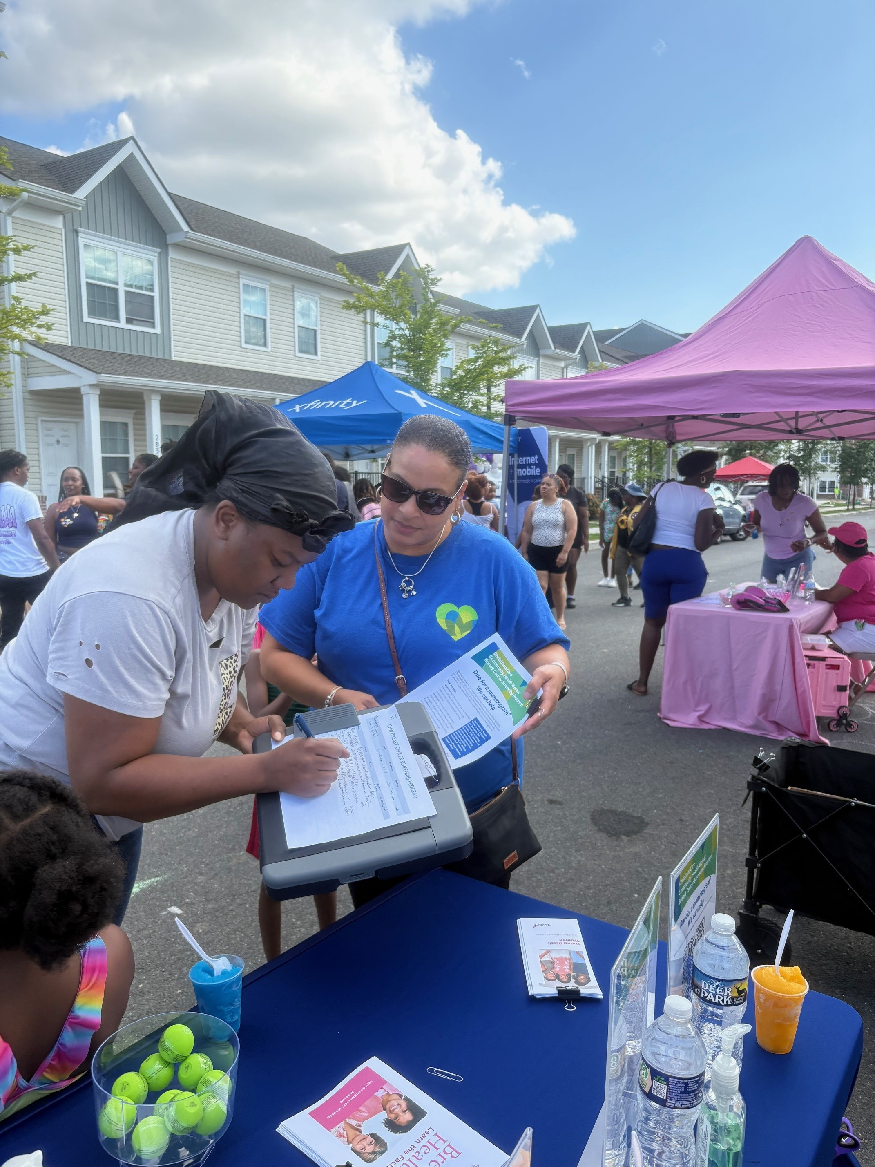
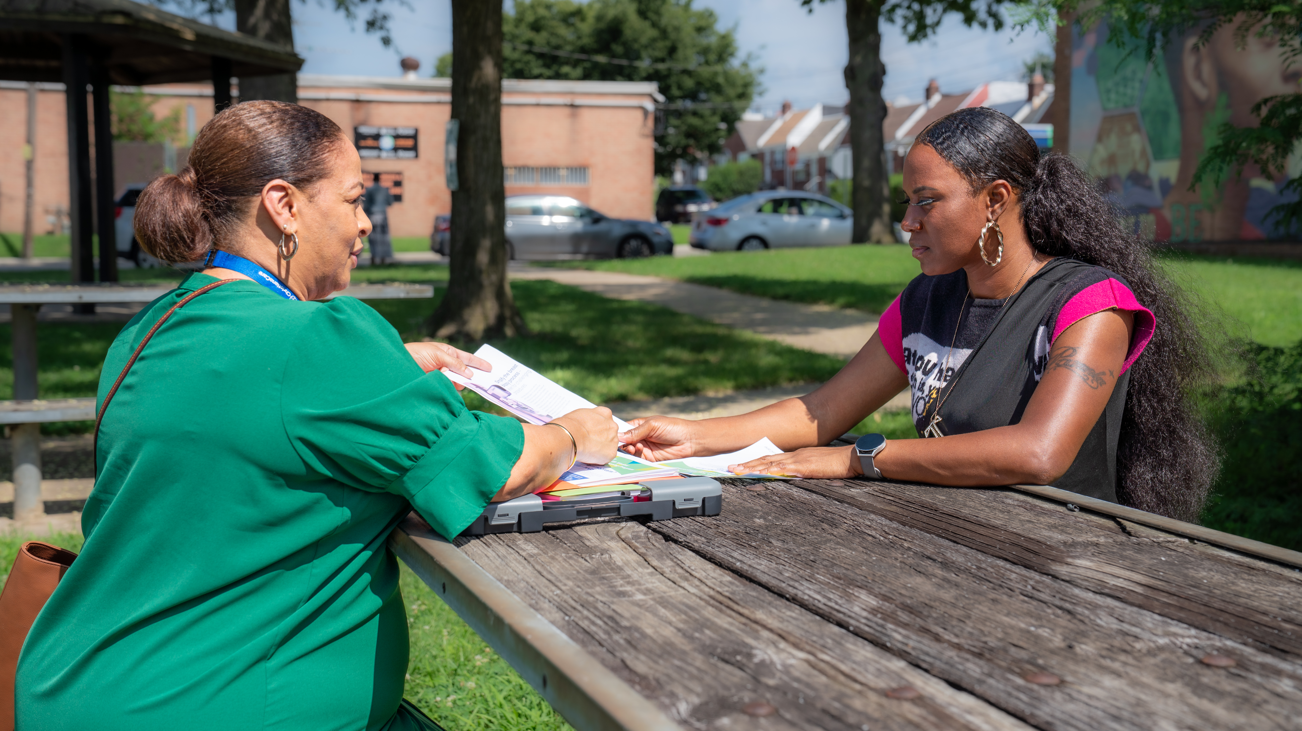
Embedded community health worker to increase screening and conduct risk assessments

Slide 28
Scaling Up:
What would a statewide precision public health strategy look like?

Slide 29
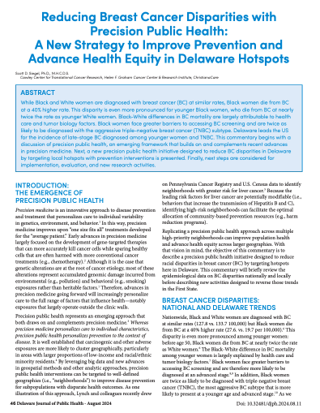
Implementing a Statewide Precision Public Health Strategy
New Delaware Cancer Consortium Task Force to develop and oversee this strategy
Task Force representation from:
  State & local government
  Health systems & other providers
  Community organizations
A tailored approach in each hotspot
Real-time evaluation and adjustment

Slide 30
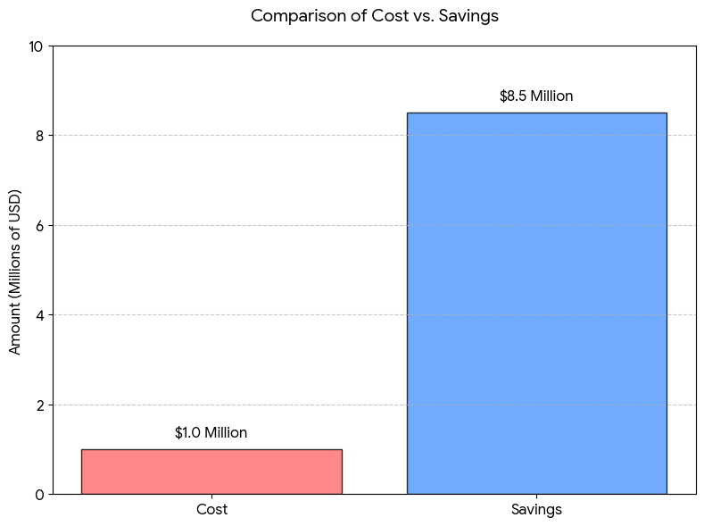
Colorectal Cancer Initiative
The cost savings from just the colorectal cancer initiative more than covered the total cost of the Delaware Cancer Treatment Program.

Slide 31
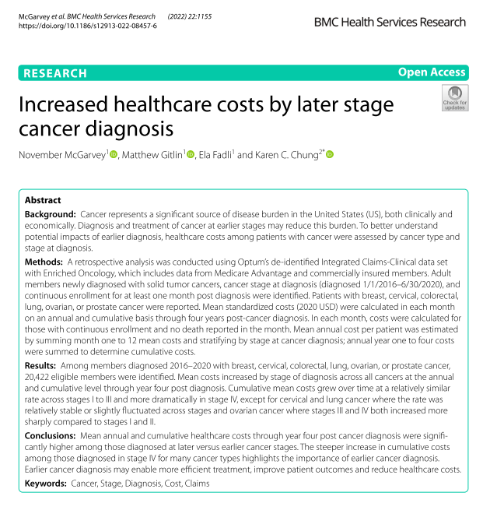
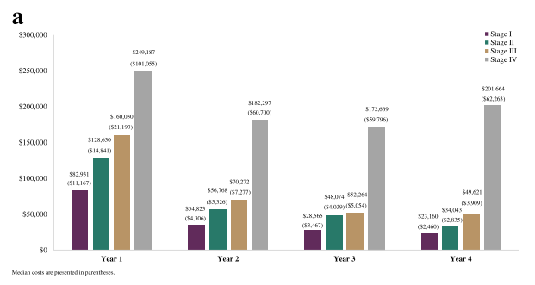
Colorectal Cancer Initiative
Diagnosing breast cancer at stage 2 vs. 3 results in 30% cost savings in year 1
Stage 4 vs 1 results in 90% cost savings

Slide 32
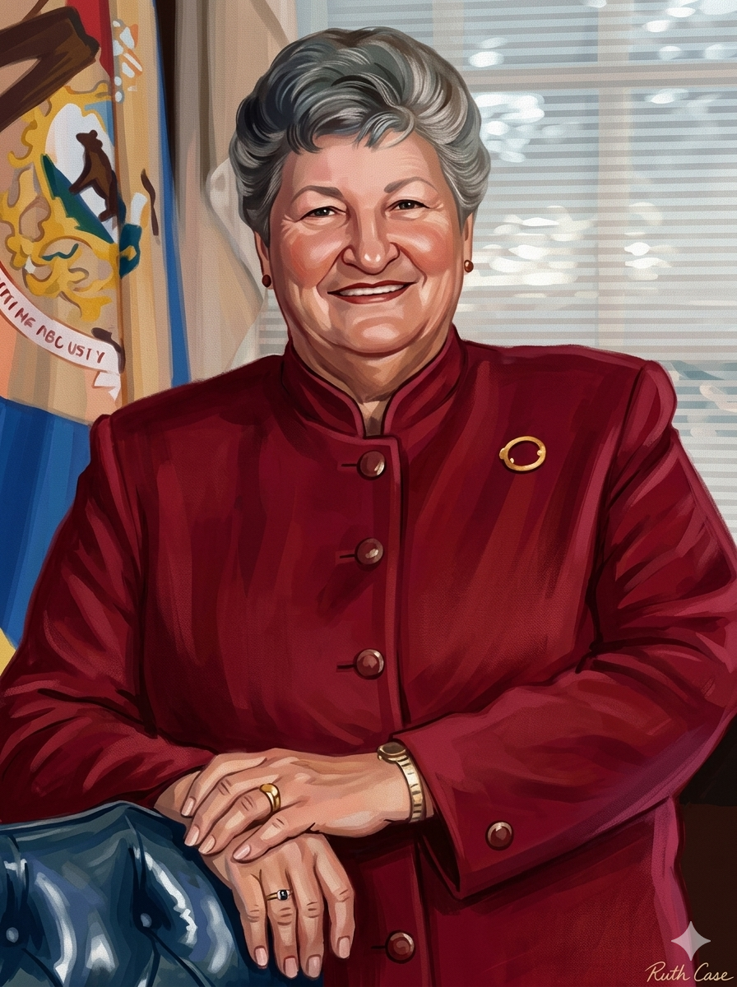
Ruth Ann Minner
1935-2021

Slide 33
“Work hard. Do the right thing. And leave things better than you found them.”
2nd Inaugural Address (January 2005)
Ruth Ann Minner
1935-2021

Slide 34

“That there are complexities and nuances we do not deny, but the State of Delaware has shown us that if we have the will, there is a way.”
-Grubbs and colleagues (2013)
THE MISSION ISN’T DONE

