Slide 1

The future look of public health in delaware
April 20, 2026
Director Steven Blessing

Slide 2
The challenges in public health today
A changing federal landscape has resulted in the need to change the statewide structure
    Policy changes
    Workforce shifts
    Filling the gap
Financial challenges are more present than ever as grants and other federal funding have disappeared
    Evaluating service offerings
    Meeting needs with less money
Notes:
Influenza Wastewater Numbers

Slide 3
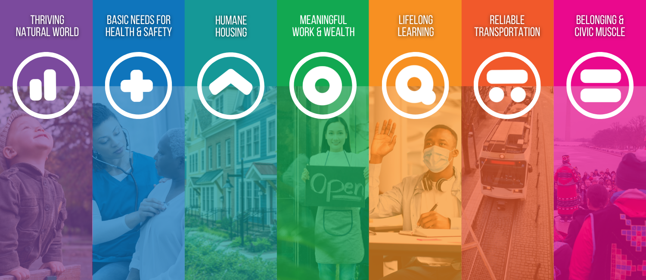
What we’re doing right now
Program integration
    Breaking down silos
    Better internal communication
Acknowledging and understanding the vital conditions
    Recognizing the barriers to health service and health equity
    Bringing those to the table who have a part in all the vital conditions
A holistic approach
    Enhancing collaboration in all sectors – both in public health and outside public health
    Using the breakdown of silos to refer individuals to other services
Notes:
Influenza Wastewater Numbers

Slide 4
The future of public health
The goal will always remain to meet people where they live, work, and play
    We need to adapt as those things change into the future.
        Expand services to new areas
        Bring new programs to fruition
        Cultivate relationships with those we serve
        Recognize changing landscapes and areas of concern
Notes:
Influenza Wastewater Numbers

Slide 5
The role of the cancer consortium
Cancer screening, detection, and treatment are all closely linked to the DPH holistic approach
We are exploring new opportunities for funding and expansion of programs.
Progress requires all of us – our partners, supporters, and friends.
Notes:
Influenza Wastewater Numbers

Slide 6
Thank you for all you do.
Stay healthy and safe!
Notes:
Thank you

