Slide 1

CANCER INCIDENCE AND MORTALITY IN DELAWARE, 2018-2022 ___________________________
Stephanie Belinske, DrPH, MPH
Chronic Disease Epidemiologist
Delaware Cancer Registry, Division of Public Health
April 20, 2026
Notes:
Good morning, everyone. My name is Stephanie Belinske, and I am a Chronic Disease Epidemiologist at the Delaware Division of Public Health.
Thank you for attending this presentation of the latest Delaware cancer incidence and mortality report covering the period 2018 to 2022.

Slide 2
Cancer Incidence and Mortality Updates
All-site incidence and mortality rates cancer rates
Trends on cancer incidence from 2008-2022
Trends on cancer mortality from 2008-2022
Comparative U.S statistics
Four summary site-specific tables (top 23 cancer sites)
By gender (Male, Female)
By race and ethnicity (Non-Hispanic White, Non-Hispanic Black, Hispanic)
Statistically significant differences by gender
Statistically significant differences by race and ethnicity
Notes:
The report focuses on all-site cancer and provides trends on cancer incidence and mortality and comparative U.S statistics. Trends are reported from 2008-2022.
This report also includes site-specific tables on cancer rates and rankings for the top 23 cancer sites and significance testing by gender and race/ethnicity.

Slide 3
Behavioral Risk Factor Survey Updates
Important Updates to Screening and Risk Factor Data
2024 prevalence estimates on screenings for prostate, lung, colorectal and breast
2024 prevalence estimates on tobacco use, obesity, and physical activity
2021 prevalence estimate on dietary fruits and vegetables use
Notes:
Readers will find 2024 Behavior Risk Factor Survey prevalence estimates for cancer screenings, obesity, smoking status, physical activity and nutrition.

Slide 4
Small Area-Level Cancer Incidence Report
Released January 2026
This report presents the 2018-2022 cancer incidence statistics for Delaware by census tract.
Statistics at the zone-level are provided for all-site, female breast, prostate, lung, and colorectal cancers.
Released annually by legislative mandate Title 16, Chapter 20 of the Delaware Code, https://delcode.delaware.gov/title16/c020/index.html
Notes:
In January 2026, we released the Small Area-Level Cancer Incidence Report. That report provides cancer rates at the census-tract level and is published annually by legislative mandate. A link to Title 16, Chapter 20 of the Delaware Code is provided on the slide.
The purpose of this report is to to inform policymakers and program managers on what areas of our state experience a greater burden of cancer compared to others to help in targeted community cancer prevention efforts.
The Small Area-Level Cancer Incidence Report along with all other cancer reports can be accessed at the link I will share at the end of my presentation.

Slide 5
ALL-SITE CANCER INCIDENCE
Notes:
We’re going to start with a summary of all-site cancer incidence in Delaware for the five-year period 2018-2022.

Slide 6
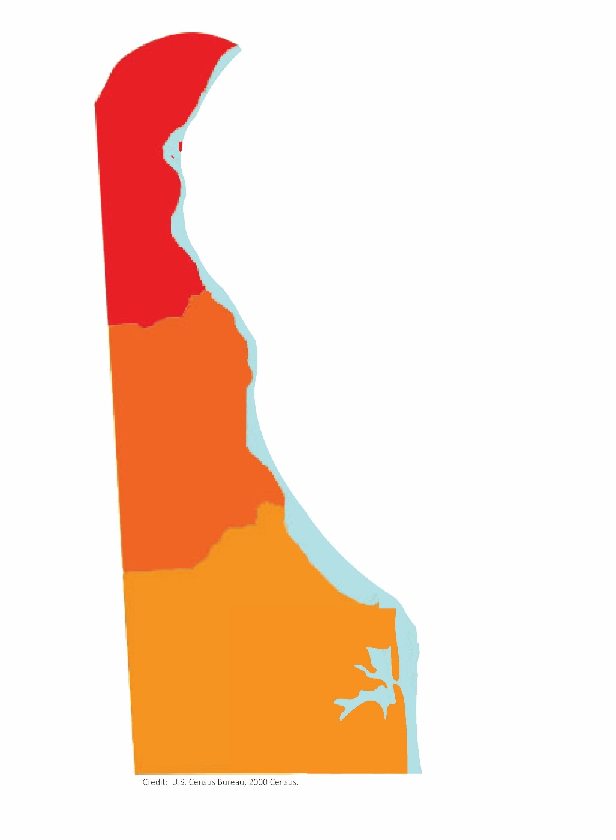
All-site Cancer Incidence, Delaware, 2018-2022
New Castle County 53%
32,090 cancer cases
average of 6,418 per year
By sex
Male – 51%
Female – 49%
By race/ethnicity
Non-Hispanic White – 76%
Non-Hispanic Black– 17%
Hispanic – 3%
Kent County
18%
Sussex County 29%
Source: Division of Public Health. (2026). Cancer Incidence and Morality in Delaware, 2018-2022. Delaware Department of Health and Social Services.
Notes:
In 2018-2022 there were just over 32,000 new cancers diagnosed in Delaware. Here you’ll see a breakdown of cases by sex, race/ethnicity, and county.
51% of cases were diagnosed in males compared to females. 76% of cases were diagnosed in non-Hispanic Whites compared to other racial groups. 53% of cases were in New Castle County compared to other counties.

Slide 7
Age-Adjusted All-Site Cancer Incidence Rate per 100,000 Population by Sex, Delaware vs. U.S., 2018-2022
 | All-Site Cancer Incidence Rate per 100,000 population | National Ranking
 |  | 2018-2022 | 2017-2021
Delaware | 469.9 | 14th | 15th
U.S. | 444.8
Delaware males | 507.1 | 13th | 16th
U.S. males | 484.8
Delaware females | 443.7 | 10th | 16th
U.S. females | 424.8
Source: Division of Public Health. (2026). Cancer Incidence and Morality in Delaware, 2018-2022. Delaware Department of Health and Social Services.
Notes:
For 2018-2022, the age-adjusted cancer incidence rate for Delaware was 469.9 per 100,00 population which is higher than the U.S. For this period Delaware was ranked 14th and for the previous period Delaware was ranked 15th.
Both Delaware males and females had higher cancer incidence rates compared to males and females in the U.S.
For Delaware males, the ranking went from 16th to 13th compared to the previous period. For Delaware females, the ranking went from 16th to 10th compared to the previous period.

Slide 8
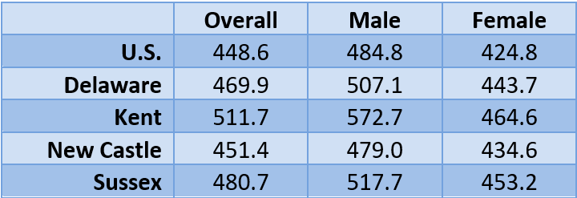
Age-Adjusted All-Site Cancer Incidence Rate per 100,000 Population by Sex, U.S., Delaware, and Counties in Delaware, 2018-2022
Source: Division of Public Health. (2026). Cancer Incidence and Morality in Delaware, 2018-2022. Delaware Department of Health and Social Services.
Notes:
When comparing among counties, Kent County had the highest cancer incidence rate compared to the other two counties. The rate for Kent County was 511.7 per 100,000 population.

Slide 9
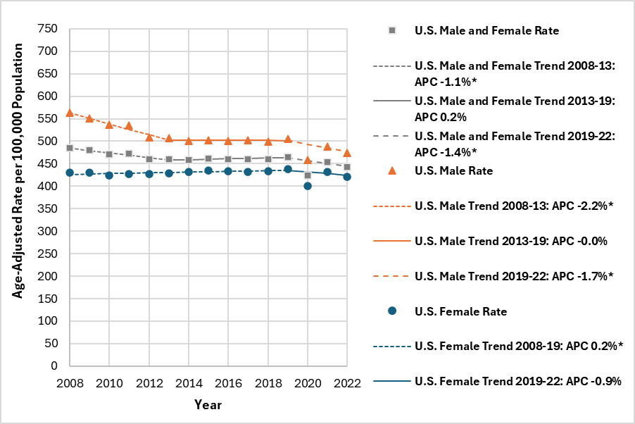
Age-Adjusted All-Site Cancer Incidence Rate Trend by Sex; U.S., 2008-2022
All-site incidence rate decreased an average of 0.7% per year
Source: Division of Public Health. (2026). Cancer Incidence and Morality in Delaware, 2018-2022. Delaware Department of Health and Social Services.
Notes:
This graph depicts the trends in age-adjusted all-site cancer incidence rates in the US and Delaware from 2008-2022 by gender.
Incidence rates for all-site cancer decreased an average of 0.7% per year in the U.S. between 2008 and 2022. There were three distinct trends in the U.S. during this time period:
A 1.1% annual decrease between 2008 and 2013
Stable rates between 2013 and 2019
A 1.4% annual decrease between 2019 and 2022
Incidence rates for all-site cancer decreased an average of 1.2% per year among U.S. males between 2008 and 2022. There were three distinct trends among U.S. males during this time period:
A 2.2% annual decrease between 2008 and 2013
Stable rates between 2013 and 2019
A 1.7% annual decrease between 2019 and 2022
The trend in incidence rates for all-site cancer was stable among U.S. females between 2008 and 2022. There were two distinct trends among U.S. females during this time period:
A 0.2% annual increase between 2008 and 2019
Stable rates between 2019 and 2022

Slide 10
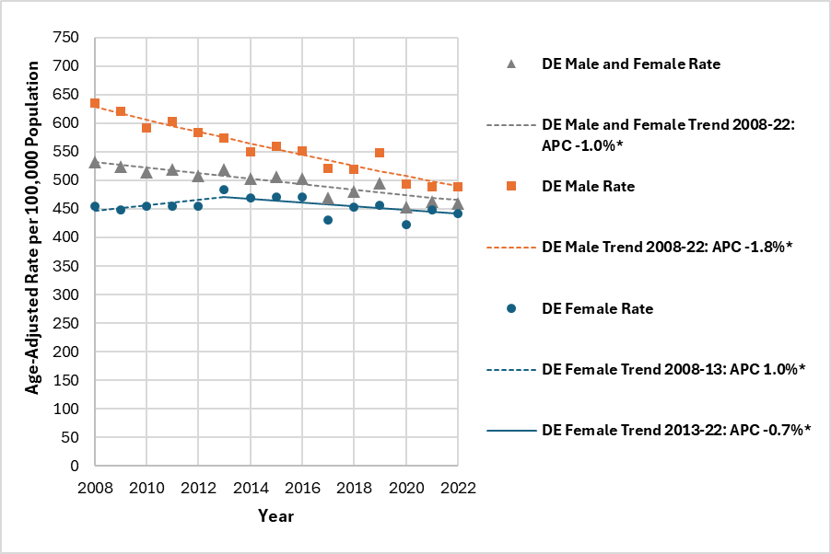
Age-Adjusted All-Site Cancer Incidence Rate Trend by Sex; Delaware, 2008-2022
All-site incidence rate decreased an average of 1.0% per year
Source: Division of Public Health. (2026). Cancer Incidence and Morality in Delaware, 2018-2022. Delaware Department of Health and Social Services.
Notes:
Incidence rates for all-site cancer decreased an average of 1.0% per year in Delaware between 2008 and 2022 and the trend was consistent over this time period.
Incidence rates for all-site cancer decreased an average of 1.8% per year among Delaware males between 2008 and 2022 and the trend was consistent over this time period.
Incidence rates for all-site cancer increased an average of 1.0% per year among Delaware females between 2008 and 2022. There were two distinct trends among Delaware females during this time period:
A 1.0% annual increase between 2008 and 2013
A 0.7% annual decrease between 2013 and 2022

Slide 11
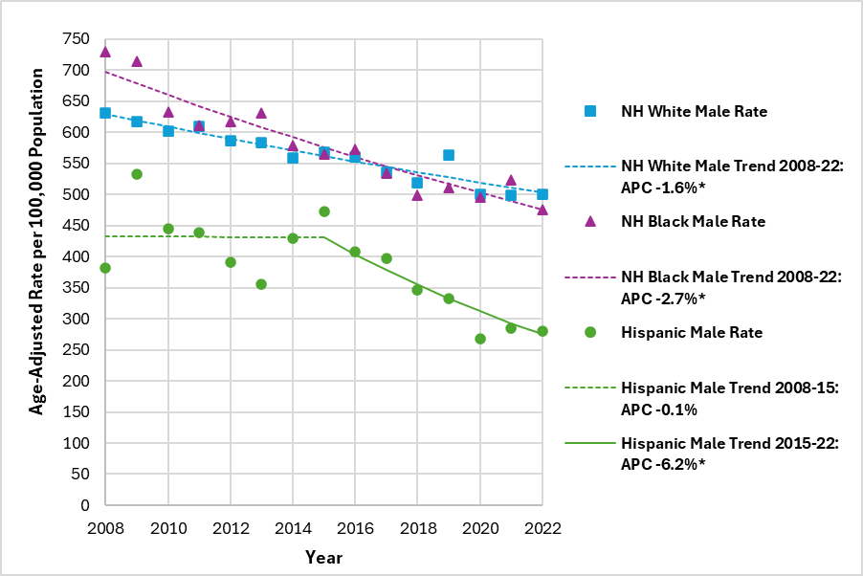
Age-Adjusted All-Site Cancer Incidence Rate Trend for Males by Race/Ethnicity; Delaware, 2008-2022
↑ Increase ↓ Decrease → Stable
Non-Hispanic White incidence rate ↓
Non-Hispanic Black incidence rate ↓
Hispanic incidence rate ↓
Source: Division of Public Health. (2026). Cancer Incidence and Morality in Delaware, 2018-2022. Delaware Department of Health and Social Services.
Notes:
This graph depicts the trends in age-adjusted all-site cancer incidence rates in Delaware from 2008-2022 for males by race and ethnicity.
Incidence rates for all-site cancer decreased an average of 1.6% per year among non-Hispanic White males in Delaware between 2008 and 2022 and the trend was consistent over this time period.
Incidence rates for all-site cancer decreased an average of 2.7% per year among non-Hispanic Black males in Delaware between 2008 and 2022 and the trend was consistent over this time period.
Incidence rates for all-site cancer decreased an average of 3.2% per year among Hispanic males in Delaware between 2008 and 2022. There were two distinct trends among Hispanic males during this time period:
Stable rates between 2008 and 2015
A 6.2% annual decrease between 2015 and 2022

Slide 12
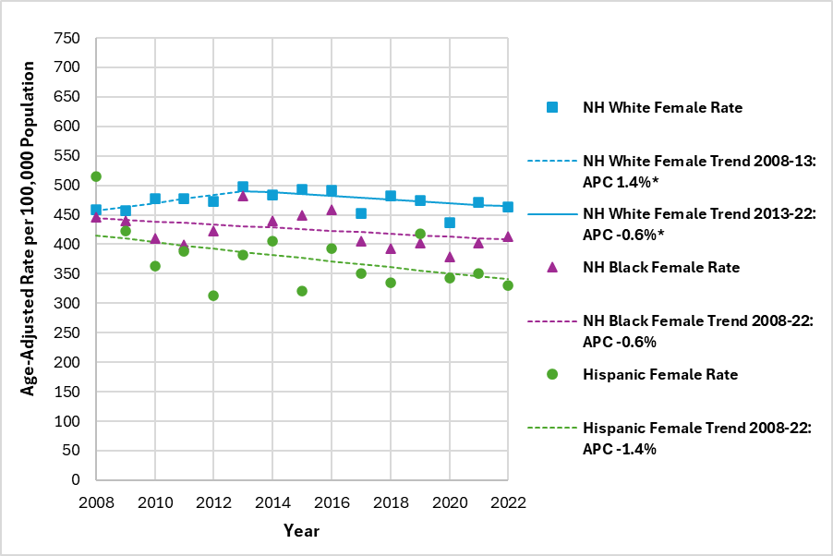
Age-Adjusted All-Site Cancer Incidence Rate Trend for Females and Race/Ethnicity; Delaware, 2008-2022
Females
Non-Hispanic White incidence rate →
Non-Hispanic Black incidence rate →
Hispanic incidence rate →
↑ Increase ↓ Decrease → Stable
Source: Division of Public Health. (2026). Cancer Incidence and Morality in Delaware, 2018-2022. Delaware Department of Health and Social Services.
Notes:
This graph depicts the trends in age-adjusted all-site cancer incidence rates in Delaware from 2008-2022 by gender and race and ethnicity.
The trend in incidence rates for all-site cancer was stable among non-Hispanic White females in Delaware between 2008 and 2022. There were two distinct trends among non-Hispanic White females in Delaware during this time period:
A 1.4% annual increase between 2008 and 2013
A 0.6% annual decrease between 2013 and 2022
The trend in incidence rates for all-site cancer was stable among both non-Hispanic Black and Hispanic females in Delaware between 2008 and 2022.

Slide 13
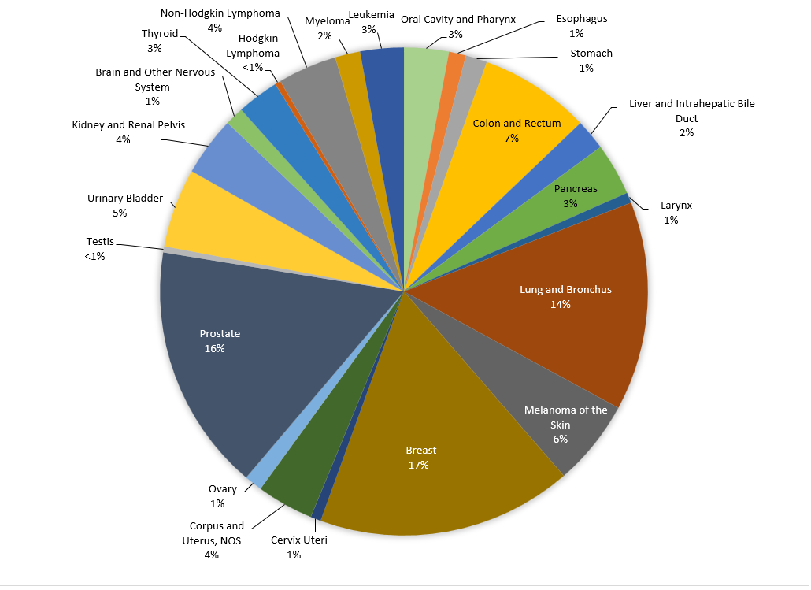
Percent Distribution of Cancer Cases by Cancer Site, Delaware, 2018-2022
Source: Division of Public Health. (2026). Cancer Incidence and Morality in Delaware, 2018-2022. Delaware Department of Health and Social Services.
Notes:
This slide shows the percent distribution of cancer cases by cancer site.
The cancers with the highest percent of cases diagnosed from 2018-2022 were female breast, lung and bronchus, prostate, and colorectal cancers.
Female breast cancer accounted for 17% of all new cancer cases in Delaware.
Prostate cancer accounted for 16% of all new cancer cases in Delaware.
Lung and bronchus cancer accounted for 14% of all new cancer cases in Delaware.
Colorectal cancer accounted for 7% of all new cancer cases in Delaware.

Slide 14
NOTABLE SITE-SPECIFIC CANCER DETAILS
Notes:
Now we will discuss some site-specific cancer incidence details in Delaware for the five-year period 2018-2022.

Slide 15
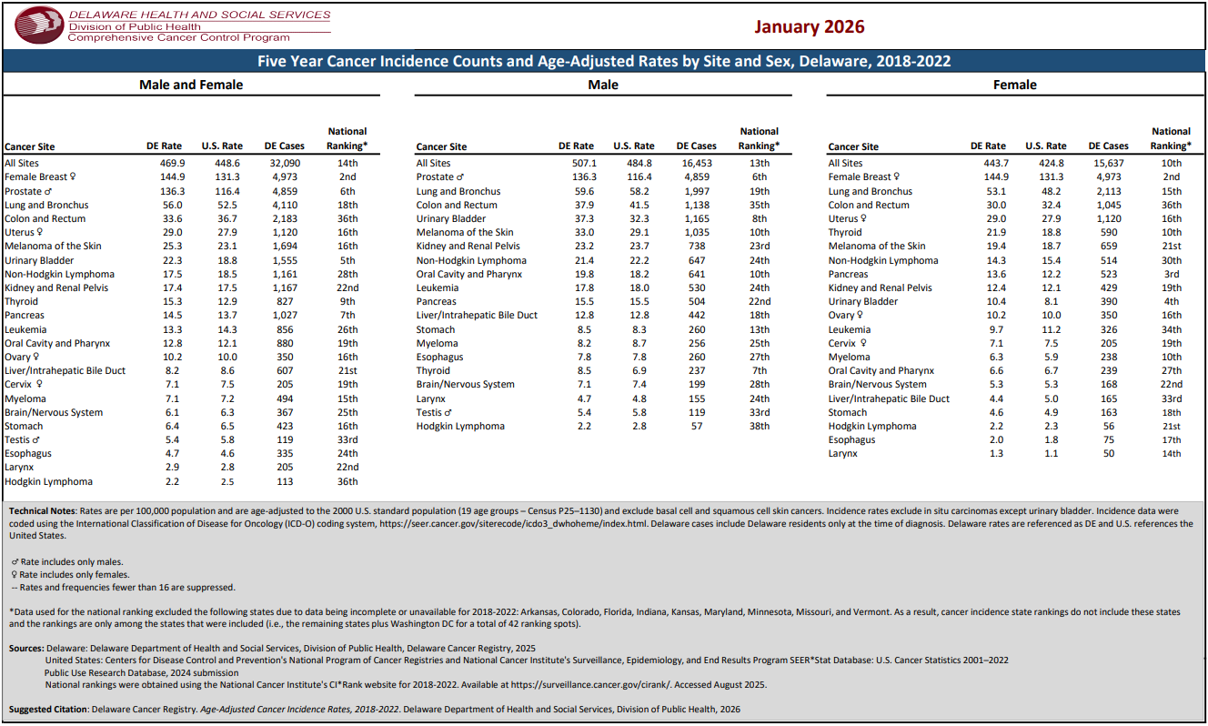
Age-Adjusted Site-specific Incidence Rates by Sex, U.S. and Delaware, 2018-2022
Notes:
This tables displays age-adjusted incidence rates for the top 23 cancer sites by gender.
The most common cancer among women is breast cancer, prostate cancer is most common among men. With men and women combined, lung cancer is the most common.
From 2018-2022, Delaware had a higher cancer incidence rate for all-site, female breast, prostate, uterine, lung and melanoma cancers compared to the U.S. Delaware had a lower cancer incidence for colorectal cancer compared to the U.S.

Slide 16
Age-Adjusted Site-specific Incidence Rates by Sex, U.S. and Delaware, 2018-2022
Site |  | DE | U.S. | Ranking
All-Site |  | 469.9 | 448.6 | 14th
 | Males | 507.1 | 484.8 | 13th
 | Females | 443.7 | 424.8 | 10th
Lung and Bronchus |  | 56.0 | 52.5 | 18th
 | Males | 59.6 | 58.2 | 19th
 | Females | 53.1 | 48.2 | 15th
Colon and Rectal |  | 33.6 | 36.7 | 36th
 | Males | 37.9 | 41.5 | 35th
 | Females | 30.0 | 32.4 | 36th
Source: Division of Public Health. (2026). Cancer Incidence and Morality in Delaware, 2018-2022. Delaware Department of Health and Social Services.
Notes:
This tables displays age-adjusted incidence rates for the top 23 cancer sites by gender.
The most common cancer among women is breast cancer, prostate cancer is most common among men. With men and women combined, lung cancer is the most common.
From 2018-2022, Delaware had a higher cancer incidence rate for all-site, female breast, prostate, uterine, lung and melanoma cancers compared to the U.S. Delaware had a lower cancer incidence for colorectal cancer compared to the U.S.

Slide 17
Age-Adjusted Site-specific Incidence Rates by Sex, U.S. and Delaware, 2018-2022
Site |  | DE | U.S. | Ranking
Prostate
 | Males | 136.3 | 116.4 | 6th
Female Breast
 | Females | 144.9 | 131.3 | 2nd
Source: Division of Public Health. (2026). Cancer Incidence and Morality in Delaware, 2018-2022. Delaware Department of Health and Social Services.
Notes:
This tables displays age-adjusted incidence rates for the top 23 cancer sites by gender.
The most common cancer among women is breast cancer, prostate cancer is most common among men. With men and women combined, lung cancer is the most common.
From 2018-2022, Delaware had a higher cancer incidence rate for all-site, female breast, prostate, uterine, lung and melanoma cancers compared to the U.S. Delaware had a lower cancer incidence for colorectal cancer compared to the U.S.

Slide 18
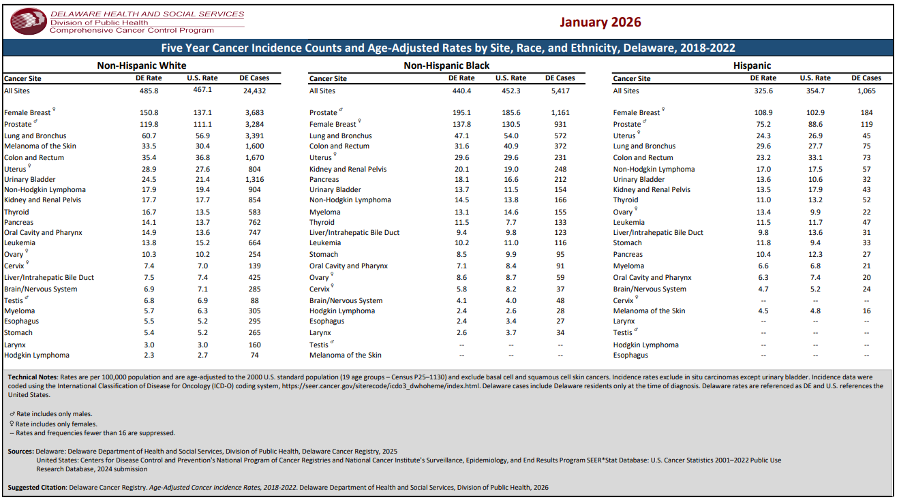
Age-adjusted Site-Specific Incidence Rates by Race/Ethnicity, Delaware, 2018-2022
Notes:
When stratifying incidence rates by race:
Non-Hispanic Black Delaware men have a higher prostate cancer incidence rate of 195.1 per 100,000 compared to other racial groups and higher than the U.S rate of 185.6 per 100,000
Non-Hispanic White Delaware women have a higher female breast cancer incidence rate of 150.8 per 100,000 compared to other racial groups and higher than the U.S rate of 137.1 per 100,000
Non-Hispanic White Delawareans have a higher lung cancer incidence rate of 60.7 per 100,000 compared to other racial groups and higher than the U.S rate of 56.9 per 100,000

Slide 19
Age-Adjusted Site-specific Incidence Rates by Race/Ethnicity, U.S. and Delaware, 2018-2022
Site |  | DE | U.S.
All-Site |  | 469.9 | 448.6
 | Non-Hispanic White | 485.8 | 467.1
 | Non-Hispanic Black | 440.4 | 452.3
 | Hispanic | 325.6 | 354.7
Lung and Bronchus |  | 56.0 | 52.5
 | Non-Hispanic White | 60.7 | 56.9
 | Non-Hispanic Black | 47.1 | 54.0
 | Hispanic | 29.6 | 27.7
Source: Division of Public Health. (2026). Cancer Incidence and Morality in Delaware, 2018-2022. Delaware Department of Health and Social Services.
Notes:
This tables displays age-adjusted incidence rates for the top 23 cancer sites by gender.
The most common cancer among women is breast cancer, prostate cancer is most common among men. With men and women combined, lung cancer is the most common.
From 2018-2022, Delaware had a higher cancer incidence rate for all-site, female breast, prostate, uterine, lung and melanoma cancers compared to the U.S. Delaware had a lower cancer incidence for colorectal cancer compared to the U.S.

Slide 20
Age-Adjusted Site-specific Incidence Rates by Race/Ethnicity, U.S. and Delaware, 2018-2022
Site |  | DE | U.S.
Colon and Rectum |  | 33.6 | 36.7
 | Non-Hispanic White | 35.4 | 36.8
 | Non-Hispanic Black | 31.6 | 40.9
 | Hispanic | 23.2 | 33.1
Male Prostate |  | 136.3 | 116.4
 | Non-Hispanic White | 119.8 | 111.1
 | Non-Hispanic Black | 195.1 | 185.6
 | Hispanic | 75.2 | 88.6
Source: Division of Public Health. (2026). Cancer Incidence and Morality in Delaware, 2018-2022. Delaware Department of Health and Social Services.
Notes:
This tables displays age-adjusted incidence rates for the top 23 cancer sites by gender.
The most common cancer among women is breast cancer, prostate cancer is most common among men. With men and women combined, lung cancer is the most common.
From 2018-2022, Delaware had a higher cancer incidence rate for all-site, female breast, prostate, uterine, lung and melanoma cancers compared to the U.S. Delaware had a lower cancer incidence for colorectal cancer compared to the U.S.

Slide 21
Age-Adjusted Site-specific Incidence Rates by Race/Ethnicity, U.S. and Delaware, 2018-2022
Site |  | DE | U.S.
Female Breast |  | 144.9 | 131.3
 | Non-Hispanic White | 150.8 | 137.1
 | Non-Hispanic Black | 137.8 | 130.5
 | Hispanic | 108.9 | 102.9
Source: Division of Public Health. (2026). Cancer Incidence and Morality in Delaware, 2018-2022. Delaware Department of Health and Social Services.
Notes:
This tables displays age-adjusted incidence rates for the top 23 cancer sites by gender.
The most common cancer among women is breast cancer, prostate cancer is most common among men. With men and women combined, lung cancer is the most common.
From 2018-2022, Delaware had a higher cancer incidence rate for all-site, female breast, prostate, uterine, lung and melanoma cancers compared to the U.S. Delaware had a lower cancer incidence for colorectal cancer compared to the U.S.

Slide 22
Cancer Sites with Statistically Significant Differences by Sex, Delaware, 2018-2022
Incidence Rate Statistically Significantly Different From Male
 | Female
All-Site | Lower
Oral Cavity and Pharynx | Lower
Esophagus | Lower
Stomach | Lower
Colon and Rectum | Lower
Liver and Intrahepatic Bile Duct | Lower
Larynx | Lower
Lung and Bronchus | Lower
Melanoma of the Skin | Lower
Urinary Bladder | Lower
Kidney and Renal Pelvis | Lower
Brain and Other Nervous System | Lower
Thyroid | Higher
Non-Hodgkin Lymphoma | Lower
Myeloma | Lower
Leukemia | Lower
Source: Division of Public Health. (2026). Cancer Incidence and Morality in Delaware, 2018-2022. Delaware Department of Health and Social Services.
Notes:
To test for statistical significance, rate ratios were calculated at 95% confidence. In the displayed table, male was used as the reference group.
In 2018-2022. when comparing males to females, females had a statistically higher rate for thyroid cancer compared to men. For most other cancer cancers, females had a statistically lower cancer rate compared to males.

Slide 23
Cancer Sites with Statistically Significant Differences by Race/Ethnicity, Delaware, 2018-2022
Incidence Rate Statistically Significantly Different From Non-Hispanic White | Only included cancer sites with higher rates
 | Non-Hispanic Black | Hispanic
Stomach | Higher | Higher
Liver and Intrahepatic Bile Duct | Higher | *
Pancreas | Higher | *
Myeloma | Higher | *
Prostate | Higher | *
*no statistically significant difference
Non-Hispanic White is the reference group
Source: Division of Public Health. (2026). Cancer Incidence and Morality in Delaware, 2018-2022. Delaware Department of Health and Social Services.
Notes:
From 2018-2022, there were significant differences in incidence rates among specific cancers when compared by race and ethnicity. In the displayed table, Non-Hispanic White was used as the reference group.
Non-Hispanic Black Delawareans had a statistically higher cancer incidence rate for stomach, prostate, liver, myeloma and pancreatic cancers compared to Non-Hispanic White Delawareans.
Hispanic Delawareans had a statistically higher cancer incidence rate for stomach compared to Non-Hispanic White Delawareans.

Slide 24
ALL-SITE CANCER MORTALITY
Notes:
Now we will move onto a summary of all-site cancer mortality in Delaware for the five-year period 2018-2022

Slide 25
All-site Cancer Mortality, Delaware, 2018-2022
New Castle County, 51%
10,667 deaths from cancer
average of 2,133 per year
By sex
Male – 53%
Female – 47%
By race/ethnicity
Non-Hispanic White – 78%
Non-Hispanic Black – 18%
Hispanic – 2%
Kent County, 18%
Sussex County, 31%
Source: Division of Public Health. (2026). Cancer Incidence and Morality in Delaware, 2018-2022. Delaware Department of Health and Social Services.
Notes:
In 2018-2022, there were a little over 10,600 deaths from cancer in Delaware.
53% of cancer deaths were in males compared to females. 78% of cancer deaths were in non-Hispanic White Delawareans compared to other racial groups. 51% of cancer deaths were diagnosed in New Castle County compared to the other counties.

Slide 26
Age-Adjusted All-Site Cancer Mortality Rate per 100,000 Population by Sex, Delaware vs. U.S., 2018-2022
 | All-Site Cancer Mortality Rate per 100,000 population | National Ranking
 |  | 2018-2022 | 2017-2021
Delaware | 155.6 | 15th | 16th
U.S. | 147.6
Delaware males | 183.6 | 16th | 16th
U.S. males | 174.6
Delaware females | 134.7 | 14th | 22nd
U.S. females | 128.0
Source: Division of Public Health. (2026). Cancer Incidence and Morality in Delaware, 2018-2022. Delaware Department of Health and Social Services.
Notes:
For 2018-2022, the age-adjusted cancer mortality rate for Delaware was 155.6 per 100,00 population which is higher than the U.S. For this period Delaware was ranked 15th and for the previous period Delaware was ranked 16th.
Both Delaware males and females had higher cancer mortality rates compared to males and females in the U.S.
For Delaware males, the ranking remained at 16th when compared to the previous period. For Delaware females, the ranking went from 22nd to 14th compared to the previous 2017-2021 period.

Slide 27
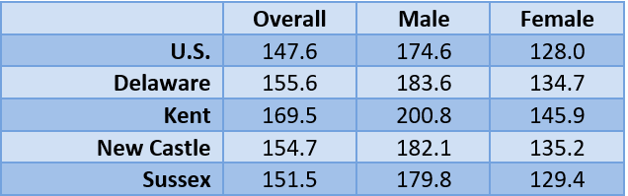
Age-Adjusted All-Site Cancer Mortality Rate per 100,000 Population by Sex, U.S., Delaware, and County in Delaware, 2018-2022
Source: Division of Public Health. (2026). Cancer Incidence and Morality in Delaware, 2018-2022. Delaware Department of Health and Social Services.
Notes:
When comparing among counties, Kent County had the highest cancer mortality rate compared to the other two counties. The rate for Kent County was 169.5 per 100,000 population.

Slide 28
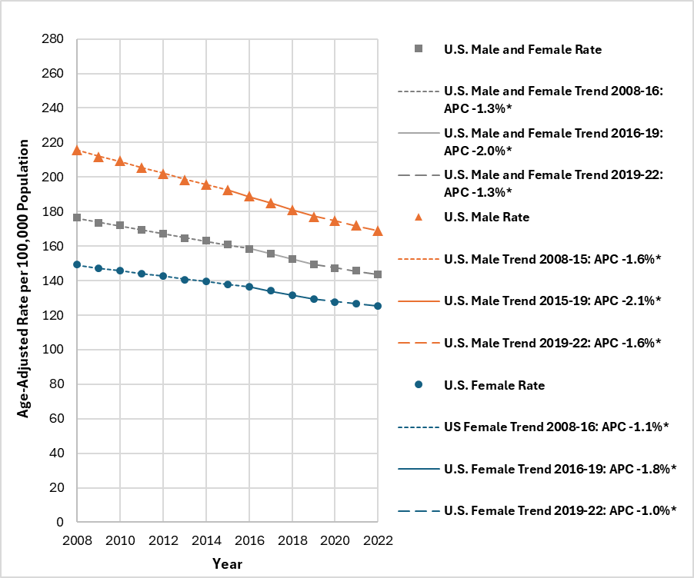
Age-Adjusted All-Site Cancer Mortality Rate Trend by Sex; U.S., 2008-2022
All-site mortality rate decreased an average of 1.5% per year
Source: Division of Public Health. (2026). Cancer Incidence and Morality in Delaware, 2018-2022. Delaware Department of Health and Social Services.
Notes:
This graph depicts the trends in age-adjusted all-site cancer mortality rates in the US and Delaware from 2008-2022 by gender.
Mortality rates for all-site cancer decreased an average of 1.5% per year in the U.S. between 2008 and 2022. There were three distinct trends in the U.S. during this time period, where there was an annual decrease of:
1.3% between 2008 and 2016
2.0% between 2016 and 2019
1.3% between 2019 and 2022
Mortality rates for all-site cancer decreased an average of 1.7% per year among U.S. males between 2008 and 2022. There were three distinct trends among U.S. males during this time period, where there was an annual decrease of:
1.6% between 2008 and 2015
2.1% between 2015 and 2019
1.6% between 2019 and 2022
Mortality rates for all-site cancer decreased an average of 1.2% per year among U.S. females between 2008 and 2022. There were three distinct trends among U.S. females during this time period, where there was an annual decrease of:
1.1% between 2008 and 2016
1.8% between 2016 and 2019
1.0% between 2019 and 2022

Slide 29
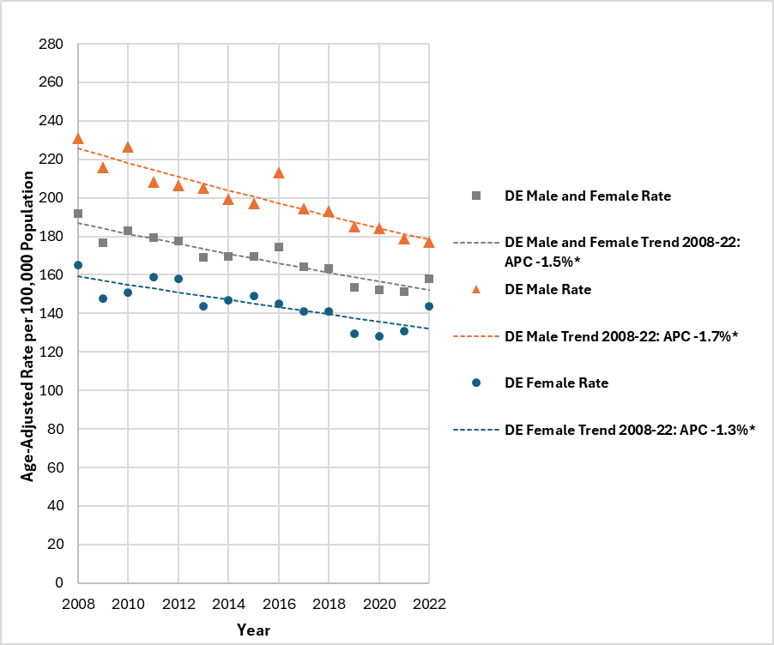
Age-Adjusted All-Site Cancer Mortality Rate Trend by Sex; U.S. and Delaware, 2008-2022
All-site mortality rate decreased an average of 1.5% per year
Source: Division of Public Health. (2026). Cancer Incidence and Morality in Delaware, 2018-2022. Delaware Department of Health and Social Services.
Notes:
This graph depicts the trends in age-adjusted all-site cancer mortality rates in the US and Delaware from 2008-2022 by gender.
Mortality rates for all-site cancer decreased an average of 1.5% per year in Delaware between 2008 and 2022 and the trend was consistent over this time period.
Mortality rates for all-site cancer decreased an average of 1.7% per year among Delaware males between 2008 and 2022 and the trend was consistent over this time period.
Mortality rates for all-site cancer decreased an average of 1.3% per year among Delaware females between 2008 and 2022 and the trend was consistent over this time period.

Slide 30
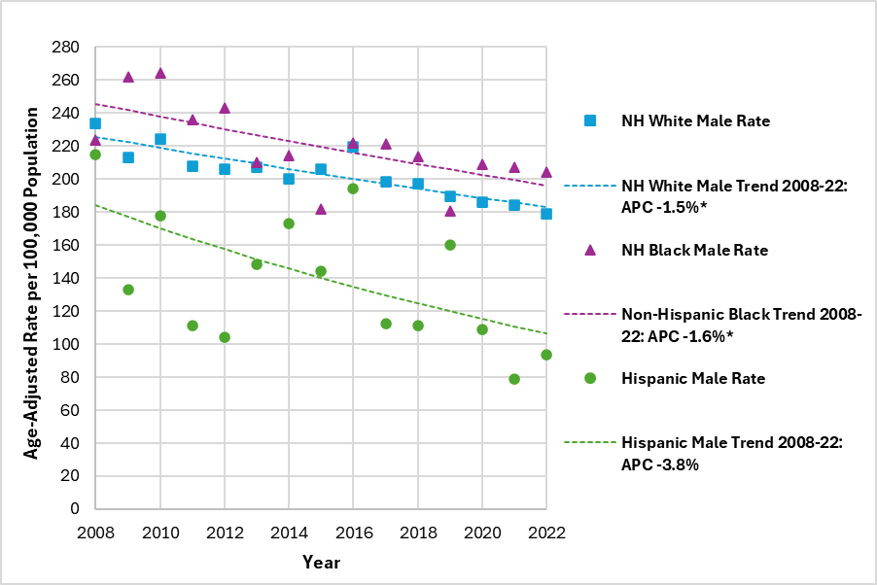
Age-Adjusted All-Site Cancer Mortality Rate Trend by Sex and Race/Ethnicity; Delaware, 2008-2022
Males
Non-Hispanic White incidence rate ↓
Non-Hispanic Black incidence rate ↓
Hispanic incidence rate →
↑ Increase ↓ Decrease → Stable
Source: Division of Public Health. (2026). Cancer Incidence and Morality in Delaware, 2018-2022. Delaware Department of Health and Social Services.
Notes:
This graph depicts the trends in age-adjusted all-site cancer mortality rates in Delaware from 2008-2022 by gender and race and ethnicity.
Mortality rates for all-site cancer decreased an average of 1.5% per year among non-Hispanic White males in Delaware between 2008 and 2022 and the trend was consistent over this time period.
Mortality rates for all-site cancer decreased an average of 1.6% per year among non-Hispanic Black males in Delaware between 2008 and 2022 and the trend was consistent over this time period.
The trend in mortality rates for all-site cancer was stable among Hispanic males in Delaware between 2008 and 2022.

Slide 31
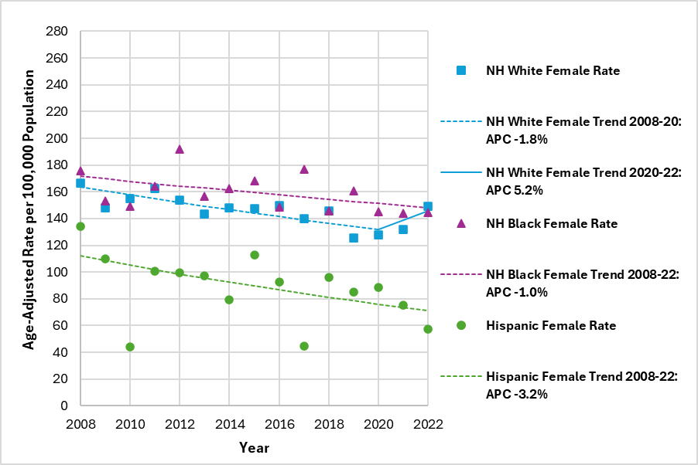
Age-Adjusted All-Site Cancer Mortality Rate Trend by Sex and Race/Ethnicity; Delaware, 2008-2022
Females
Non-Hispanic White incidence rate →
Non-Hispanic Black incidence rate →
Hispanic incidence rate →
↑ Increase ↓ Decrease → Stable
Source: Division of Public Health. (2026). Cancer Incidence and Morality in Delaware, 2018-2022. Delaware Department of Health and Social Services.
Notes:
This graph depicts the trends in age-adjusted all-site cancer mortality rates in Delaware from 2008-2022 by gender and race and ethnicity.
The trend in mortality rates for all-site cancer was stable among Delaware females between 2008 and 2022. There were two distinct trends among Delaware females during this time period, but neither were significant.
The trend in mortality rates for all-site cancer was stable among both non-Hispanic Black and Hispanic females in Delaware between 2008 and 2022.

Slide 32
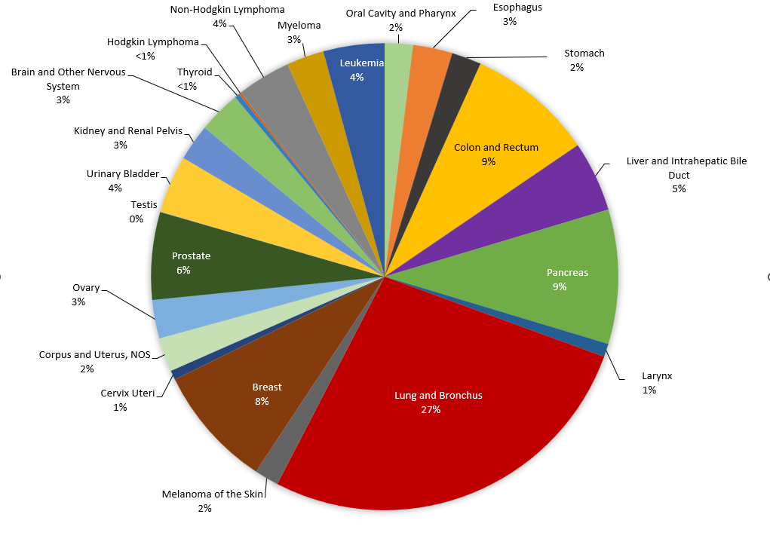
Percent Distribution of Cancer Deaths by Cancer Site, Delaware, 2018-2022
Source: Division of Public Health. (2026). Cancer Incidence and Morality in Delaware, 2018-2022. Delaware Department of Health and Social Services.
Notes:
This slide shows the percent distribution of cancer deaths by cancer site.
Lung and bronchus accounted for largest percentage of new cancer deaths at 27%.
Colorectal cancer accounted for 9% of all new cancer deaths
Pancreatic cancer also accounted for 9% of all new cancer deaths.
Female breast cancer accounted for 8% of all new cancer deaths.
Prostate cancer accounted for 6% of all new cancer deaths.

Slide 33
NOTABLE SITE-SPECIFIC CANCER DETAILS
Notes:
Now we will discuss some site-specific cancer mortality details in Delaware for the five-year period 2018-2022.

Slide 34
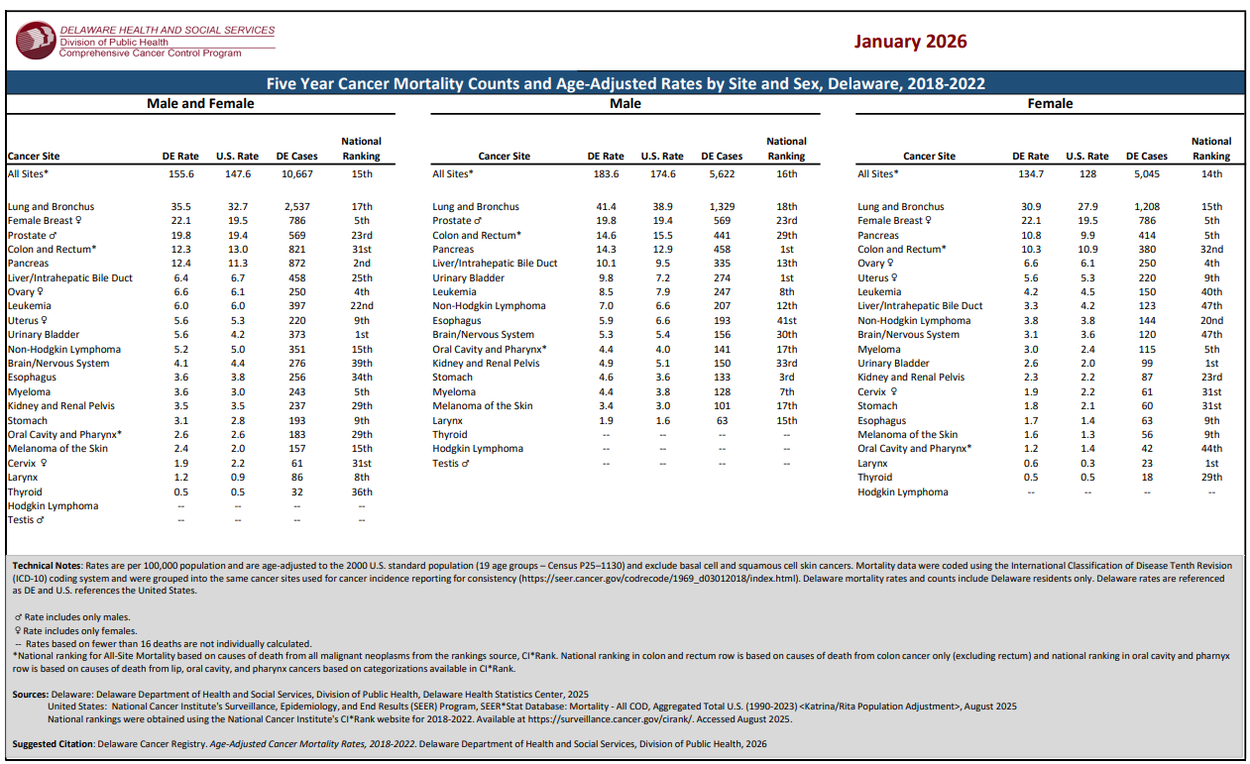
Age-adjusted Site-specific Mortality Rates by Sex, U.S. and Delaware, 2018-2022
Notes:
This table displays age-adjusted mortality rates for the top 23 cancer sites by gender.
Lung cancer is the leading cause of cancer death among both males and females.
From 2018-2022, Delaware had a higher cancer mortality rate for all-site, female breast prostate, and lung cancers compared to the U.S.
From 2018-2022, Delaware had a lower cancer incidence for colorectal and cervical cancers compared to the U.S.

Slide 35
Age-Adjusted Site-specific Mortality Rates by Sex, U.S. and Delaware, 2018-2022
Site |  | DE | U.S. | Ranking
All-Site |  | 155.6 | 147.6 | 15th
 | Males | 183.6 | 174.6 | 16th
 | Females | 134.7 | 128.0 | 14th
Lung and Bronchus |  | 35.5 | 32.7 | 17th
 | Males | 41.4 | 38.9 | 18th
 | Females | 30.9 | 27.9 | 15th
Colon and Rectal |  | 12.3 | 11.3 | 31st
 | Males | 14.6 | 15.5 | 29th
 | Females | 10.3 | 10.9 | 32nd
Source: Division of Public Health. (2026). Cancer Incidence and Morality in Delaware, 2018-2022. Delaware Department of Health and Social Services.
Notes:
This tables displays age-adjusted incidence rates for the top 23 cancer sites by gender.
The most common cancer among women is breast cancer, prostate cancer is most common among men. With men and women combined, lung cancer is the most common.
From 2018-2022, Delaware had a higher cancer incidence rate for all-site, female breast, prostate, uterine, lung and melanoma cancers compared to the U.S. Delaware had a lower cancer incidence for colorectal cancer compared to the U.S.

Slide 36
Age-Adjusted Site-specific Mortality Rates by Sex, U.S. and Delaware, 2018-2022
Site |  | DE | U.S. | Ranking
Prostate
 | Males | 19.8 | 19.4 | 23rd
Female Breast
 | Females | 22.1 | 19.5 | 5th
Source: Division of Public Health. (2026). Cancer Incidence and Morality in Delaware, 2018-2022. Delaware Department of Health and Social Services.
Notes:
This tables displays age-adjusted incidence rates for the top 23 cancer sites by gender.
The most common cancer among women is breast cancer, prostate cancer is most common among men. With men and women combined, lung cancer is the most common.
From 2018-2022, Delaware had a higher cancer incidence rate for all-site, female breast, prostate, uterine, lung and melanoma cancers compared to the U.S. Delaware had a lower cancer incidence for colorectal cancer compared to the U.S.

Slide 37
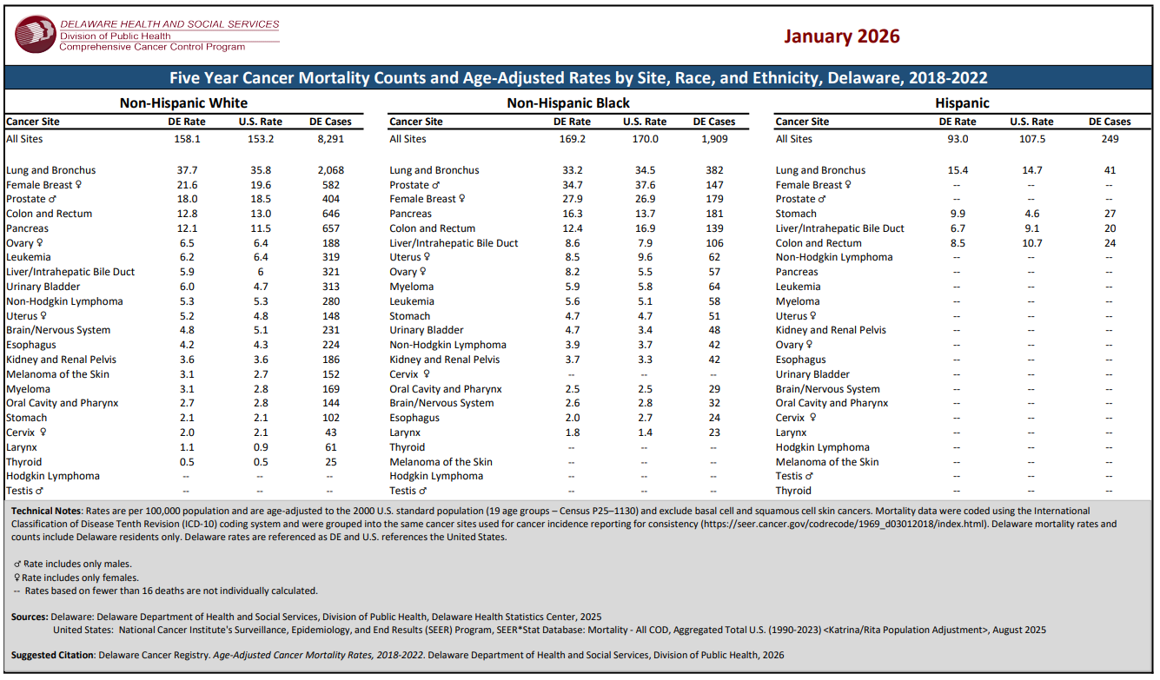
Site-specific Age-adjusted Mortality Rates by Race/Ethnicity, U.S. and Delaware, 2018-2022
Notes:
When stratifying mortality rates by race for the 2018-2022 period:
Non-Hispanic Black Delaware men had a higher prostate cancer mortality rate of 34.7 per 100,000 compared to other racial groups.
Non-Hispanic Black Delaware women had a higher female breast cancer mortality rate of 27.9 per 100,000 compared to other racial groups, which is slightly higher than the U.S. rate of 26.9 per 100,000.
Non-Hispanic White Delawareans had a higher lung cancer mortality rate of 37.7 per 100,000 compared to other racial groups, which is higher than the U.S rate of 35.8 per 100,000.

Slide 38
Age-Adjusted Site-specific Mortality Rates by Race/Ethnicity, U.S. and Delaware, 2018-2022
Site |  | DE | U.S.
All-Site |  | 155.6 | 147.6
 | Non-Hispanic White | 158.1 | 153.2
 | Non-Hispanic Black | 169.2 | 170.0
 | Hispanic | 93.0 | 107.5
Lung and Bronchus |  | 35.5 | 32.7
 | Non-Hispanic White | 37.7 | 35.8
 | Non-Hispanic Black | 33.2 | 34.5
 | Hispanic | 15.4 | 14.7
Source: Division of Public Health. (2026). Cancer Incidence and Morality in Delaware, 2018-2022. Delaware Department of Health and Social Services.
Notes:
This tables displays age-adjusted incidence rates for the top 23 cancer sites by gender.
The most common cancer among women is breast cancer, prostate cancer is most common among men. With men and women combined, lung cancer is the most common.
From 2018-2022, Delaware had a higher cancer incidence rate for all-site, female breast, prostate, uterine, lung and melanoma cancers compared to the U.S. Delaware had a lower cancer incidence for colorectal cancer compared to the U.S.

Slide 39
Age-Adjusted Site-specific Mortality Rates by Race/Ethnicity, U.S. and Delaware, 2018-2022
Site |  | DE | U.S.
Colon and Rectum |  | 12.3 | 11.3
 | Non-Hispanic White | 12.8 | 13.0
 | Non-Hispanic Black | 12.4 | 16.9
 | Hispanic | 8.5 | 10.7
Male Prostate |  | 19.8 | 19.4
 | Non-Hispanic White | 18.0 | 18.5
 | Non-Hispanic Black | 34.7 | 37.6
 | Hispanic | -- | --
Source: Division of Public Health. (2026). Cancer Incidence and Morality in Delaware, 2018-2022. Delaware Department of Health and Social Services.
Notes:
This tables displays age-adjusted incidence rates for the top 23 cancer sites by gender.
The most common cancer among women is breast cancer, prostate cancer is most common among men. With men and women combined, lung cancer is the most common.
From 2018-2022, Delaware had a higher cancer incidence rate for all-site, female breast, prostate, uterine, lung and melanoma cancers compared to the U.S. Delaware had a lower cancer incidence for colorectal cancer compared to the U.S.

Slide 40
Age-Adjusted Site-specific Mortality Rates by Race/Ethnicity, U.S. and Delaware, 2018-2022
Site |  | DE | U.S.
Female Breast |  | 22.1 | 19.5
 | Non-Hispanic White | 21.6 | 19.6
 | Non-Hispanic Black | 27.9 | 26.9
 | Hispanic | -- | --
Source: Division of Public Health. (2026). Cancer Incidence and Morality in Delaware, 2018-2022. Delaware Department of Health and Social Services.
Notes:
This tables displays age-adjusted incidence rates for the top 23 cancer sites by gender.
The most common cancer among women is breast cancer, prostate cancer is most common among men. With men and women combined, lung cancer is the most common.
From 2018-2022, Delaware had a higher cancer incidence rate for all-site, female breast, prostate, uterine, lung and melanoma cancers compared to the U.S. Delaware had a lower cancer incidence for colorectal cancer compared to the U.S.

Slide 41
Cancers Sites with Statistically Significant Differences by Sex, Delaware, 2018-2022
Mortality Rate Statistically Significantly Different From Male
 | Female
All-site | Lower
Oral Cavity and Pharynx | Lower
Esophagus | Lower
Stomach | Lower
Colon and Rectum | Lower
Liver and Intrahepatic Bile Duct | Lower
Pancreas | Lower
Larynx | Lower
Lung and Bronchus | Lower
Melanoma of the Skin | Lower
Urinary Bladder | Lower
Kidney and Renal Pelvis | Lower
Brain and Other Nervous System | Lower
Non-Hodgkin Lymphoma | Lower
Myeloma | Lower
Leukemia | Lower
No sites had a statistically significantly higher rate for female compared to male
Source: Division of Public Health. (2026). Cancer Incidence and Morality in Delaware, 2018-2022. Delaware Department of Health and Social Services.
Notes:
Like the incidence tables, to test for statistical significance, rate ratios were modeled at 95% confidence. In the displayed table, male was used as the reference group
In 2018-2022, when comparing males to females, females had a statistically lower cancer mortality rate for most cancers compared to males. No cancer sites had a statistically higher cancer mortality rate for females.

Slide 42
Cancers Sites with Statistically Significant Differences by Race/Ethnicity, Delaware, 2018-2022
Mortality Rate Statistically Significantly Different From Non-Hispanic White | Only included cancer sites with higher rates
 | Non-Hispanic Black | Hispanic
All-site | Higher | *
Stomach | Higher | Higher
Liver and Intrahepatic Bile Duct | Higher | *
Pancreas | Higher | *
Myeloma | Higher | *
Female breast | Higher | *
Uterus | Higher | *
Prostate | Higher | *
*no statistically significant difference
Non-Hispanic White is the reference group
Source: Division of Public Health. (2026). Cancer Incidence and Morality in Delaware, 2018-2022. Delaware Department of Health and Social Services.
Notes:
From 2018-2022, there were significant differences in mortality rates among specific cancers when compared by race and ethnicity. In the displayed table, Non-Hispanic White was used as the reference group.
Non-Hispanic Black Delawareans had a statistically higher cancer mortality rate for all-sites, stomach, prostate, liver, myeloma, pancreatic, female breast and uterine cancers compared to Non-Hispanic White Delawareans.
Hispanic Delawareans had a statistically higher cancer mortality rate for stomach cancer compared to Non-Hispanic White Delawareans.

Slide 43
Behavioral Risk Factor Survey (BRFS) Cancer Screening Utilization, Delaware, 2024
Delaware ranks 4th nationally for mammography.
78% of Delaware females 40 and older were screened for breast cancer in the previous 2 years compared to 72% nationally.
Delaware ranks 16th nationally for pap tests.
67% of Delaware adult females with intact cervix aged 21-65 received a pap test within the past three years compared to 65% nationally.
Delaware ranks 37th nationally for lung cancer screening.
21% of Delaware adults aged 50-80 who were eligible for lung cancer screening met the United States Preventative Task Force recommendations compared to 24% nationally.
Source: Division of Public Health. (2026). Cancer Incidence and Morality in Delaware, 2018-2022. Delaware Department of Health and Social Services.
Notes:
Delaware ranked 4th nationally for mammography! According to the 2024 Delaware Behavioral Risk Factor Survey, 78% of Delaware females 40 and older were screened for breast cancer in the previous 2 years compared to 72% nationally.
67% of Delaware adult females with intact cervix aged 21-65 received a pap test within the past three years compared to 65% nationally. Delaware ranked 16th nationally for pap tests
21% of Delaware adults aged 50-80 who were eligible for lung cancer screening met the United States Preventative Task Force recommendations compared to 24% nationally. Delaware ranked 37th nationally for lung cancer screening

Slide 44
Behavioral Risk Factor Survey (BRFS) Cancer Screening Data, Delaware, 2024 (continued)
Delaware ranks 6th nationally for colorectal cancer screening.
76% of Delaware adults aged 45-75 fully met the United States Preventive Services Task Force recommendations compared to 71% nationally.
Prostate-specific antigen (PSA) question not asked in all states; no rank.
66% of Delaware males aged 55-69 who had a conversation with his health care provider about risks and benefits of a PSA test, received a PSA test.
Source: Division of Public Health. (2026). Cancer Incidence and Morality in Delaware, 2018-2022. Delaware Department of Health and Social Services.
Notes:
Delaware ranked 6th nationally, with 76% of Delaware adults aged 45-75 fully meeting the USPSTF recommendations compared to 71% nationally.
66% of DE males age 55-69 who had a conversation with his health care provider about the risks and benefits of a PSA test went on to choose to receive a PSA test.

Slide 45
Cancer Prevention
Risk factors according to the Behavioral Risk Factor Survey (BRFS):
Tobacco Use: leading risk factor
Overweight/Obesity
• In 2023, 11% of Delawareans were current smokers, almost the same as nationally 12%.
• Contributes to many cancers including lung, esophagus, kidney, urinary bladder, stomach, and pancreas.
• In 2023, 71% of Delawareans 18 years of age and older were overweight or obese, compared to 69% nationally.
Source: Division of Public Health. (2026). Cancer Incidence and Morality in Delaware, 2018-2022. Delaware Department of Health and Social Services.
Notes:
Also, according to the 2023 Behavioral Risk Factor survey, 11% of Delawareans reported currently smoking, which is close to the 12% reported nationally.
For obesity, 71% of Delawareans were obese, which is higher than 69% nationally.
74% of Delawareans participated in physical activities, which is lower than 76% nationally.
40% of Delawareans reported consuming the correct number of fruits and vegetables, which is the same nationally.

Slide 46
Cancer Prevention (continued)
Risk factors according to the Behavioral Risk Factor Survey (BRFS):
• In 2023, 74% of adults 18 years of age and older participated in any physical activities in the past month, which is lower compared to 76% nationally.
• In 2021, 40% of adults consumed fruit less than one time per day, the same as nationally.
Physical Activity
Dietary Fruits and Vegetables
Source: Division of Public Health. (2026). Cancer Incidence and Morality in Delaware, 2018-2022. Delaware Department of Health and Social Services.
Notes:
According to the 2023 DE BRFS, 74% of adults participated in any physical activity in the past month, lower than the national median of 76%
The most recent survey year that included the fruit and vegetable questions was 2021. In that year, 40% of DE adults consumed less than 1 fruit per day. This is the same as the national median.

Slide 47
Key Takeaways
For the period of 2018-2022:
Delaware remains higher than the U.S. all-site cancer incidence rate and currently ranks 14th among the states for highest all-site cancer incidence.
Delaware has higher lung cancer and breast cancer mortality rates compared to the U.S.
Non-Hispanic Black Delawareans have disproportionately higher age-adjusted mortality rates for female breast and prostate cancers compared to Non-Hispanic White Delawareans.
Source: Division of Public Health. (2026). Cancer Incidence and Morality in Delaware, 2018-2022. Delaware Department of Health and Social Services.
Notes:
For the period of 2018-2022:
Delaware remains higher than the U.S. all-site cancer incidence rate and currently ranks 14th among the states for highest all-site cancer incidence.
Delaware has higher lung cancer and breast cancer mortality rates compared to the U.S.
Non-Hispanic Black Delawareans have disproportionately higher age-adjusted mortality rates for female breast and prostate cancers compared to Non-Hispanic White Delawareans.

Slide 48
Key Takeaways (continued)
For the period of 2018-2022:
Hispanic Delawareans have statistically higher age-adjusted mortality rates for stomach cancer compared to Non-Hispanic White and Black Delawareans.
According to Behavioral Risk Factor Survey (BRFS):
Delaware was higher than the national median for colorectal and breast cancer screenings in 2024.
Delaware had similar prevalence of cigarette smoking (2024), overweight and obesity (2024), physical activity (2023), and dietary fruit and vegetable intake (2021) as the national median.
Source: Division of Public Health. (2026). Cancer Incidence and Morality in Delaware, 2018-2022. Delaware Department of Health and Social Services.
Notes:
For the period of 2018-2022:
Hispanic Delawareans have statistically higher age-adjusted mortality rates for stomach cancer compared to Non-Hispanic White and Black Delawareans.
According to 2024 Behavioral Risk Factor Survey (BRFS):
Delaware was higher than the national median for colorectal and breast cancer screenings.
Delaware had similar prevalence of cigarette smoking, overweight and obesity, physical activity, and dietary fruit and vegetable intake as the national median.

Slide 49
Delaware Division of Public Health Cancer reports can be accessed at:
Small Area-Level Cancer Incidence in Delaware, 2018-2022: 2018-2022-SMALL-AREA-LEVEL-CANCER-INCIDENCE-_FINAL.pdf
Cancer Incidence and Mortality in Delaware, 2018-2022: 2018-2022-IM-Report_FINAL.pdf
Cancer Incidence and Mortality in Delaware, Site-specific tables, 2018-2022: 2018-2022-IM-site-specific-tables_FINAL.pdf
For more information on cancer statistics from other states and the United States, visit CDC’s data visualization tool: https://gis.cdc.gov/Cancer/USCS/#/AtAGlance/

Slide 50
THANK YOU!
Notes:
Thank you all for joining us today to hear about the 2018-2022 cancer incidence and mortality report. I am happy to answer any questions.

