Slide 1



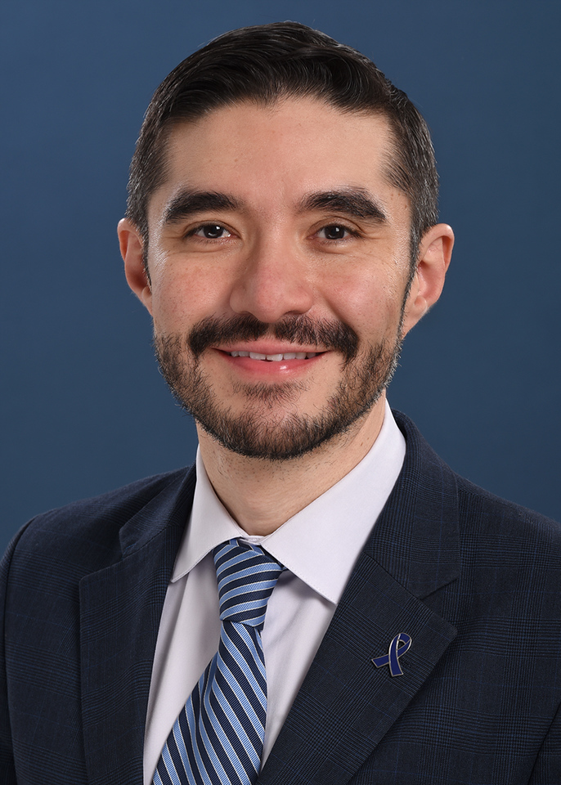

AI in Oncology: From Innovation to Infrastructure
Arturo Loaiza-Bonilla, MD, MSEd, FACP
Chief of Hematology and Oncology, St. Luke’s University Health Network
Co-Founder, Massive Bio
Associate Professor at Lewis Katz School of Medicine at Temple University
Past President, Pennsylvania Society of Oncology and Hematology – ASCO Affiliate
Twitter / X / Bluesky: @DrArturoAI

Slide 2
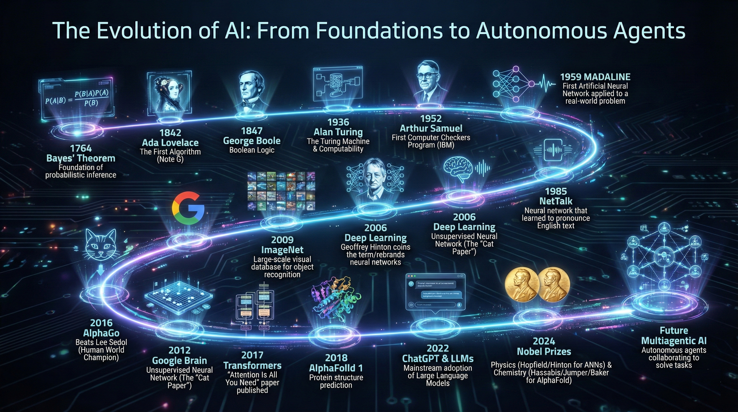
The term artificial intelligence (AI) emerged in 1956, and since then, AI has progressed tremendously
Notes:
Here is the chronological evolution of Artificial Intelligence, mapped from its mathematical foundations to future autonomous agents.
I. Foundations: Mathematical & Logical Roots
1764 | Bayes' Theorem
Significance: The foundation of probabilistic inference, allowing predictions to be updated as new evidence becomes available.
The Formula:
$$P(A|B) = \frac{P(B|A)P(A)}{P(B)}$$
1842 | Ada Lovelace: The First Algorithm
Significance: In her "Note G" on Charles Babbage's Analytical Engine, Lovelace wrote the first algorithm intended to be processed by a machine.
1847 | George Boole: Boolean Logic
Significance: Established the algebraic system of logic (True/False, 1/0) that underpins all modern computer circuitry and binary code.
II. The Birth of Computing & Early AI (20th Century)
1936 | Alan Turing: The Turing Machine
Significance: Turing proposed a theoretical model for a universal machine capable of computing anything that is computable, laying the groundwork for modern computer science.
1952 | Arthur Samuel: Machine Learning
Significance: Samuel wrote the first computer checkers program (on an IBM 701) that learned from its own experience, popularizing the term "machine learning."
1959 | MADALINE
Significance: Created by Bernard Widrow and Marcian Hoff, this was the first artificial neural network applied to a real-world problem (adaptive filters for echo cancellation in phone lines).
1985 | NetTalk
Significance: A neural network (Sejnowski & Rosenberg) that learned to pronounce English text by matching letters to phonemes, demonstrating the power of backpropagation.
III. The Deep Learning Revolution (2000s - 2010s)
2006 | Deep Learning
Significance: Geoffrey Hinton and colleagues published work that efficiently trained deep belief networks, rebranding "neural networks" as "Deep Learning" and reigniting interest in the field.
2009 | ImageNet
Significance: The launch of a massive database of labeled images. This data was the fuel necessary to train deep learning models effectively.
2012 | Google Brain: The "Cat Paper"
Significance: An unsupervised neural network built by Andrew Ng and Jeff Dean taught itself to recognize cats by watching YouTube thumbnails, proving AI could learn features without explicit labeling.
2016 | AlphaGo
Significance: DeepMind's AlphaGo defeated Lee Sedol, a human World Champion, in the complex game of Go—a feat previously thought to be a decade away.
2017 | Transformers
Significance: Google researchers published "Attention Is All You Need," introducing the Transformer architecture. This allowed for parallel processing of data sequences and serves as the backbone for modern LLMs.
2018 | AlphaFold 1
Significance: DeepMind applied AI to biology, successfully predicting protein 3D structures from amino acid sequences.
IV. The Generative Era & The Future (2020s - Beyond)
2022 | ChatGPT & Mainstream LLMs
Significance: The release of ChatGPT marked the moment Generative AI became a consumer utility, demonstrating advanced natural language understanding and generation.
2024 | Nobel Prizes in AI
Physics: John Hopfield and Geoffrey Hinton awarded for foundational discoveries in artificial neural networks.
Chemistry: Demis Hassabis, John Jumper, and David Baker awarded for protein structure prediction (AlphaFold) and computational protein design.
2025 | Boltz
Significance: A new open-source biomolecular modeling model capable of predicting the 3D structures of proteins, DNA, RNA, and small molecules, pushing drug discovery forward.
Future | Multiagentic AI
Significance: The shift from single-prompt interactions to systems of autonomous agents that collaborate, plan, and execute complex workflows to solve distinct tasks.

Slide 3

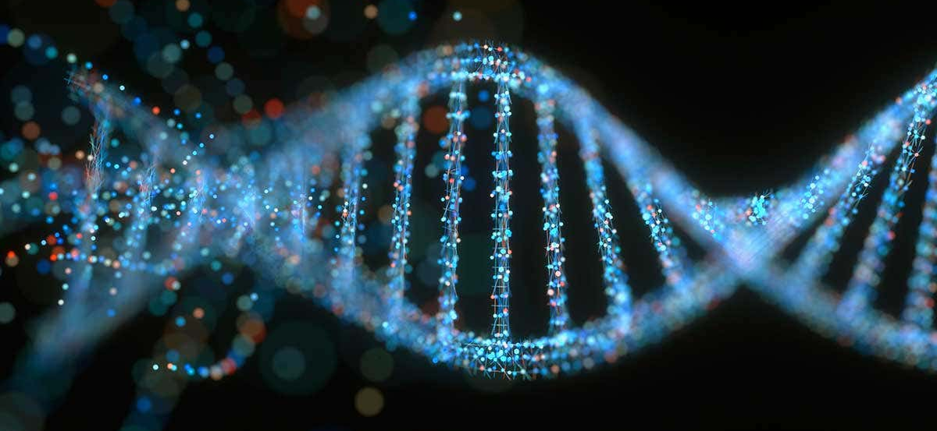
Oncology has experienced two of the greatest technological evolutions: molecular "omics" (genomics, proteomics, epigenomics) and "big data"
A couple of decades ago, cancer was diagnosed using a combination of X-ray imaging and histopathology tests. In contrast, molecular tests can now report on changes in hundreds of genes and proteins to diagnose and determine the prognosis and treatment of cancer in an individual.
In fact, these advances are extending survival and improving the quality of life of hundreds of thousands of patients, yet healthcare professionals face new challenges associated with the implementation of precision medicine,
Growth of medical knowledge is exponential
Constant specialization is required to provide highly individualized cancer care.
This debate is not unique to highly developed countries. Providing comprehensive, state-of-the-art cancer care to millions of patients remains a significant challenge, particularly for suburban and rural populations.
Biomedical data is heterogeneous and difficult to classify (e.g. high dimensionality, time dependence, parity, irregularity) for Artificial Intelligence applications.

Slide 4
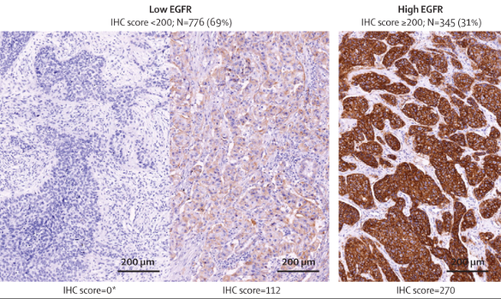
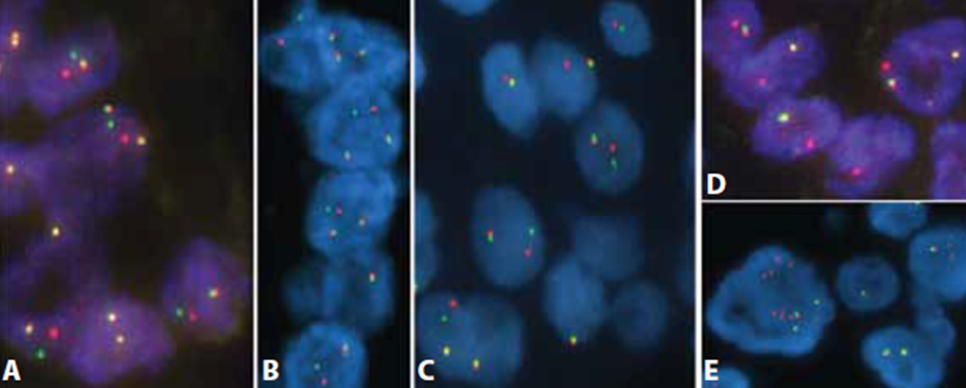
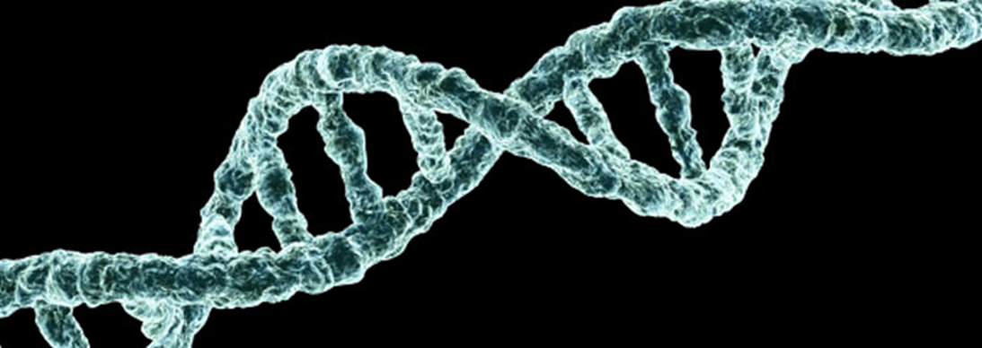
Immunohistochemistry (IHC)
Biomarker technique used to detect level of protein expression
Fluorescence In Situ Hybridization (FISH)
Biomarker technique used to detect alterations in DNA (single-gene)
Next-Generation Sequencing (NGS)
High-throughput biomarker technique used to detect alterations in DNA (multi-gene) and to construct a comprehensive genomic profile
1. Bauman TM, et al. J Vis Exp. 2016;110:e53837. doi: 10.3791/53837. 2. Pirker R, et al. Lancet Oncol. 2012 Jan;13(1):33-42. doi: 10.1016/S1470-2045(11)70318-7. Epub 2011 Nov 4. 3. Tsao MS, et al. IASLC Atlas of ALK and ROS1 Testing in Lung Cancer. 2016. Reprinted courtesy of the International Association for the Study of Lung Cancer. Copyright ©2016, IASLC. 4. Bahassi and Stambrook. Mutagenesis. 2014 Sep;29(5):303-10. doi: 10.1093/mutage/geu031.

Slide 5
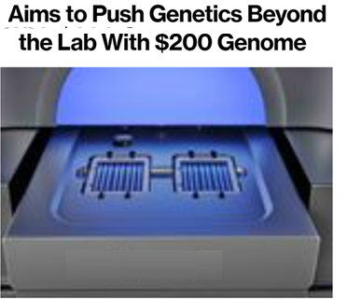
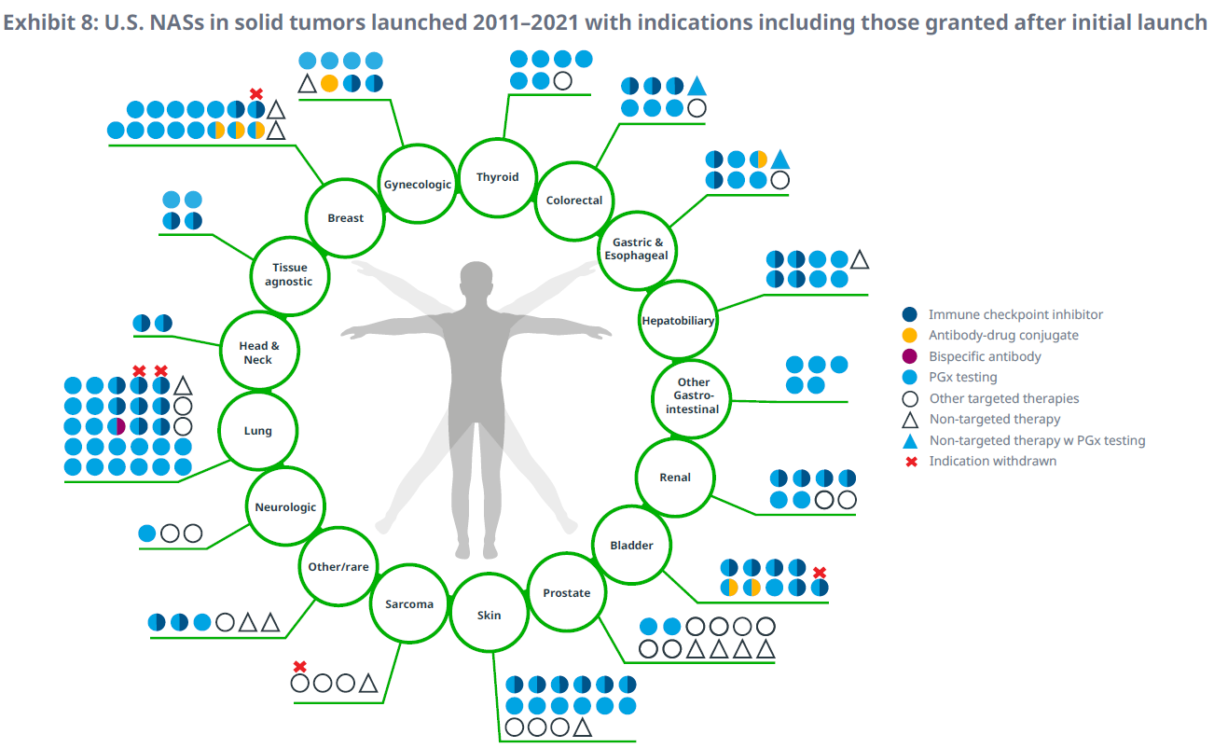
Every Cancer Patient Should Be Profiled
Notes:
Ninety-six novel cancer drugs have launched in the U.S. since 2011 to treat solid tumors, with 25 approved for multiple indications since launch.
• Significant innovation has occurred in lung cancer, with 30 products launched and predominantly targeted therapies for a variety of biomarker subtypes, including eight checkpoint inhibitors and one bispecific antibody.
• Breast cancer has had 17 new medicines launched for treatment since 2011, including three antibody-drug conjugates targeting HER2-positive and triple-negative breast cancer.
• Most novel cancer treatments utilize pharmacogenetic testing (PGx) providing personalized care to ensure the appropriate dose and drug are selected for each individual patient.
• Checkpoint inhibitors have provided significant therapeutic improvements across a range of solid tumors; however, nine indications have been withdrawn or revoked for these drugs following
accelerated approval

Slide 6



GENERATIVE AI TO ASSIST IN TRIAL DESIGNS
Umbrella
Basket
Test impact of different drugs on different mutations in a single type of cancer
BATTLE
I-SPY2
SWOG Squamous Lung Master
Test the effect of a drug(s) on a single mutation(s) in a variety of cancer types
TAPUR
NCI COMBO MATCH - myeloMATCH
TAPISTRY

Slide 7
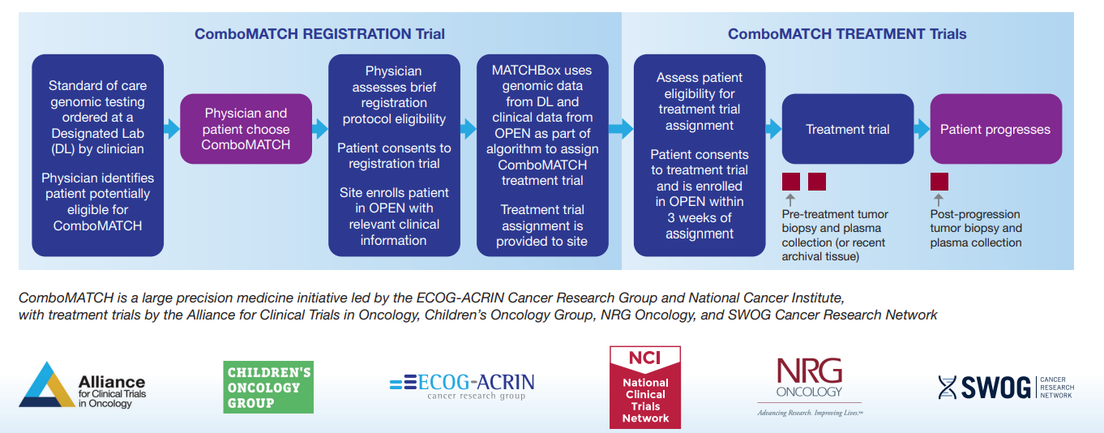
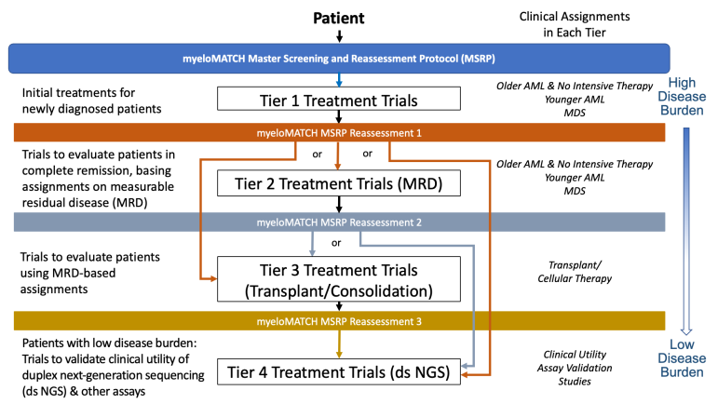


Slide 8
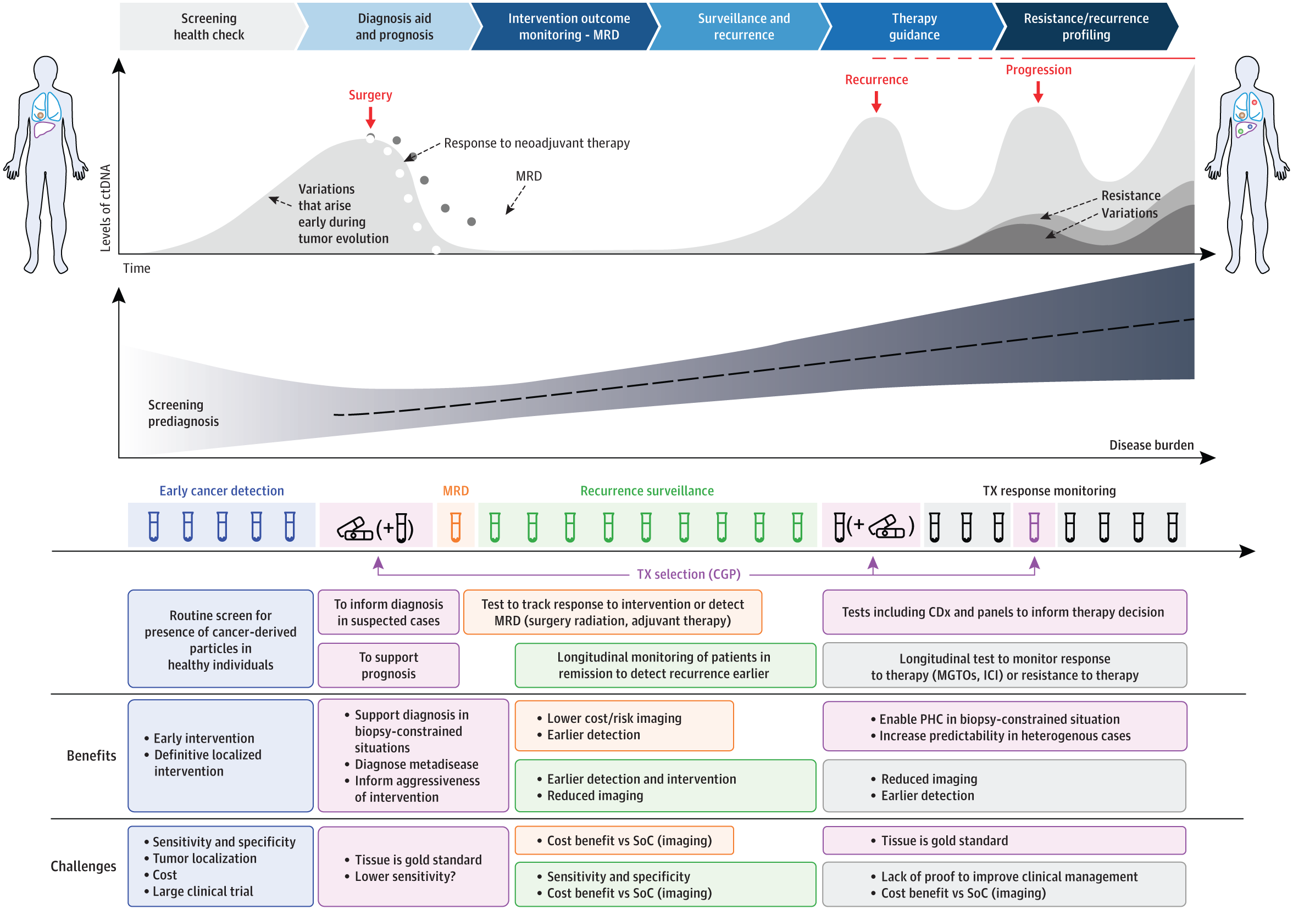
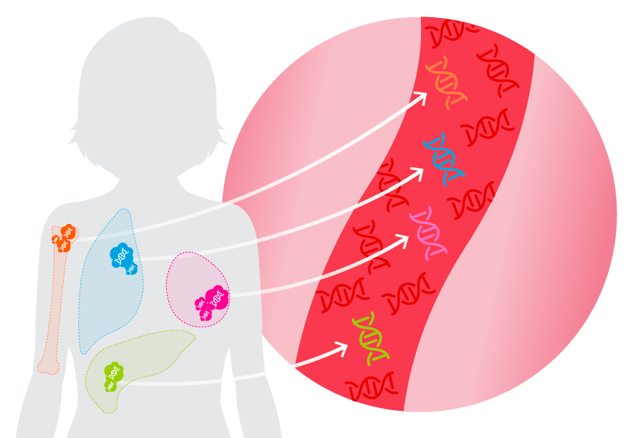
Early profiling requires lifetime tracking
Minimally-invasive liquid biopsies capture circulating tumor (ctDNA) from the blood and offer quick CGP
Bettegowda et al., Sci Transl Med. 2014. Lanman et al., PLOS One. 2015.
Notes:
The Patient Journey Through Oncology TreatmentAbbreviations: CGP, comprehensive genomic profiling; ctDNA, circulating tumor DNA; ICI, immune checkpoint inhibitor; MGTOs, molecularly guided treatment options; MRD, minimal residual disease; PHC, personalized health care; SoC, standard of care; TX, treatment. JAMA Oncol. Published online October 20, 2022. doi:10.1001/jamaoncol.2022.4457

Slide 9
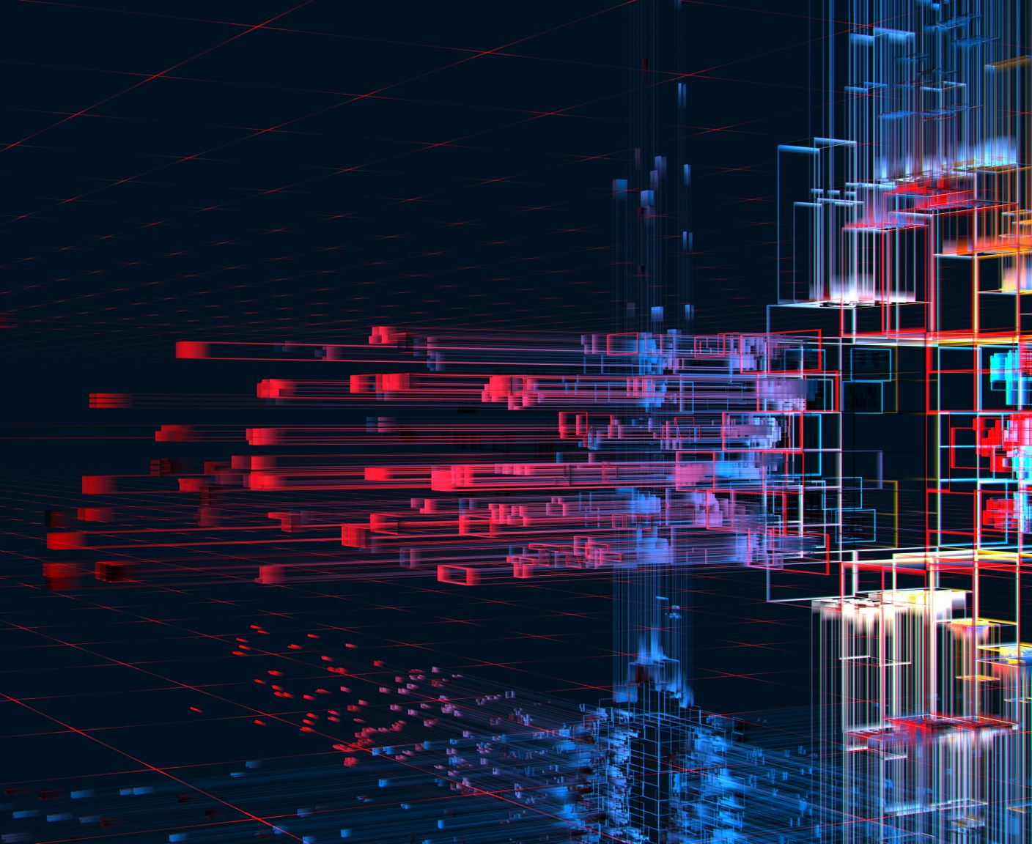
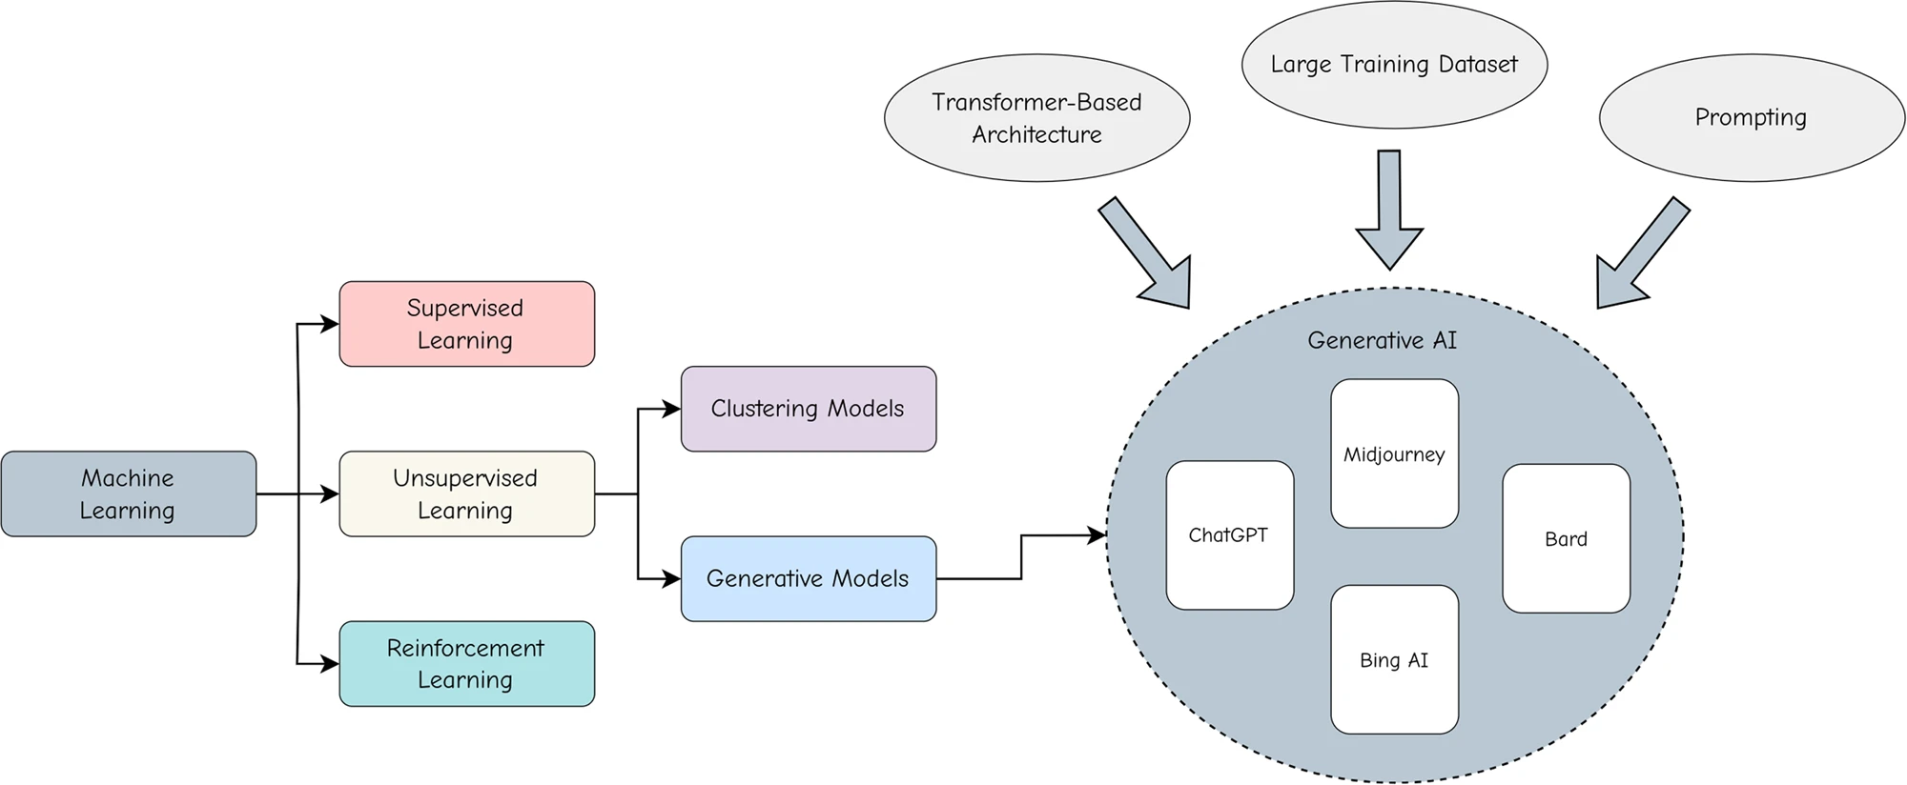
What is generative artificial intelligence (GenAI)
Generative artificial intelligence (AI) describes algorithms (such as LLMs) that can be used to create new content (generate data), including audio, code, images, text, simulations, and videos.
Generative AI systems fall under the broad category of machine learning.
The increasing application of Generative AI in healthcare has the potential to revolutionize drug discovery, basic and clinical research, and patient care.

Slide 10
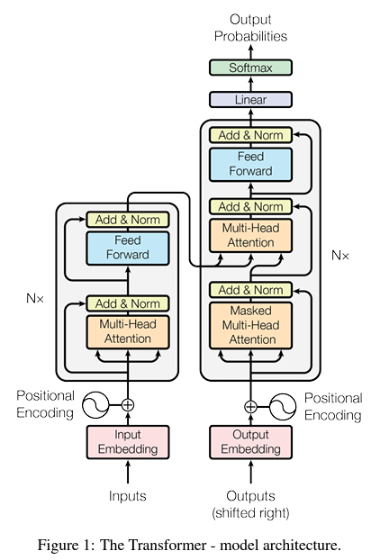
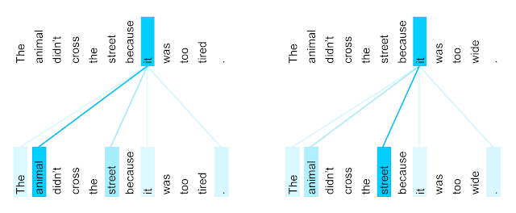
Generative AI models typically pre-trained in an unsupervised manner.
The most popular generative AI model for language generation is LLMs (Generative Pre-trained Transformer)
State-of-the-art Gen-AI models aka Large Language Models (LLMs) share a similar transformer-based architecture
The Transformer only performs a small, constant number of steps (chosen empirically). It enabled LLMs and other large models to scale to billions of parameters
In each step, it applies a self-attention mechanism which directly models relationships between all words in a sentence, regardless of their respective position.
https://doi.org/10.48550/arXiv.1706.03762
Notes:
The encoder self-attention distribution for the word “it” from the 5th to the 6th layer of a Transformer trained on English to French translation (one of eight attention heads). https://blog.research.google/2017/08/transformer-novel-neural-network.html

Slide 11
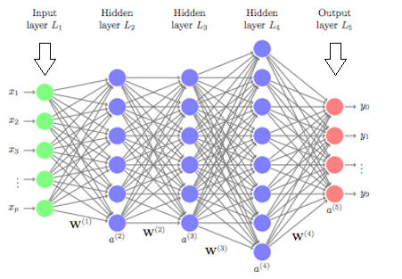
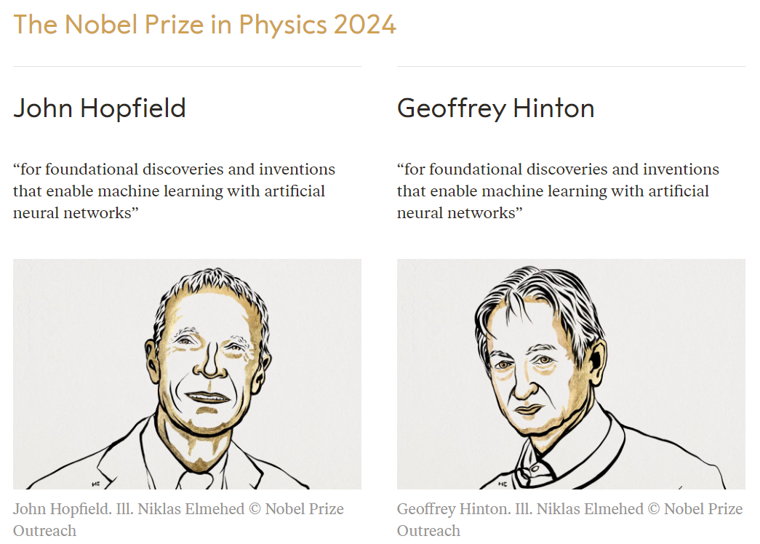
Artificial Neural Network
Notes:
In general, these models have ranged in complexity from shallow models, or less than two hidden layers, to more complex deep learning models, such as those that are tens or even hundreds of layers deep. Combine enough of these and you can represent arbitrarily complex relationships among data.

Slide 12
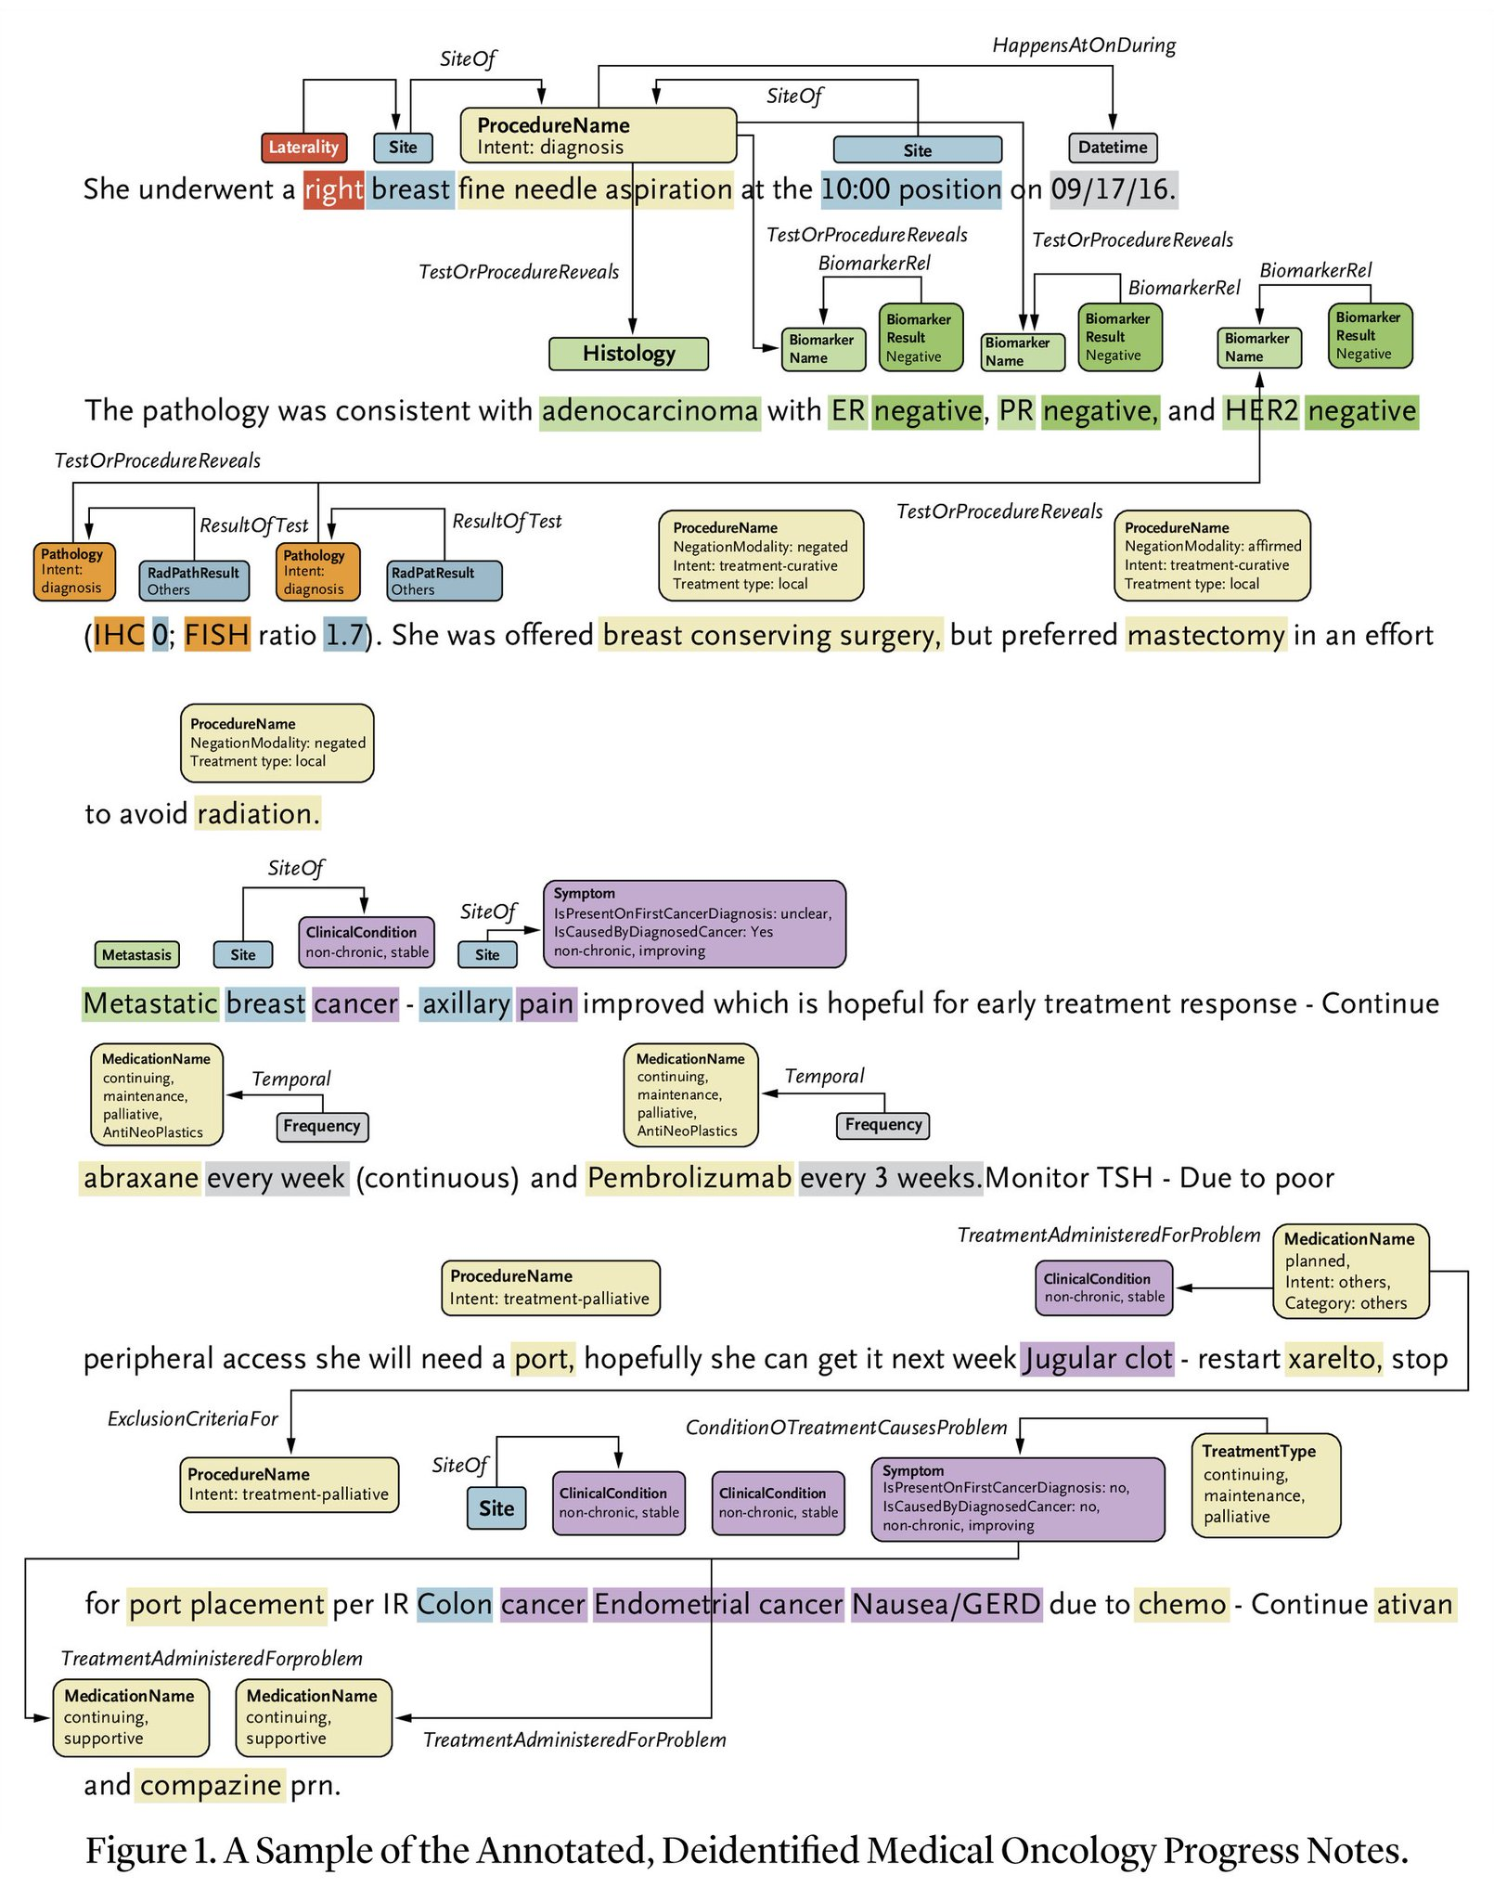
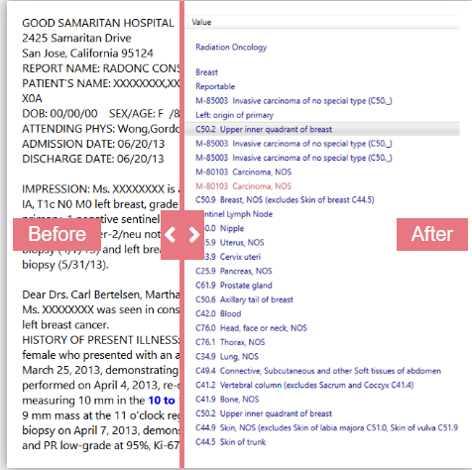
https://ai.nejm.org/doi/full/10.1056/AIdbp2300110
Using Optical Character Recognition + Natural Language Processing + Gen-AI to solve data structuring
Gen-AI can take unstructured data sets—information that has not been organized according to a preset model, making it difficult to analyze—and analyze them,
This is a potential breakthrough for healthcare operations, which are rich in unstructured data such as clinical notes, diagnostic images, medical charts, and recordings.
These unstructured data sets can be used independently or combined with large, structured data sets, such as insurance claims.
Notes:
https://www.mckinsey.com/industries/healthcare/our-insights/tackling-healthcares-biggest-burdens-with-generative-aihttps://www.inspirata.com/solutions/cancer-registry-automation/

Slide 13
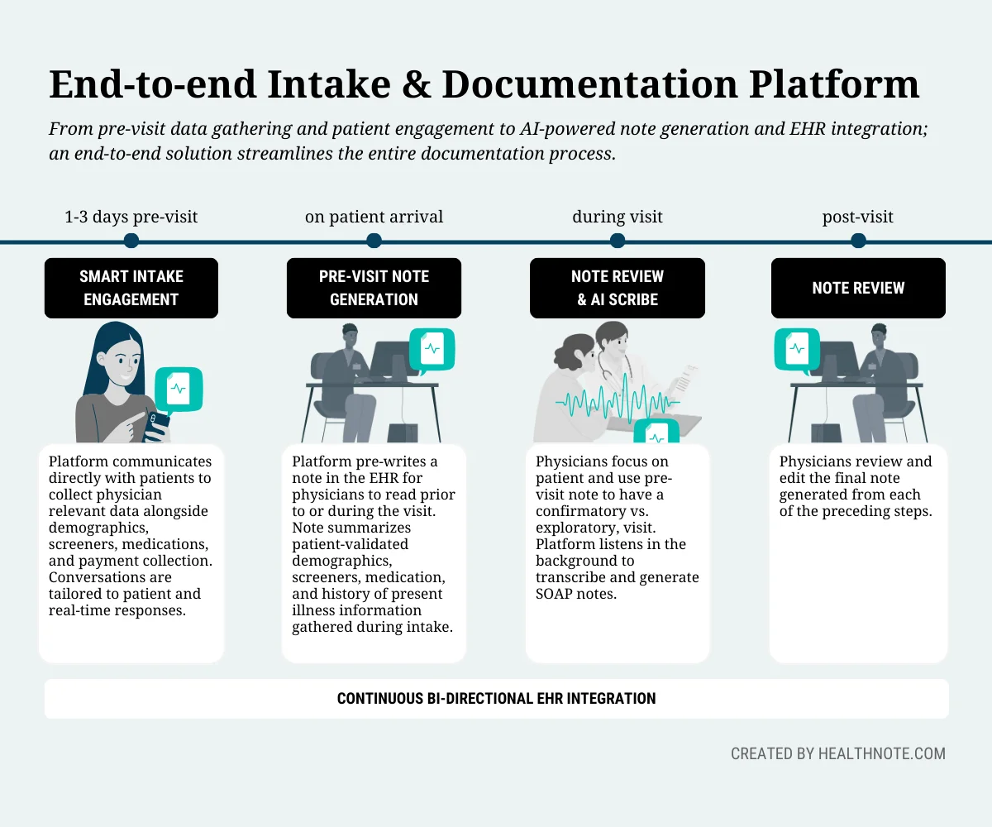
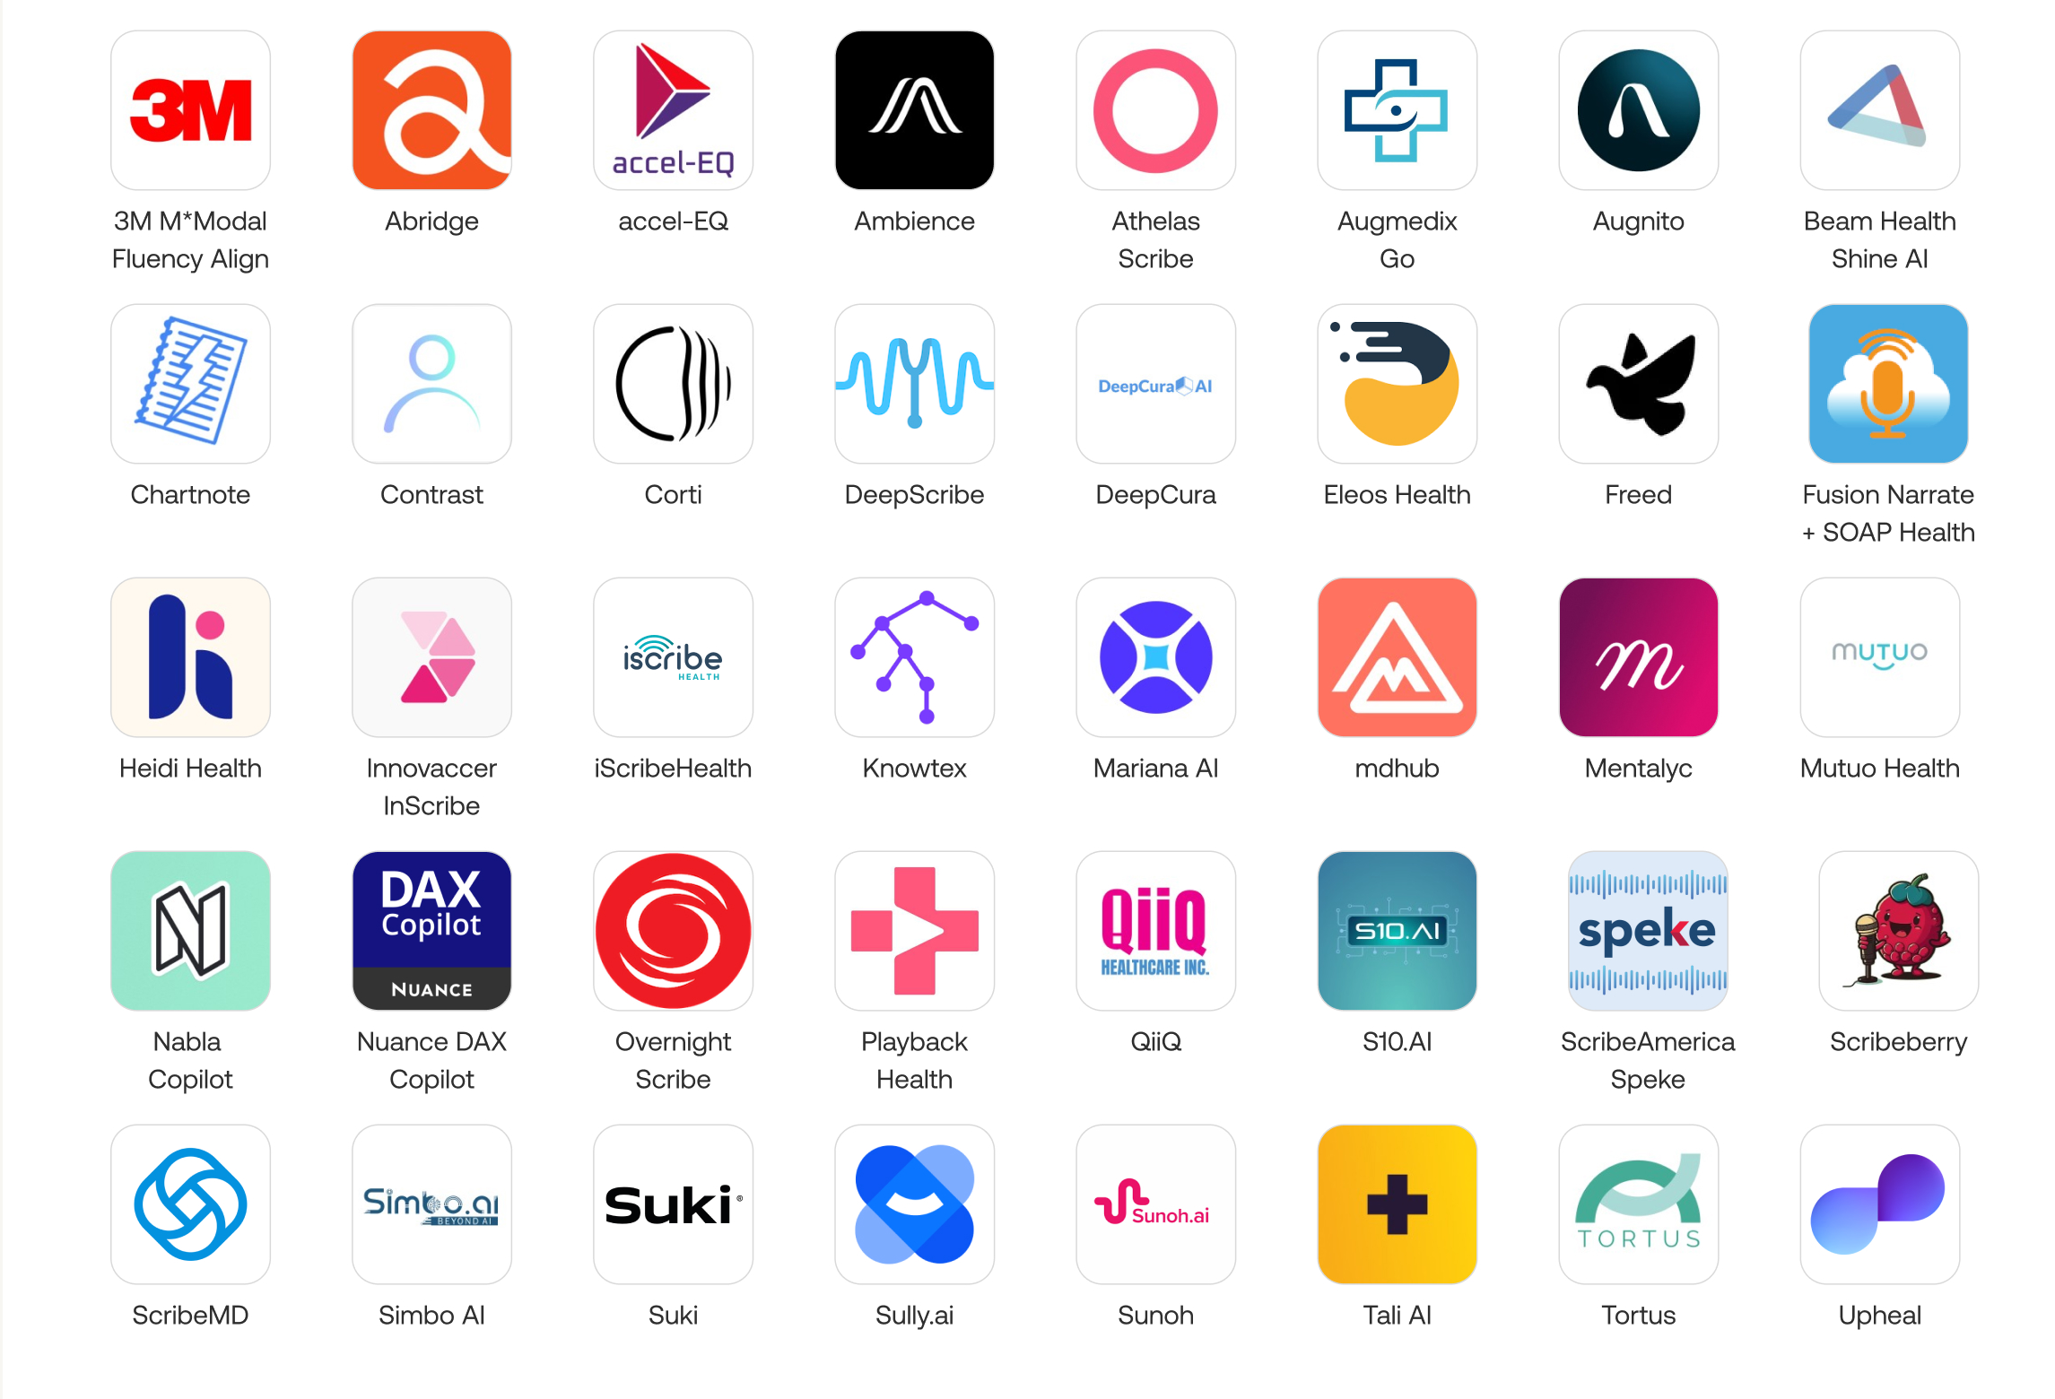
Ambient AI: Medical Scribes

Slide 14
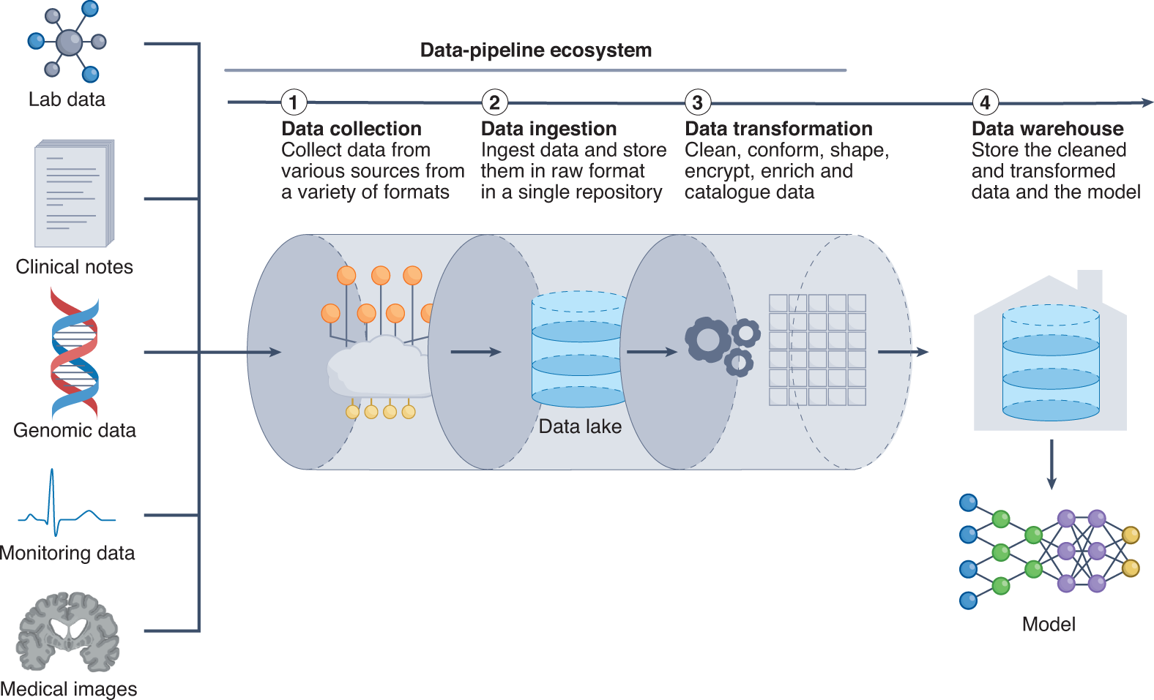
Zhang, A., Xing, L., Zou, J. et al. Shifting machine learning for healthcare from development to deployment and from models to data. Nat. Biomed. Eng 6, 1330–1345 (2022). https://doi.org/10.1038/s41551-022-00898-y
Notes:
https://www.nature.com/articles/s41551-022-00898-y
Delivering data to a model is a key bottleneck in obtaining timely and efficient inferences. ML models require input data that are organized, standardized and normalized, often in tabular format. Therefore, it is critical to establish a pipeline for organizing and storing heterogeneous clinical data. The data pipeline involves collecting, ingesting and transforming clinical data from an assortment of data sources. Data can be housed in data lakes, in data warehouses or in both. Data lakes are central repositories to store all forms of data, raw and processed, without any predetermined organizational structure. Data in data lakes can exist as a mix of binary data (for example, images), structured data, semi-structured data (such as tabular data) and unstructured data (for example, documents). By contrast, data warehouses store cleaned, enriched, transformed and structured data with a predetermined organizational structure.

Slide 15
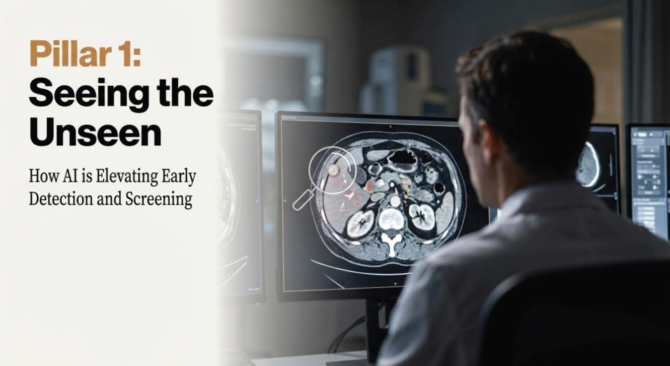

Slide 16
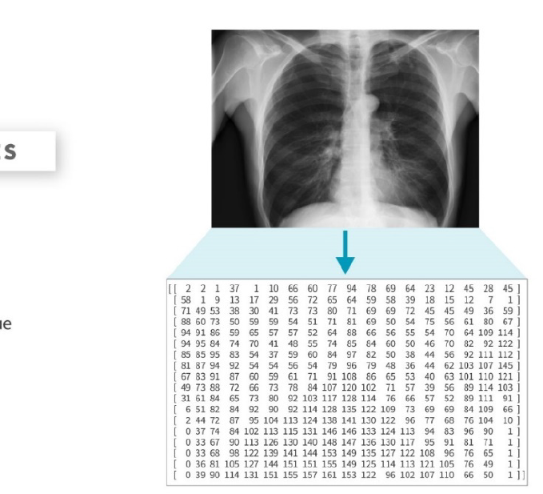
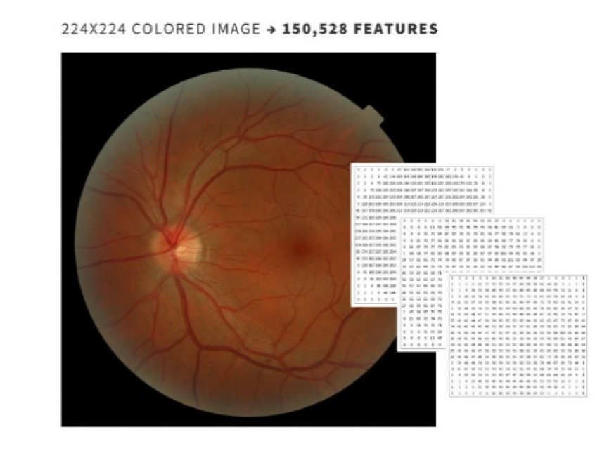
Fundamentals of Machine Learning for Healthcare - SOM-XCHE0010 Stanford School of Medicine, Stanford Center for Health Education. Study guide (1):27-28
Notes:
Numbers range from 0 to 255 representable by a single byte in a computer. In color images, representation is based on 3 grids (Red, Green, Blue). Stanford University.

Slide 17
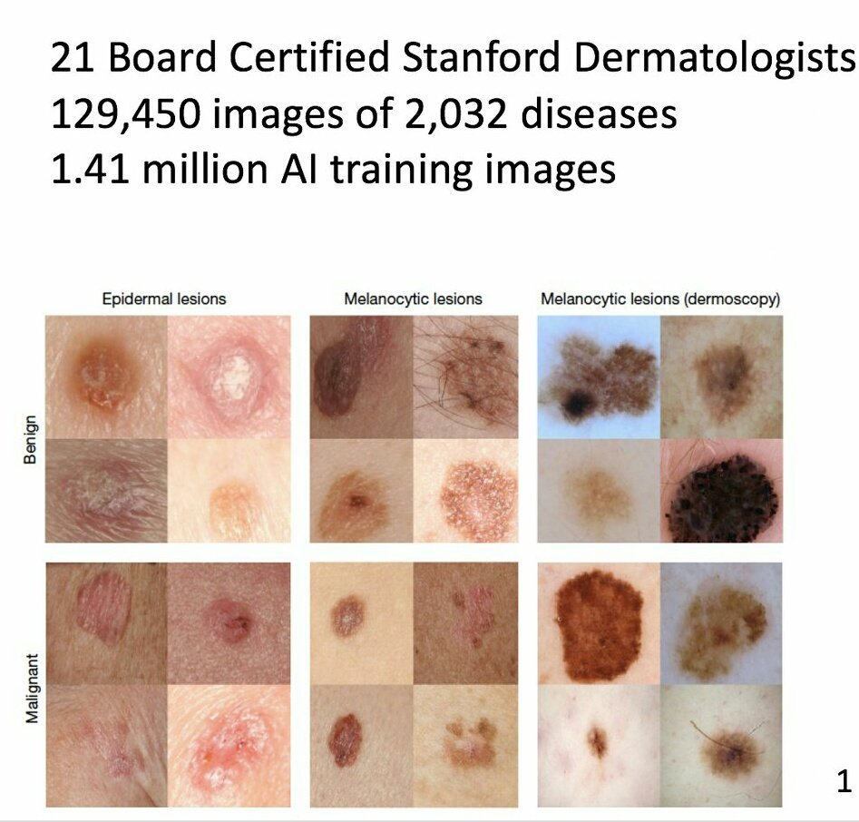
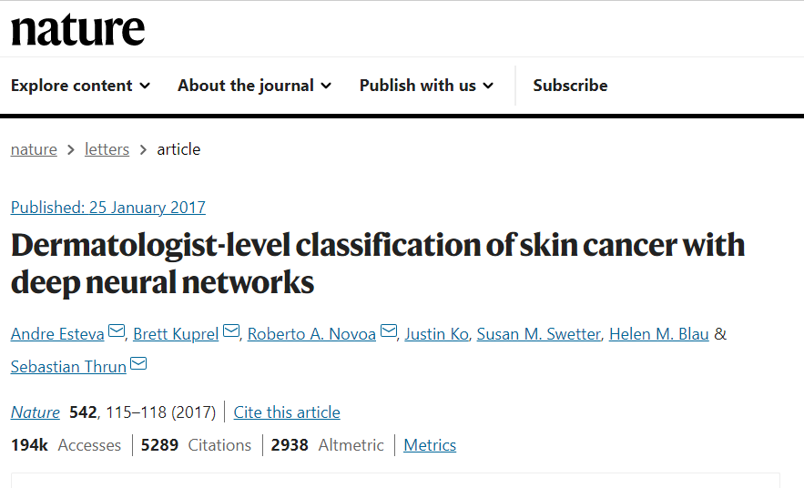
Possibilities: Using Cancer Screening and AI Models for AEs
Notes:
https://www.nature.com/articles/nature21056

Slide 18
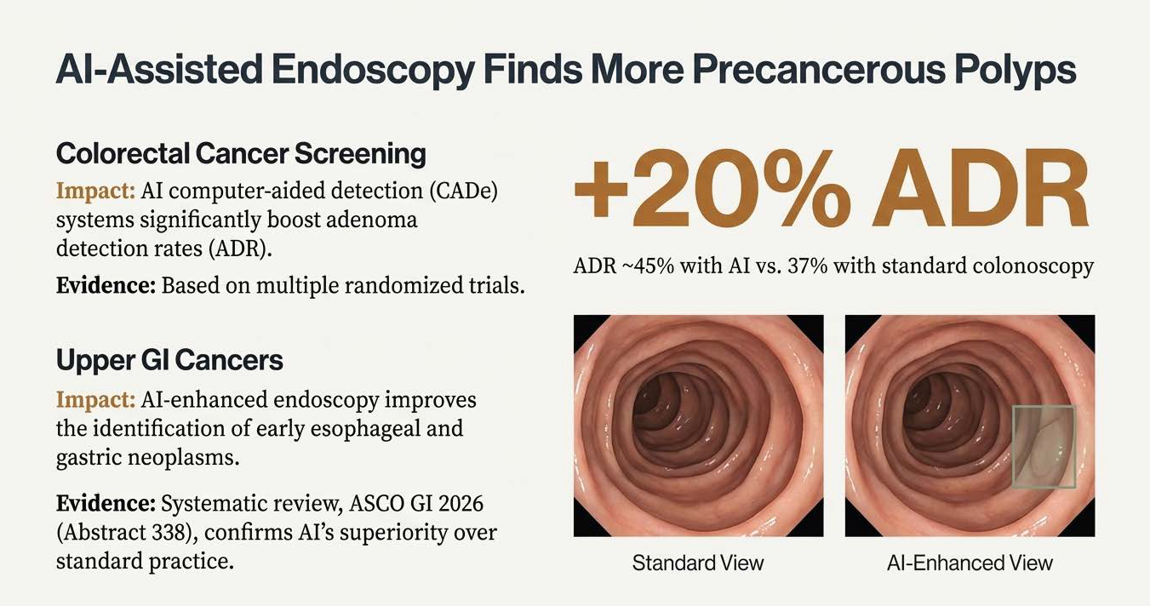

Slide 19
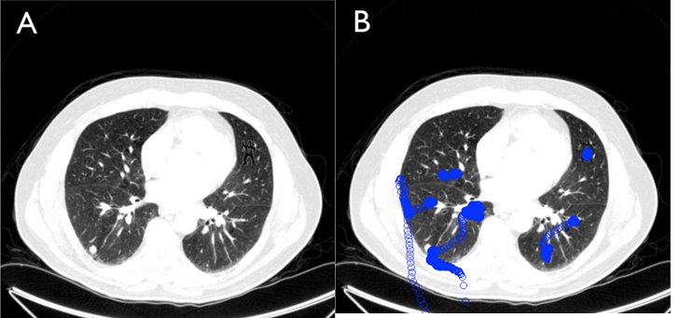
Sustained inattentional blindness
Notes:
Drew T, Võ ML, Wolfe JM. The invisible gorilla strikes again: sustained inattentional blindness in expert observers. Psychol Sci. 2013 Sep;24(9):1848-53. doi: 10.1177/0956797613479386. Epub 2013 Jul 17. PMID: 23863753; PMCID: PMC3964612.
24 radiologists to perform a familiar lung nodule detection task. A gorilla, 48 times larger than the average nodule, was inserted in the last case. 83% of radiologists did not see the gorilla. Eye-tracking revealed that the majority of the those who missed the gorilla looked directly at the location of the gorilla. Even expert searchers, operating in their domain of expertise, are vulnerable to inattentional blindness.

Slide 20
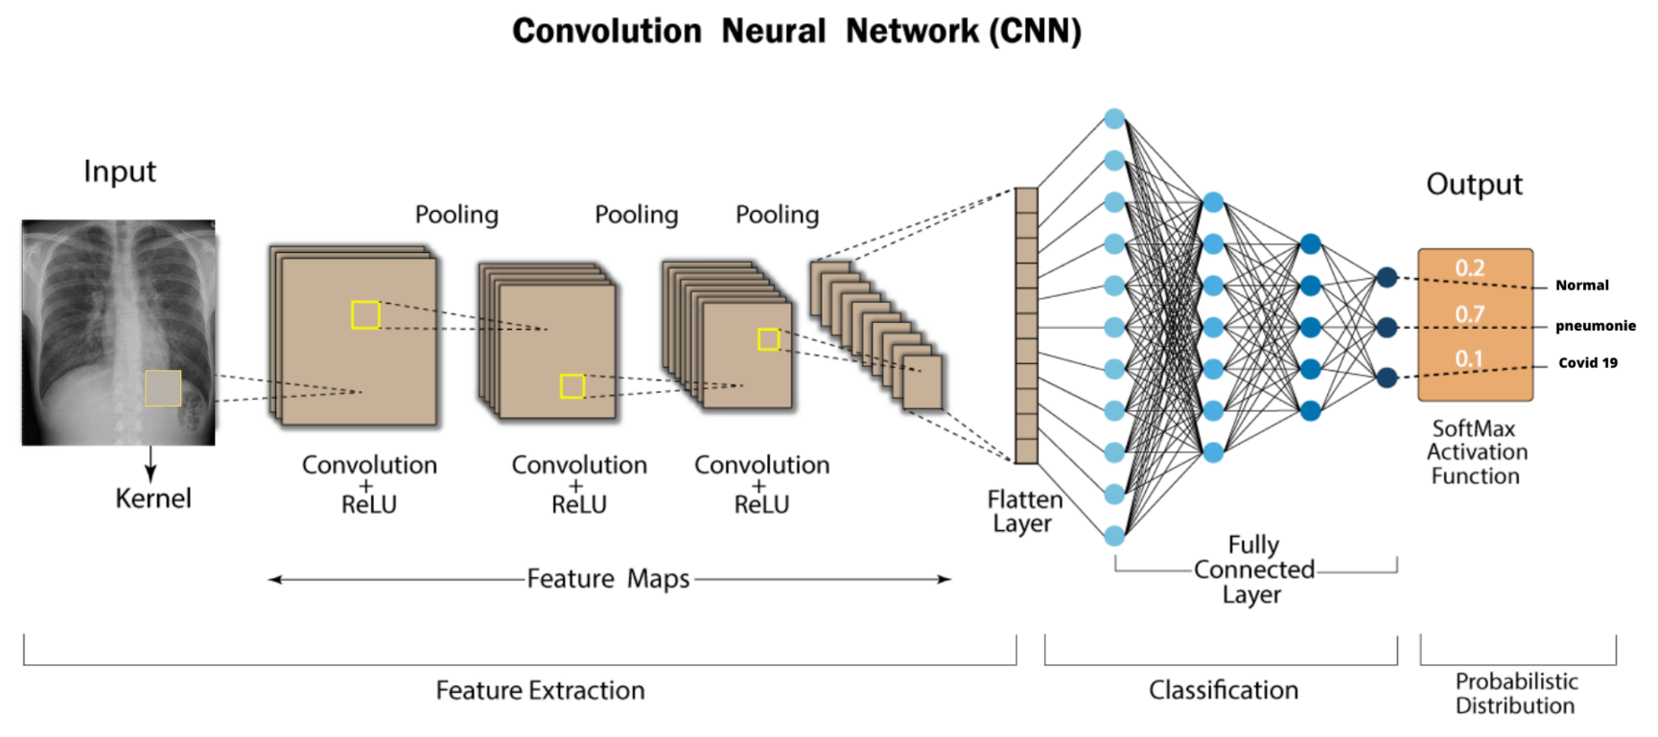
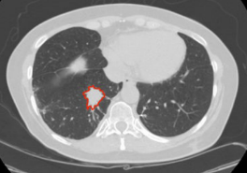
Convolutional Neural Networks (CNN)
Algorithms based on artificial intelligence (AI) represent a promising avenue to simultaneously improve the accuracy of diagnostic images, as well as to help radiologists become more, giving them more time to focus on patient care.
Academic Radiology: average radiologist must interpret an image every 3-4 seconds to maintain the daily workflow
Granuloma
Malignant
Normal
Image Source: Internet and Adapted by Dr. Nikhil Thaker
20
Notes:
There are some special deep learning architectures like convolutional neural networks or CNNs. These allow the use of color images as inputted data. Let’s take a look at an example where we are trying to calculate the probability that a chest CT identifies a malignant nodule, a benign finding like a granuloma, or just a normal scan. This CNN takes in as input CT data set here on the left. (CLICK) The input data are processed by a series of kernels which slide over image color channels and extract features, such as edges and color gradients. The downstream fully connected layers (CLICK) resemble those of the artificial neural net that we saw in the previous slide. We still have an activation function like we did in the previous example, and the output (CLICK) gives us a probability of malignancy, or a benign or normal finding.
AI components in radiology and image analysis would drive greater efficiency in this field, by generating access to a greater amount of data than their human counterparts.
Sustained inattentional blindness even in expert observers is a documented phenomenon, and AI with computer vision can overcome those challenges.
In addition, unnecessary diagnostic procedures can also be reduced by leveraging these innovative tools.
AI technologies able to detect pixel-level changes in tissue invisible to the human eye, while humans used forms of reasoning not available to AI. The ultimate goal will be to find the best way to combine the two to transform the future of radiology.

Slide 21
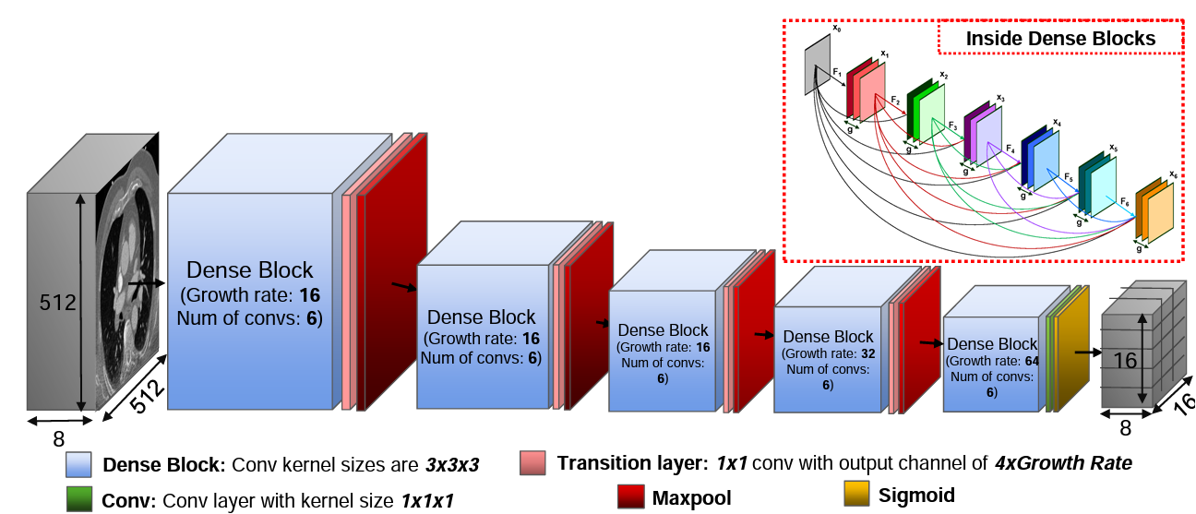
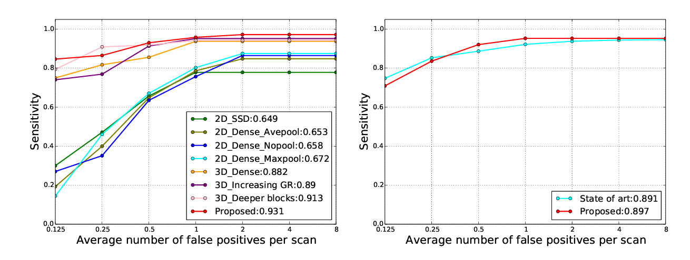
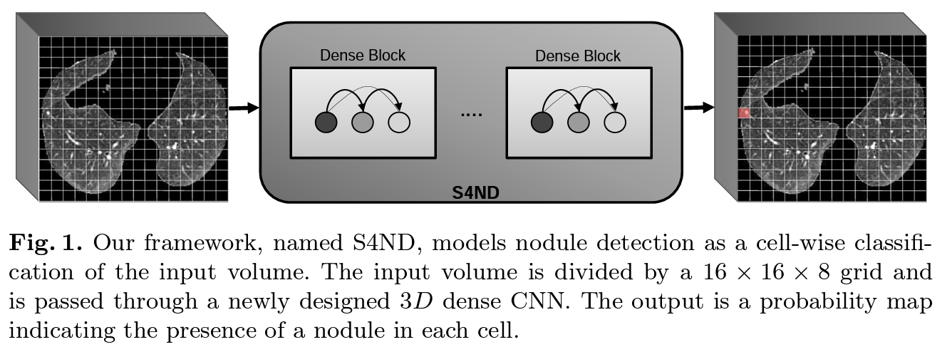
S4ND: Single-Shot Single-Scale Lung Nodule Detection
As an additional example, a deep learning algorithm in Computer Vision, using 1,000 AI CT scans to teach you how to analyze lung tissue for abnormalities, found that AI could identify lung cancer with 30% more accuracy than humans (state of the art).
Khosravan N., Bagci U. (2018) S4ND: Single-Shot Single-Scale Lung Nodule Detection. In: Frangi A., Schnabel J., Davatzikos C., Alberola-López C., Fichtinger G. (eds) Medical Image Computing and Computer Assisted Intervention – MICCAI 2018. MICCAI 2018. Lecture Notes in Computer Science, vol 11071. Springer, Cham. https://doi.org/10.1007/978-3-030-00934-2_88
Notes:
Khosravan N., Bagci U. (2018) S4ND: Single-Shot Single-Scale Lung Nodule Detection. In: Frangi A., Schnabel J., Davatzikos C., Alberola-López C., Fichtinger G. (eds) Medical Image Computing and Computer Assisted Intervention – MICCAI 2018. MICCAI 2018. Lecture Notes in Computer Science, vol 11071. Springer, Cham. https://doi.org/10.1007/978-3-030-00934-2_88

Slide 22
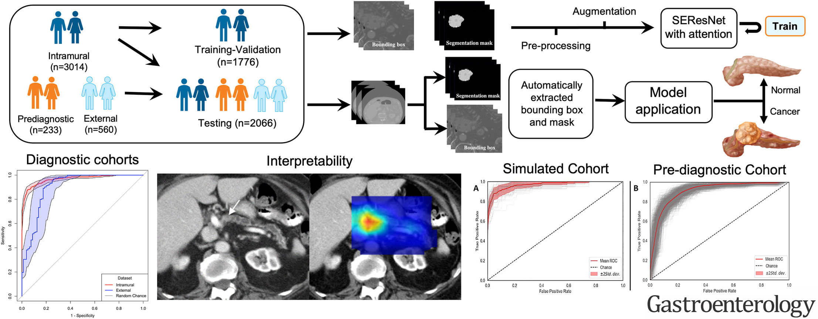
Automated Artificial Intelligence Model Trained on a Large Data Set Can Detect Pancreas Cancer on Diagnostic Computed Tomography Scans As Well As Visually Occult Preinvasive Cancer on Prediagnostic Computed Tomography Scans
Published: August 30, 2023 DOI:https://doi.org/10.1053/j.gastro.2023.08.034
Notes:
https://www.gastrojournal.org/article/S0016-5085(23)04958-2/fulltext - The aims of our case-control study were (1) to develop an automated 3-dimensional (3D) Convolutional Neural Network (CNN) for detection of pancreatic ductal adenocarcinoma (PDA) on diagnostic computed tomography scans (CTs), (2) evaluate its generalizability on multi-institutional public data sets, (3) its utility as a potential screening tool using a simulated cohort with high pretest probability, and (4) its ability to detect visually occult preinvasive cancer on prediagnostic CTs.

Slide 23
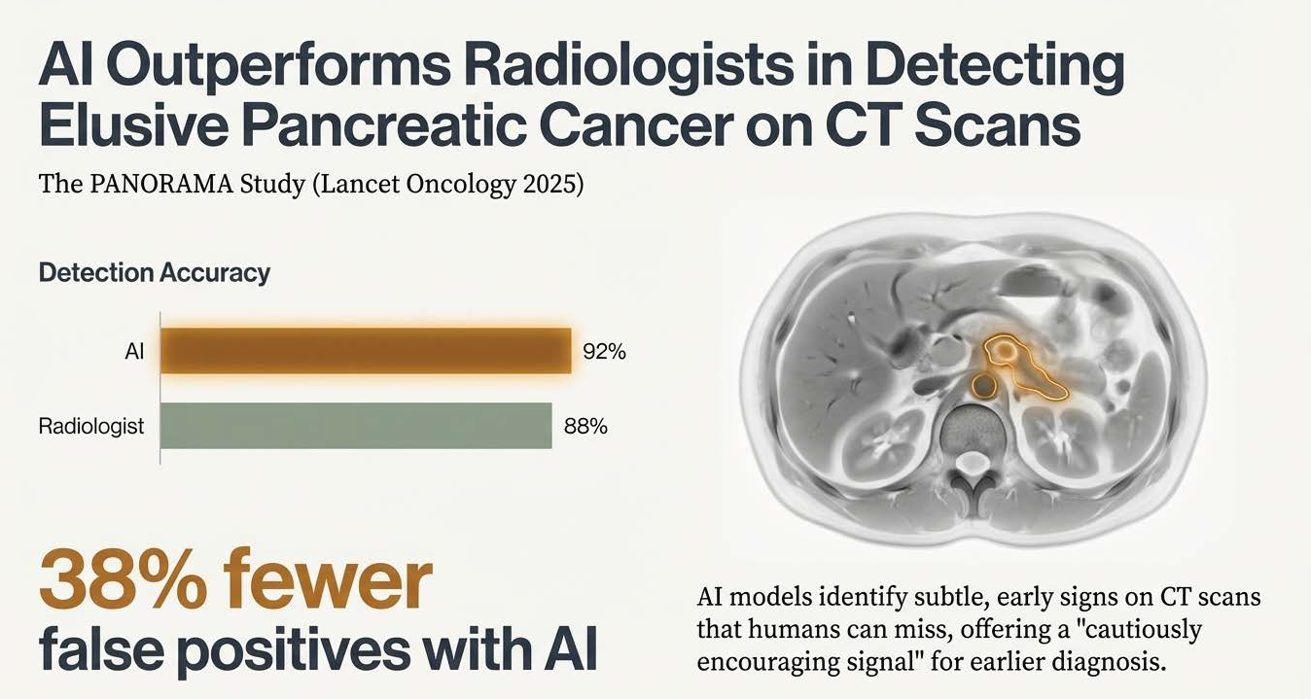

Slide 24


Tumor Scans Support an Understanding of Treatment Response
RECIST
CR
PR
SD
PD
Radiological Baseline Scan
Tumor Measurement
Treatment
Radiological Surveillance Scan
Tumor Measurement
Assess Response
Traditionally in clinical trials, radiologists measure tumors at the local sites and later, the
measurement is confirmed by a blinded independent central review (BICR).
There is potential to incorporate AI tools that measure tumors to streamline this process.

Slide 25
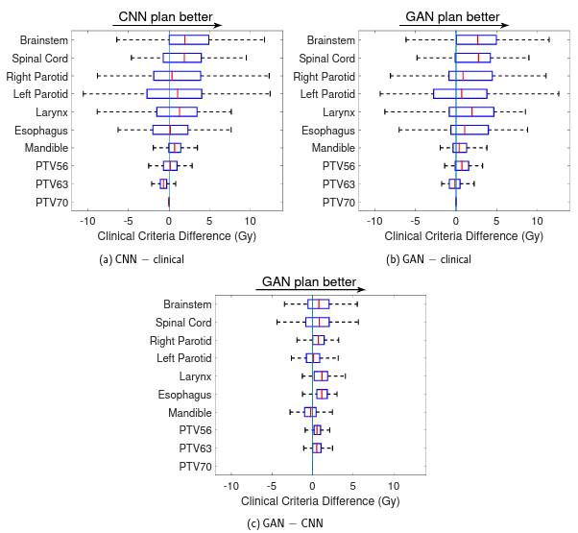
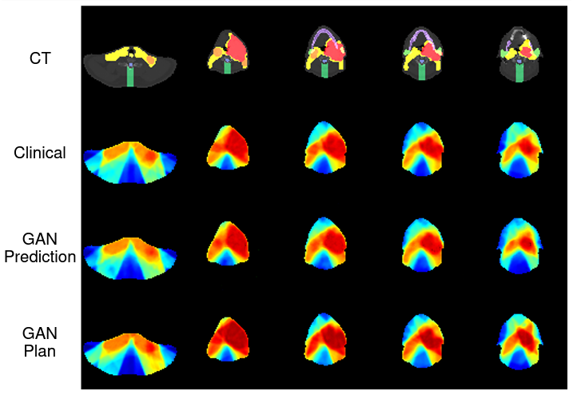
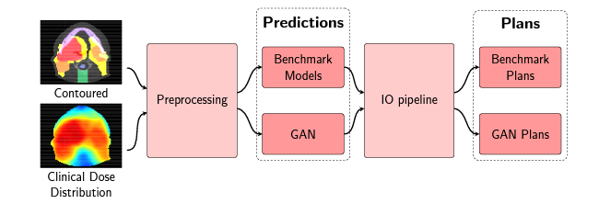
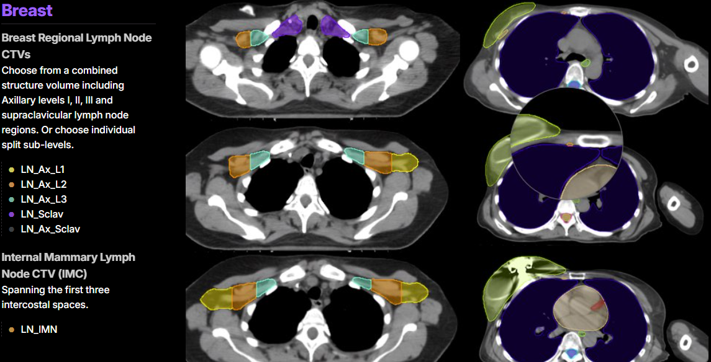
GenAI to optimize radiation oncology treatments
Generative Adversarial Network (GAN)
An AI tool designed by a team at the University of Toronto has shown promise for reducing the time to tailor radiation treatment plans to individual patients.
This particular AI used historical radiation data to recommend treatment strategies with comparable success to radiation oncology specialists.
In 20 minutes, the Toronto team's AI was able to replicate the complex treatment plans that top specialists arrived at after several days of work, optimizing radiation therapy treatment planning.
Autocontouring: LimbusAI - Expert level deep learning autocontouring within 1-3 minutes
Notes:
AI is also being used in image analysis in the field of radiation oncology. While we won’t be able to discuss these topics today in detail, I’ll highlight two major applications that have already improved care for our breast cancer patients. The first is deep learning algorithms that can autocontour CT scans taken for radiation treatment planning. Radiation Oncologists need to contour or segment many organs and targets before patients can begin treatment, which can be time consuming and subjective. New AI models such as LimbusAI and Radformation can segment entire CT scans within 1-3 minutes on our existing workstations without needing to export any DICOM data and without the need for a GPU. Here’s an example of breast and lymph node autosegmentation.
R. Mahmood, A.Babier, A.L. McNiven, A. Diamant, T.C.Y. Chan, “Automated treatment planning in radiation therapy using generative adversarial networks,” Proceedings of Machine Learning Research, Vol. 85 (Machine Learning for Healthcare), pp. 484-499, 2018.
Wei Mu, Lei Jiang, Jianyuan Zhang, Yu Shi, Jhanelle E. Gray, Xinming Zhao, Xilin Sun, Jie Tian, Matthew B. Schabath, Robert J. Gillies. Radiomics and AI-based treatment decision support for non-small cell lung cancer [abstract]. In: Proceedings of the AACR Virtual Special Conference on Artificial Intelligence, Diagnosis, and Imaging; 2021 Jan 13-14. Philadelphia (PA): AACR; Clin Cancer Res 2021;27(5_Suppl):Abstract nr PR-03.

Slide 26
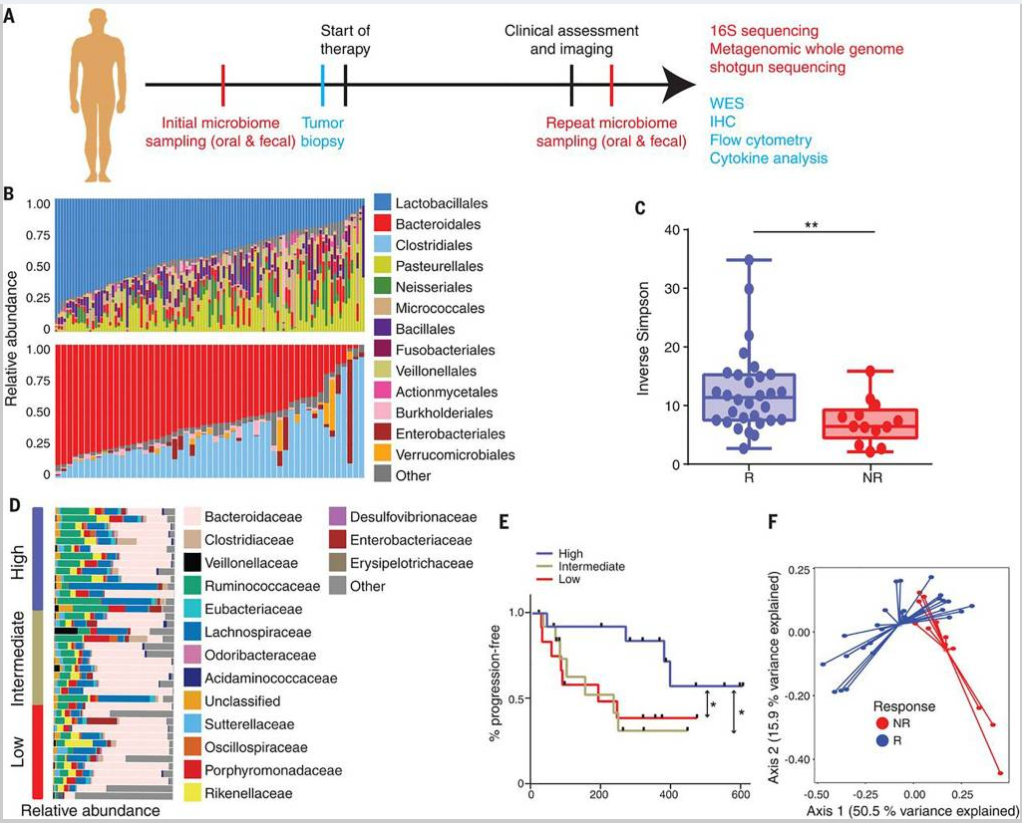

Machine Learning and the Microbiome Gut Microbiome Impacts Response to Immunotherapy Significantly higher alpha diversity (p<0.01) in responding patients
Gopalakrishnan V, et al. Gut microbiome modulates response to anti-PD-1 immunotherapy in melanoma patients. Science. 2018 Jan 5;359(6371):97-103. doi: 10.1126/science.aan4236.
Notes:
Gopalakrishnan V, Spencer CN, Nezi L, Reuben A, Andrews MC, Karpinets TV, Prieto PA, Vicente D, Hoffman K, Wei SC, Cogdill AP, Zhao L, Hudgens CW, Hutchinson DS, Manzo T, Petaccia de Macedo M, Cotechini T, Kumar T, Chen WS, Reddy SM, Szczepaniak Sloane R, Galloway-Pena J, Jiang H, Chen PL, Shpall EJ, Rezvani K, Alousi AM, Chemaly RF, Shelburne S, Vence LM, Okhuysen PC, Jensen VB, Swennes AG, McAllister F, Marcelo Riquelme Sanchez E, Zhang Y, Le Chatelier E, Zitvogel L, Pons N, Austin-Breneman JL, Haydu LE, Burton EM, Gardner JM, Sirmans E, Hu J, Lazar AJ, Tsujikawa T, Diab A, Tawbi H, Glitza IC, Hwu WJ, Patel SP, Woodman SE, Amaria RN, Davies MA, Gershenwald JE, Hwu P, Lee JE, Zhang J, Coussens LM, Cooper ZA, Futreal PA, Daniel CR, Ajami NJ, Petrosino JF, Tetzlaff MT, Sharma P, Allison JP, Jenq RR, Wargo JA. Gut microbiome modulates response to anti-PD-1 immunotherapy in melanoma patients. Science. 2018 Jan 5;359(6371):97-103. doi: 10.1126/science.aan4236. Epub 2017 Nov 2. PMID: 29097493; PMCID: PMC5827966.

Slide 27
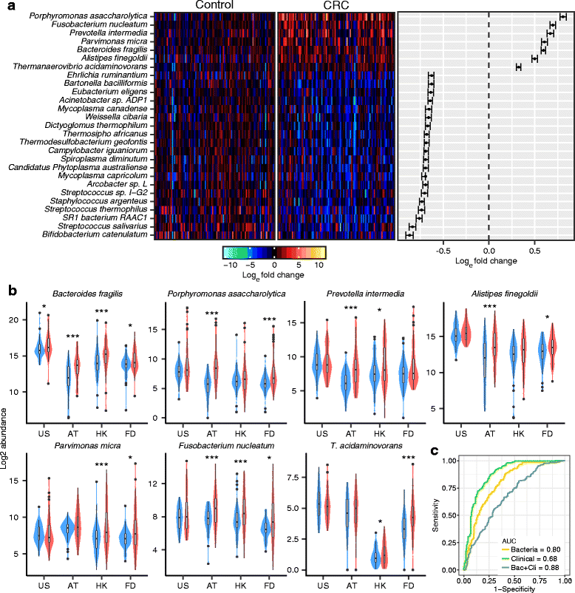
Multi-cohort analysis of colorectal cancer metagenome identified altered bacteria across populations and universal bacterial markers
Based on the combined analysis of 526 metagenomic samples from Chinese, Austrian, American, and German and French cohorts, seven CRC-enriched bacteria have been identified across populations:
Bacteroides fragilis,
Fusobacterium nucleatum,
Porphyromonas asaccharolytica,
Parvimonas micra,
Prevotella intermedia,
Alistipes finegoldii,
Thermanaerovibrio acidaminovorans
Dai, Z., Coker, O.O., Nakatsu, G. et al. Multi-cohort analysis of colorectal cancer metagenome identified altered bacteria across populations and universal bacterial markers. Microbiome 6, 70 (2018). https://doi.org/10.1186/s40168-018-0451-2
Notes:
Differentially abundant bacteria in CRC across cohorts. a Left panel; abundance of 7 CRC-enriched species and 20 CRC-depleted species with largest fold change. The bacteria abundance was normalized to natural log fold change relative to abundance median of control samples. Right panel; confidence interval for individual pair fold change. The confidence intervals were calculated based on Wilcoxon signed-rank test. b Violin graph for the abundance of the 7 CRC-enriched bacteria in different cohorts. Abundance change significance within individual cohort is labeled with * (P < 0.05, *P < 0.01, **P < 0.001, ***). c Prediction power of 7 CRC-enriched bacteria with SVM model. Dai, Z., Coker, O.O., Nakatsu, G. et al. Multi-cohort analysis of colorectal cancer metagenome identified altered bacteria across populations and universal bacterial markers. Microbiome 6, 70 (2018). https://doi.org/10.1186/s40168-018-0451-2

Slide 28
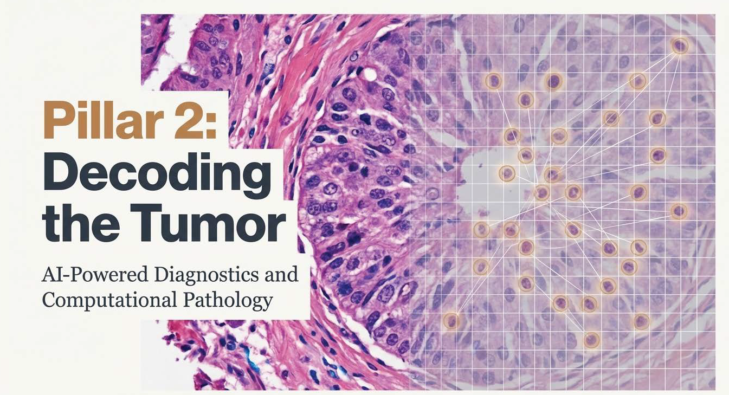

Slide 29
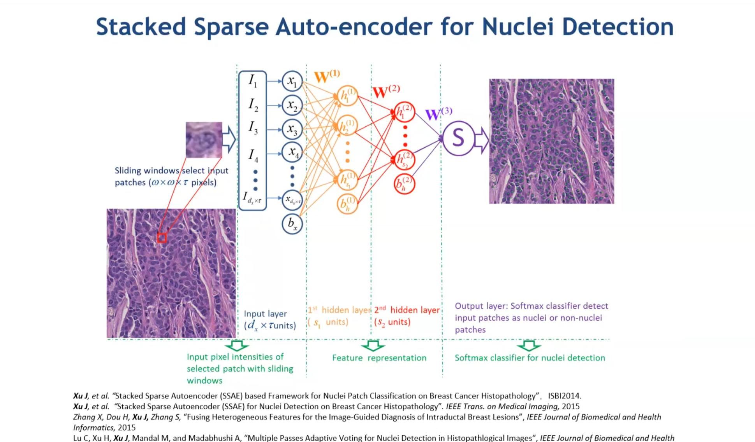

Slide 30
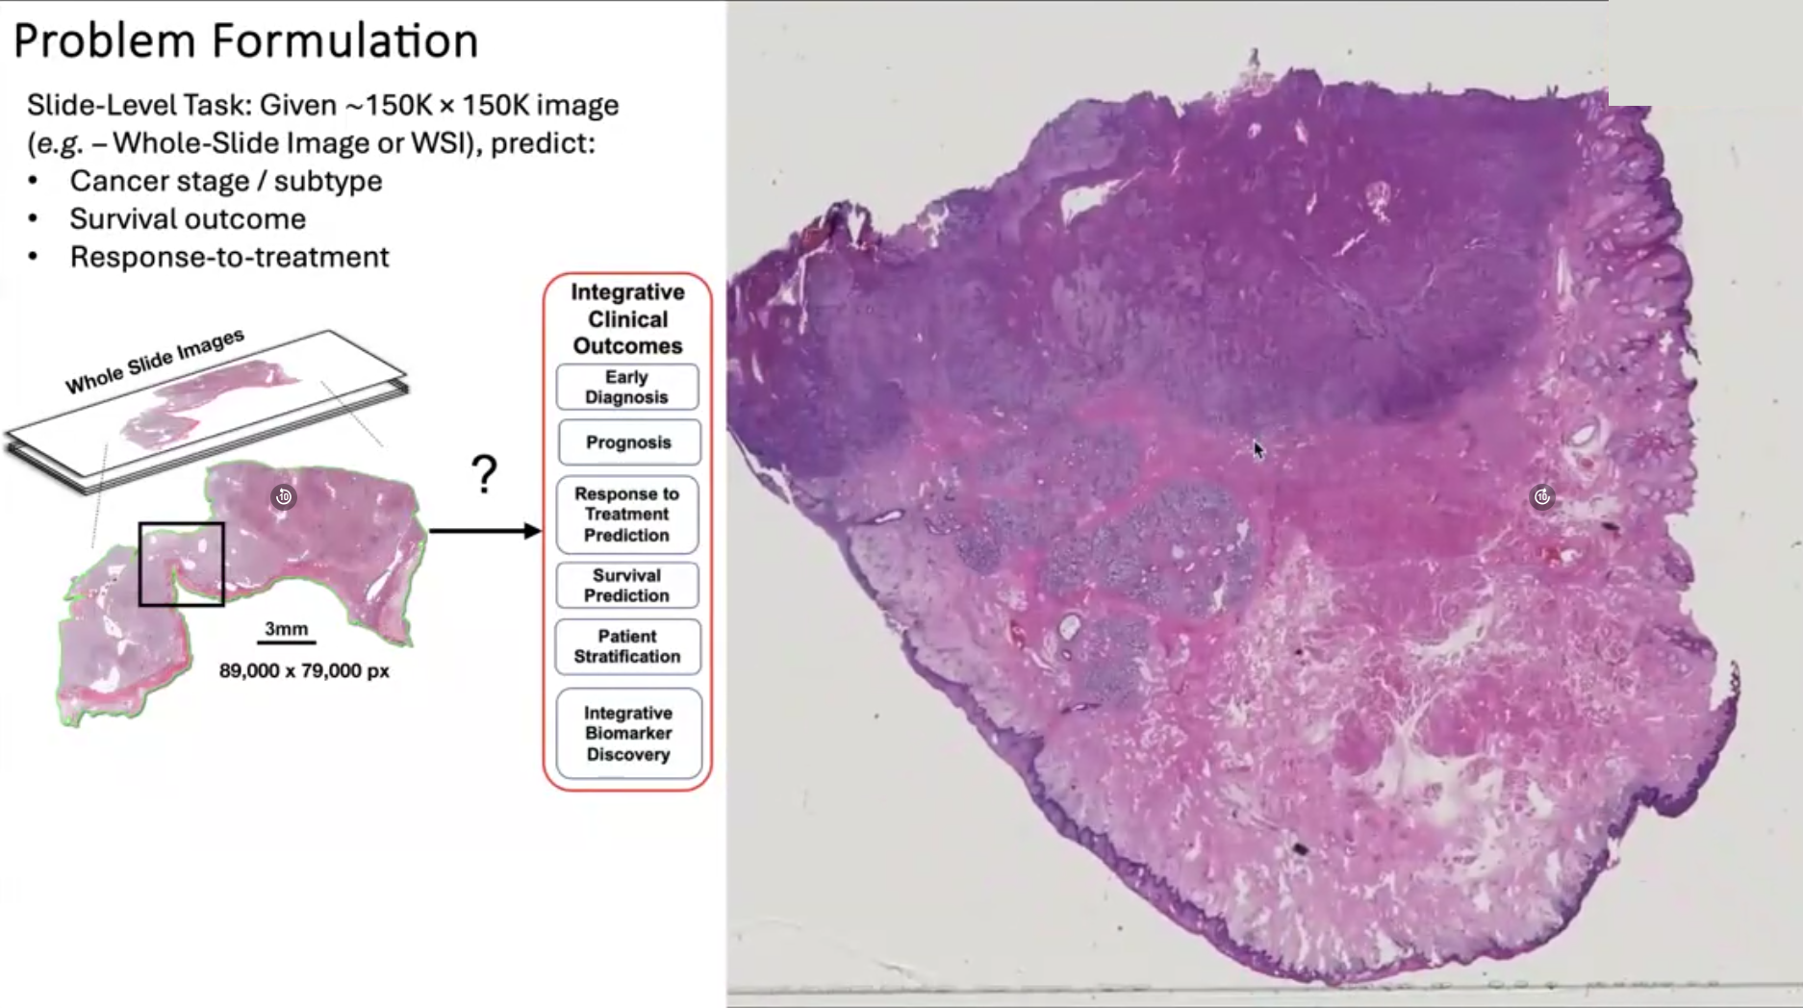
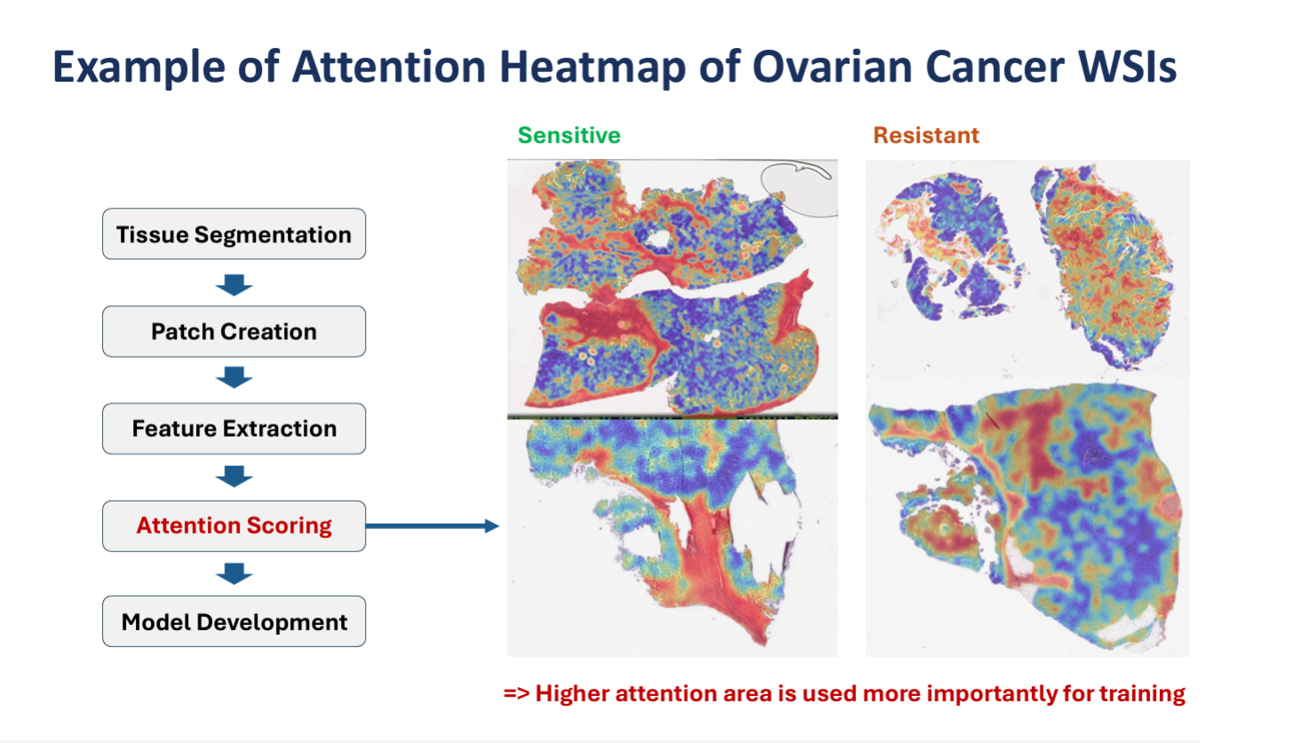

Adapted from Dr. Faisal Mahmood. https://faisal.ai/
Dr. Daoud Meerzaman Computational Genomics and Bioinformatics Branch (CGBB) NCI Center for Biomedical Informatics and IT
Notes:
Dr. Daoud Meerzaman Computational Genomics and Bioinformatics Branch (CGBB) NCI Center for Biomedical Informatics and IT

Slide 31
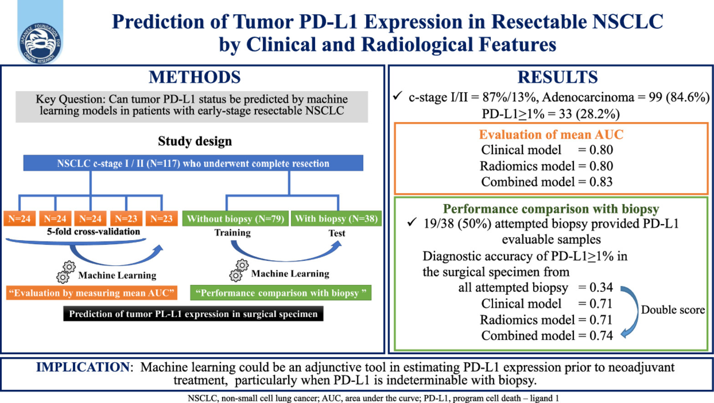
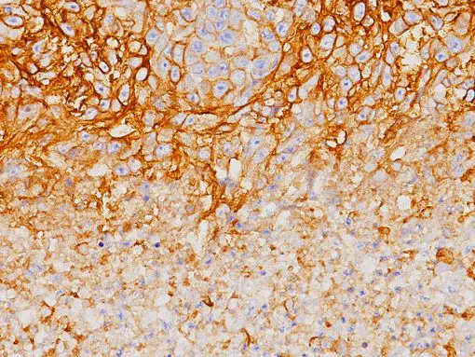
According to results of a performance comparison, a machine learning tool based on clinical and radiological features can accurately predict PD-L1 expression prior to neoadjuvant treatment in c-stage 1/2 non-small cell lung cancer (NSCLC) when PD-L1 expression is indeterminable by biopsy.
Clinical/radiomics features predicted PD-L1 in NSCLC with AUC0.83.
Clin Lung Cancer. Published online: August 10, 2023. doi: 10.1016/j.cllc.2023.08.010
Clin Lung Cancer. Published online: August 10, 2023. doi: 10.1016/j.cllc.2023.08.010
Notes:
Hashimoto K, Murakami Y, Omura K, et al. Prediction of tumor PD-L1 expression in resectable non-small cell lung cancer by machine learning models based on clinical and radiological features: Performance comparison with preoperative biopsy. Clin Lung Cancer. Published online: August 10, 2023. doi: 10.1016/j.cllc.2023.08.010
Slide image: https://biocare.net/product/pd-l1/

Slide 32
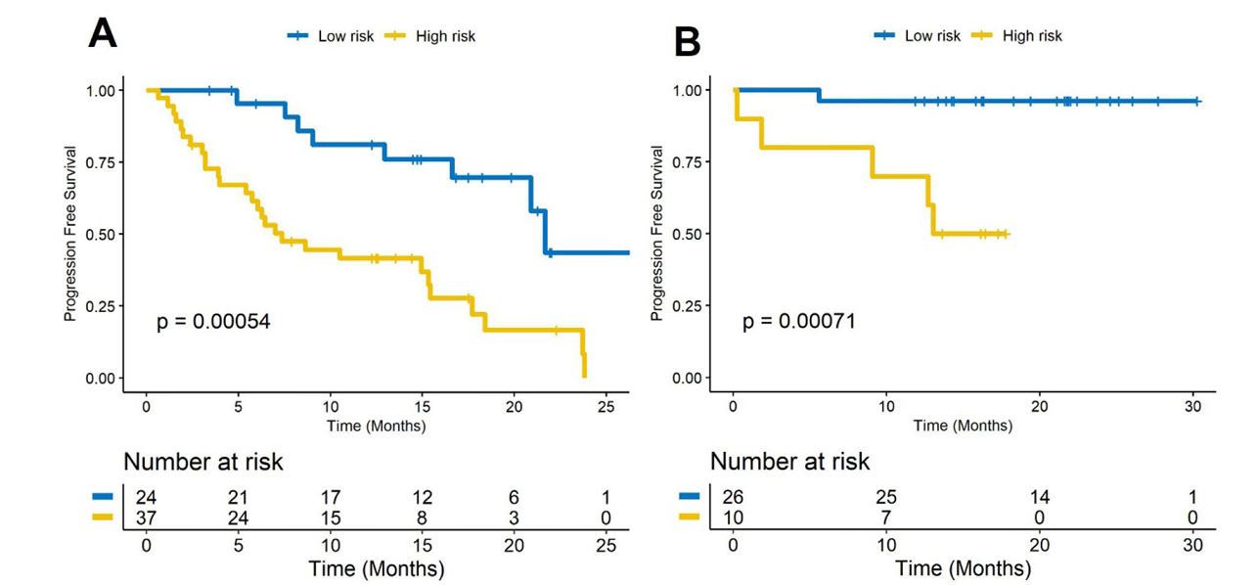


Novel imaging biomarkers predict outcomes in stage III unresectable non-small cell lung cancer treated with chemoradiation and durvalumab
High PD-L1 >50%
Low PD-L1 <50%
Jazieh K, et al. J Immunother Cancer. 2022 Mar;10(3):e003778. doi: 10.1136/jitc-2021-003778
Notes:
The landmark study of durvalumab as consolidation therapy in NSCLC patients (PACIFIC trial) demonstrated significantly longer progression-free survival (PFS) in patients with locally advanced, unresectable non-small cell lung cancer (NSCLC) treated with durvalumab (immunotherapy, IO) therapy after chemoradiotherapy (CRT). In clinical practice in the USA, durvalumab continues to be used in patients across all levels of programmed cell death ligand-1 (PD-L1) expression. While immune therapies have shown promise in several cancers, some patients either do not respond to the therapy or have cancer recurrence after an initial response. It is not clear so far who will benefit of this therapy or what the mechanisms behind treatment failure are.
Methods: A total of 133 patients with unresectable stage III NSCLC who underwent durvalumab after CRT or CRT alone were included. Patients treated with durvalumab IO after CRT were randomly split into training (D1=59) and test (D2=59) sets and the remaining 15 patients treated with CRT alone were grouped in D3. Radiomic textural patterns from within and around the target nodules were extracted. A radiomic risk score (RRS) was built and was used to predict PFS and overall survival (OS). Patients were divided into high-risk and low-risk groups based on median RRS.
Results: RRS was found to be significantly associated with PFS in D1 (HR=2.67, 95% CI 1.85 to 4.13, p<0.05, C-index=0.78) and D2 (HR=2.56, 95% CI 1.63 to 4, p<0.05, C-index=0.73). Similarly, RRS was associated with OS in D1 (HR=1.89, 95% CI 1.3 to 2.75, p<0.05, C-index=0.67) and D2 (HR=2.14, 95% CI 1.28 to 3.6, p<0.05, C-index=0.69), respectively. RRS was found to be significantly associated with PFS in high PD-L1 (HR=3.01, 95% CI 1.41 to 6.45, p=0.0044) and low PD-L1 (HR=2.74, 95% CI 1.8 to 4.14, p=1.77e-06) groups. Moreover, RRS was not significantly associated with OS in the high PD-L1 group (HR=2.08, 95% CI 0.98 to 4.4, p=0.054) but was significantly associated with OS in the low PD-L1 group (HR=1.61, 95% CI 1.14 to 2.28, p=0.0062). In addition, RRS was significantly associated with PFS (HR=2.77, 95% CI 1.17 to 6.52, p=0.019, C-index=0.77) and OS (HR=2.62, 95% CI 1.25 to 5.51, p=0.01, C-index=0.77) in D3, respectively.
Conclusions: Tumor radiomics of pretreatment CT images from patients with stage III unresectable NSCLC were prognostic of PFS and OS to CRT followed by durvalumab IO and CRT alone.

Slide 33

Entropy theory to calculate CFOD-TS: Degree of disorder of collagen fiber orientations at the tumor leading edge and across the entire tumor region
More aligned and ordered collagen fiber organization
Li, H., Bera, K., Toro, P. et al. Collagen fiber orientation disorder from H&E images is prognostic for early stage breast cancer: clinical trial validation. npj Breast Cancer 7, 104 (2021). https://doi.org/10.1038/s41523-021-00310-z
Higher degree of disorganization of collagen fiber orientation
Notes:
The first column (a, e) showed the original H&E stained WSIs with tumor mask (blue) overlaid. The second column (b, e) showed the magnified tumor region at the leading edge, which was compartmentalized into a grid of smaller tumor neighborhoods of 50 um × 50 um. The third column (c, g) illustrates the quantified CFOD-TS in each individual tumor neighborhood within the tumor region in (b) and (f), where a warm color illustrates a higher feature value (higher disorder degree of fiber orientations); The fourth column (d, h) illustrates the organization of the collagen fiber orientations (the orientations indicated by the blue arrows) in the tumor-associated stroma in representative tumor neighborhoods (position of each tumor neighborhood was indicated by the corresponding number on (c) and (g)). The patient with short DFS was characterized by a more aligned and ordered collagen fiber organization, while the patient with long DFS presented a higher degree of disorganization of collagen fiber orientation. Li, H., Bera, K., Toro, P. et al. Collagen fiber orientation disorder from H&E images is prognostic for early stage breast cancer: clinical trial validation. npj Breast Cancer 7, 104 (2021). https://doi.org/10.1038/s41523-021-00310-z

Slide 34



QuanTAV: Quantitative tumor-associated vasculature response and risk scores as potential prognostic and predictive biomarkers
Braman N, et al. Clin Cancer Res. 2022 Oct 14;28(20):4410-4424. doi: 10.1158/1078-0432.CCR-21-4148.
Notes:
QuanTAV morphology measures detect differences in vessel shape on pre-treatment breast MRI and lung CT predictive of outcome following treatment including chemotherapy. Top: Elevated vessel torsion is associated with non-response to anthracycline-based chemotherapy in breast cancer (BRCA-ACT). a) maximum intensity projections of pre-treatment DCE-MRI subtraction images for patients who did (left) and did not (right) experience pathologic response following BRCA-ACT. b) Vessel torsion on pre-treatment dynamic MRI distinguishes non-responders and complete responders. For each discrete vascular branch, all corresponding voxels within the branch are shaded according to the torsion value of the branch. The vasculature of patients who do not respond (left) exhibit elevated torsion, indicating vessels that twist back on themselves and are more convoluted in shape. Conversely, patients who achieve pathologic response exhibit less tortuous vasculature that transports blood more directly towards the tumor or throughout the breast. Bottom, c) Curvature across vessels on pre-treatment CT differs between NSCLC patients who will (right) and will not (left) recur following neoadjuvant chemoradiation followed by surgery (NSCLC-TRI). Vessel center-lines are shaded according to local curvature, computed for every set of three adjacent points along a vessel. Elevated standard deviation of curvature was associated with recurrence following NSCLC-TRI, visible as regions of local bends and twists along the length of a vessel (right). Responsive patients, in contrast, were surrounded by vessels with fewer of these micro-deviations. Braman N, Prasanna P, Bera K, Alilou M, Khorrami M, Leo P, Etesami M, Vulchi M, Turk P, Gupta A, Jain P, Fu P, Pennell N, Velcheti V, Abraham J, Plecha D, Madabhushi A. Novel Radiomic Measurements of Tumor-Associated Vasculature Morphology on Clinical Imaging as a Biomarker of Treatment Response in Multiple Cancers. Clin Cancer Res. 2022 Oct 14;28(20):4410-4424. doi: 10.1158/1078-0432.CCR-21-4148. PMID: 35727603; PMCID: PMC9588630.

Slide 35


Slide 36


Figure 1
http://pancancer.mahmoodlab.org/
Cancer Cell 2022 40865-878.e6DOI: (10.1016/j.ccell.2022.07.004)
Copyright © 2022 The Author(s) Terms and Conditions
Notes:
Pathology-Omic Research Platform for Integrative Survival Estimation (PORPOISE) workflow
Recent advancements made in deep learning for computational pathology have enabled the use of whole-slide images (WSIs) for automated cancer diagnosis and quantification of morphologic phenotypes in the tumor microenvironment. Using weakly supervised learning, slide-level clinical annotations can be used to guide deep-learning algorithms in recapitulating routine diagnostic tasks such as cancer detection, grading, and subtyping
(A) Patient data in the form of digitized high-resolution formalin-fixed paraffin-embeded (FFPE) H&E histology glass slides (known as WSIs) with corresponding molecular data are used as input in our algorithm. Our multimodal algorithm consists of three neural network modules together: (1) an attention-based multiple-instance learning (AMIL) network for processing WSIs, (2) a self-normalizing network (SNN) for processing molecular data features, and (3) a multimodal fusion layer that computes the Kronecker Product to model pairwise feature interactions between histology and molecular features.
(B) For WSIs, per-patient local explanations are visualized as high-resolution attention heatmaps using attention-based interpretability, in which high-attention regions (red) in the heatmap correspond to morphological features that contribute to the model’s predicted risk score.
(C) Global morphological patterns are extracted via cell quantification of high-attention regions in low- and high-risk patient cohorts.
(D) For molecular features, per-patient local explanations are visualized using attribution-based interpretability in integrated gradients.
(E) Global interpretability for molecular features is performed via analyzing the directionality, feature value, and magnitude of gene attributions across all patients.
(F) Kaplan-Meier analysis is performed to visualize patient stratification of low- and high-risk patients for individual cancer types.
See also Table S1.

Slide 37


Slide 38


Slide 39

Artificial general intelligence (AGI) and Research
An artificial general intelligence (AGI) is a hypothetical type of intelligent agent. If realized, an AGI could learn to accomplish any intellectual task that human beings or animals can perform.
Alternatively, AGI has been defined as an autonomous system that surpasses human capabilities in the majority of economically valuable tasks

Slide 40


Slide 41


AlphaFold3 is now Open Source!
https://github.com/google-deepmind/alphafold3
Notes:
AlphaFold3 can predict the structures of proteins as they interact with DNA

Slide 42


Image-based Profiling and Machine Learning for Drug Discovery
Array of robots treat millions of cell samples with drugs and genetic perturbations, stain them, and image them.
It then applies machine learning algorithms to search for informative relationships between the perturbations and the morphological features of the cells.
The creation of well-curated image data could also be useful across a wide array of problems in drug discovery, including target identification, target deconvolution, library enrichment, lead optimization and toxicity testing.
https://www.nature.com/articles/d41573-019-00144-2
Notes:
Chandrasekaran SN, Ceulemans H, Boyd JD, Carpenter AE. Image-based profiling for drug discovery: due for a machine-learning upgrade? Nat Rev Drug Discov. 2021 Feb;20(2):145-159. doi: 10.1038/s41573-020-00117-w. Epub 2020 Dec 22. PMID: 33353986; PMCID: PMC7754181.

Slide 43





On October 02, 2024, FDA cleared an investigational new drug (IND) application for a Phase 1/2 clinical trial of REC-1245, a new chemical entity for the treatment of biomarker-enriched solid tumors and lymphoma.
RMB39 was identified in biology maps as a novel target that looks functionally similar to the well-known but hard to drug target CDK12.
Also identified and optimized small molecules that target RBM39 without directly impacting CDK12 or CDK13 using these same AI-enabled maps.
Notes:
https://www.globenewswire.com/news-release/2024/10/02/2956875/0/en/Recursion-Announces-FDA-Clearance-of-Investigational-New-Drug-Application-for-REC-1245-a-Potential-First-In-Class-RBM39-Degrader-for-Biomarker-Enriched-Solid-Tumors-and-Lymphoma.html

Slide 44

Addressing Challenges in AI-driven Healthcare
Interpretability and Transparency: The need for clearer understanding of AI decisions.
Data Requirements: Tackling the need for large, diverse datasets.
Ethics: Discussing privacy, security, and potential biases in AI applications.
Essential to address risks like data security, bias, and regulatory compliance.
Human-in-the-loop involvement and rigorous risk and compliance review are crucial.

Slide 45

Beyond Static Checks: Handling Real-Time "Data Drift"
The Reality: Trial matching isn't static. It's a dynamic environment with constant "data drift":
Trial Changes: Amendments, site openings/closures, competitive enrollment, regulatory holds.
Patient Evolution: Disease progression, new biomarkers, changing performance status, completion of prior therapies.
Standard of Care Shifts: New approvals impacting eligibility or treatment landscape.
Analogy: Think "Logistics for Trials" – like Uber or Instacart, needing real-time awareness of availability, need, and location. Manual tracking simply cannot keep pace.
Arturo Loaiza-Bonilla, MD MEd FACP

Slide 46




AI as Multiplier Force for Trials: ACS ACTS
Source: American Cancer Society - https://acts.cancer.org/
Arturo Loaiza-Bonilla, MD MEd FACP

Slide 47

Arturo Loaiza-Bonilla, MD MEd FACP

Slide 48

Notes:
https://www.nature.com/articles/s41551-022-00898-y Multiple institutions collaboratively train an ML model. Federated learning begins when each institution notifies a central server of their intention to participate in the current round of training. Upon notification, approval and recognition of the institution, the central server sends the current version of the model to the institution (step 1). Then, the institution trains the model locally using the data available to it (step 2). Upon completion of local training, the institution sends the model back to the central server (step 3). The central server aggregates all of the models that have been trained locally by each of the individual institutions into a single updated model (step 4). This process is repeated in each round of training until model training concludes. At no point during any of the training rounds do patient data leave the institution (step 5). The successful implementation of federated learning requires healthcare-specific federated learning frameworks that facilitate training, as well as institutional infrastructure for communication with the central server and for locally training the model.
Also: Rieke, N., Hancox, J., Li, W. et al. The future of digital health with federated learning. npj Digit. Med. 3, 119 (2020). https://doi.org/10.1038/s41746-020-00323-1

Slide 49



AMIE (Articulate Medical Intelligence Explorer), a large language model (LLM)-based AI system optimized for diagnostic dialogue
Tu, T., Schaekermann, M., Palepu, A. et al. Nature (2025)
Arturo Loaiza-Bonilla, MD MEd FACP
Notes:
https://www.nature.com/articles/s41586-025-08866-7AMIE (Articulate Medical Intelligence Explorer), a large language model (LLM)-based AI system optimized for diagnostic dialogue.

Slide 50


Keeping It Human – AI as Augmentation, Not Replacement
Moravec’s Paradox
The human element – be it patient navigators, physicians, or study staff – remains vital to complement the technology, providing empathy, trust, and final verification in the enrollment process.
Arturo Loaiza-Bonilla, MD MEd FACP
Notes:
Loaiza-Bonilla, Arturo, and Scott Penberthy. "Harnessing Moravec’s Paradox in Health Care: A New Era of Collaborative Intelligence." NEJM AI 2.5 (2025).
Importantly, the human element – be it patient navigators, physicians, or study staff – remains vital to complement the technology, providing empathy, trust, and final verification in the enrollment process.

Slide 51





Arturo Loaiza-Bonilla, MD MEd FACP
Notes:
Kann BH et al. Cancer Cell. 2021 Apr 29;39(7):916–927. doi: 10.1016/j.ccell.2021.04.002
Loaiza-Bonilla A et al. Driving Knowledge to Action: Building a Better Future With Artificial Intelligence–Enabled Multidisciplinary Oncology. Am Soc Clin Oncol Educ Book 45, e100048(2025).DOI:10.1200/EDBK-25-100048

Slide 52


Slide 53

Théâtre D’opéra Spatial
Notes:
Théâtre D'opéra Spatial (French for "Space Opera Theater") is an image created by the generative artificial intelligence platform Midjourney, using a prompt by Jason Michael Allen. The image became a news story when it won the 2022 Colorado State Fair's annual fine art competition on September 5, becoming one of the first AI generated images to win such a prize

