Slide 1

From Disparities to Action:
Health Equity in the Medical Profession
April, 20, 2026
WAYNE A. I. FREDERICK, M.D., M.B.A., FACS
Interim President, President Emeritus
Charles R. Drew Professor of Surgery
Howard University

Slide 2
Before AI: Where Disparities Begin
Notes:
Disparities in cancer outcomes do not begin at diagnosis—they begin far earlier.
They are rooted in access, awareness, trust, and structural inequities.
If we want to close gaps later, we must understand where they start.

Slide 3
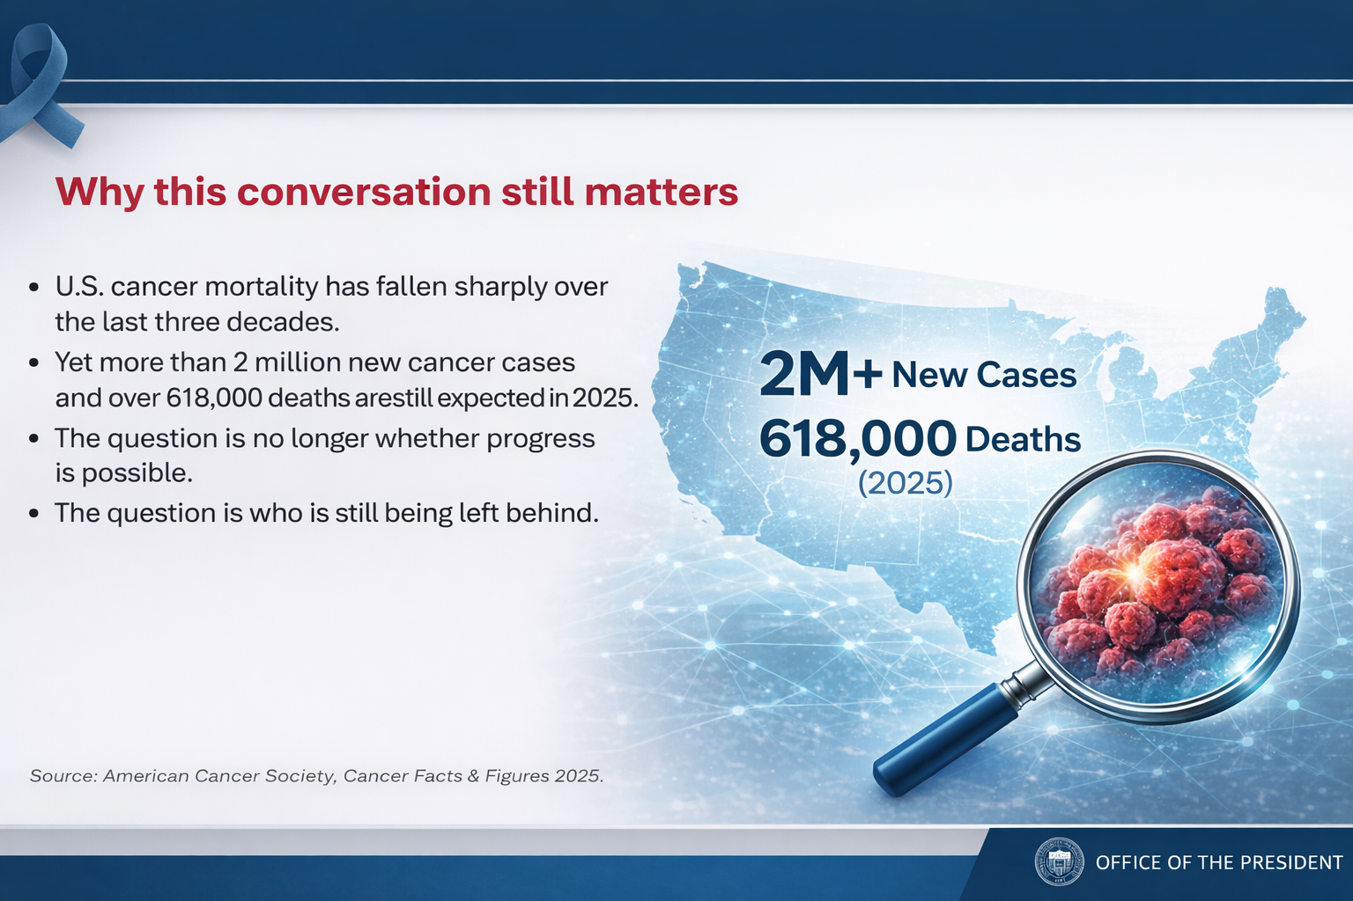
Source: American Cancer Society, Cancer Facts & Figures 2025.
Notes:
Representation in the physician workforce remains a critical issue.
Despite progress in medical school enrollment, diversity does not yet reflect the populations we serve.
This has implications for trust, communication, and ultimately, outcomes.

Slide 4
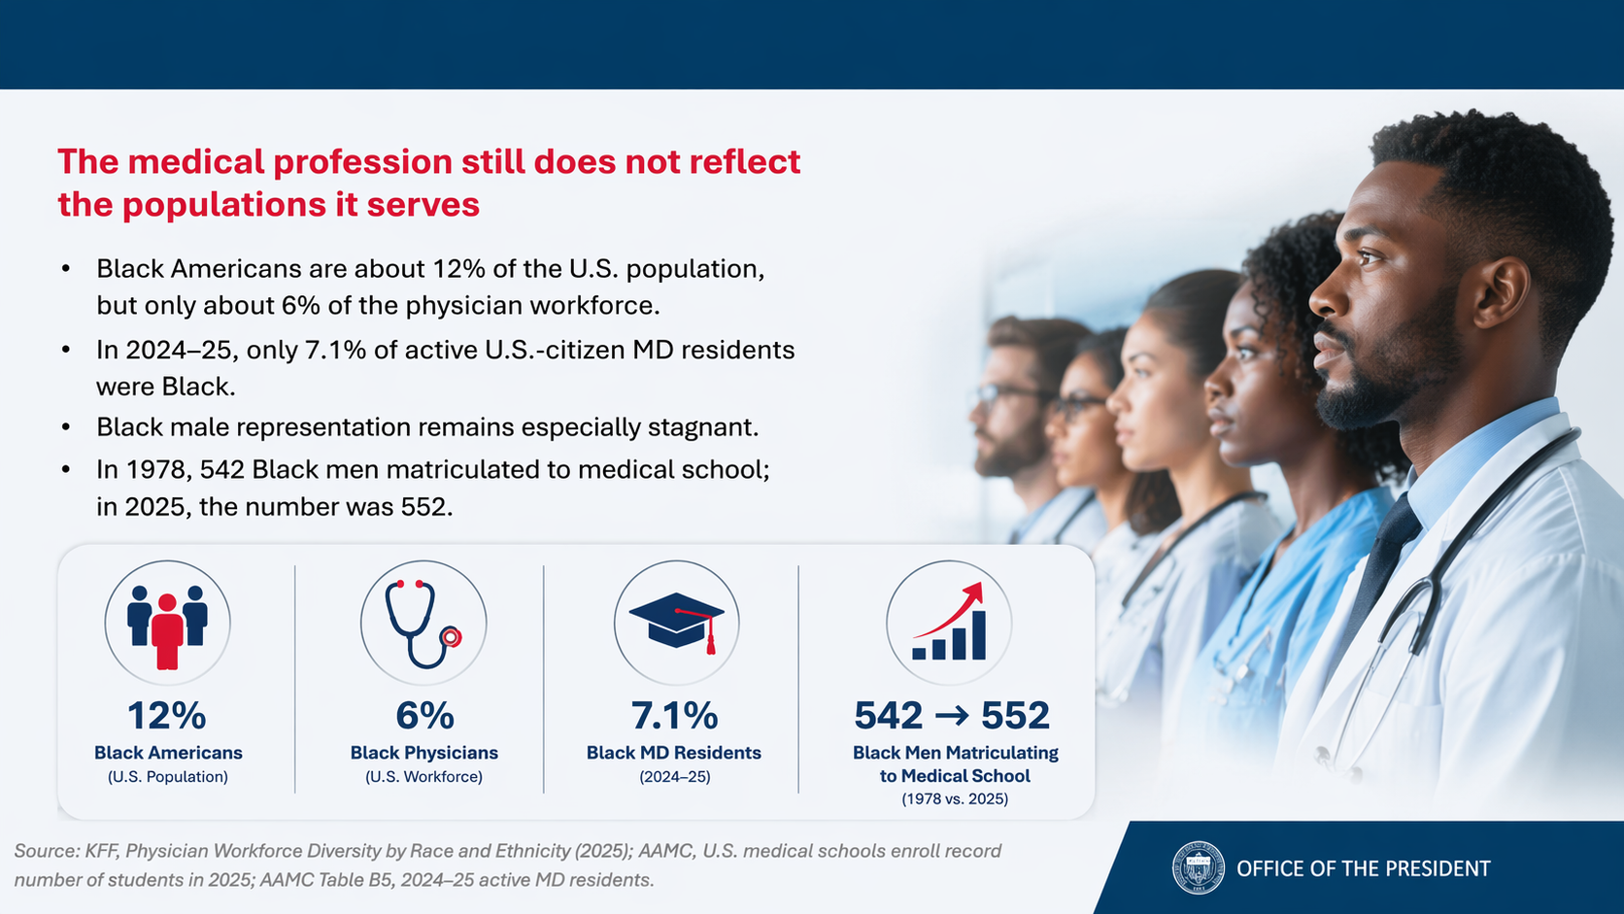
Source: KFF, Physician Workforce Diversity by Race and Ethnicity (2025); AAMC, U.S. medical schools enroll record number of students in 2025; AAMC Table B5, 2024–25 active MD residents.

Slide 5
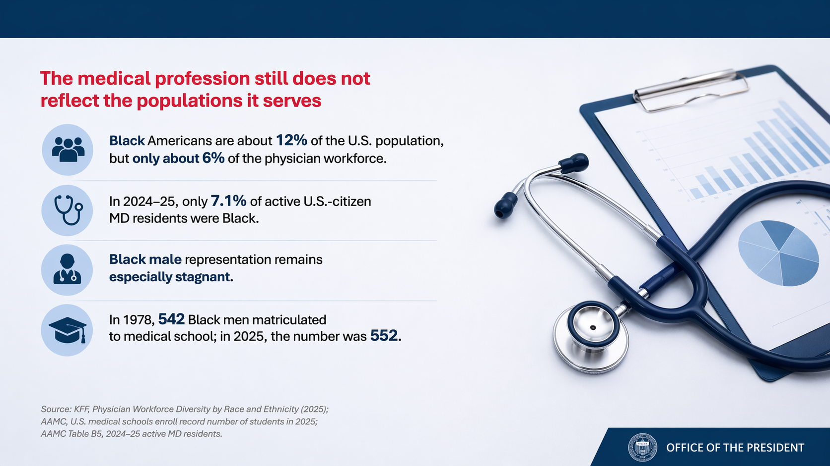
Source: KFF, Physician Workforce Diversity by Race and Ethnicity (2025); AAMC, U.S. medical schools enroll record number of students in 2025; AAMC Table B5, 2024–25 active MD residents.
Notes:
The data is consistent: Black patients face higher mortality across multiple cancer types.
These are not biological inevitabilities—they are system failures.
Our focus must be on eliminating preventable differences.

Slide 6
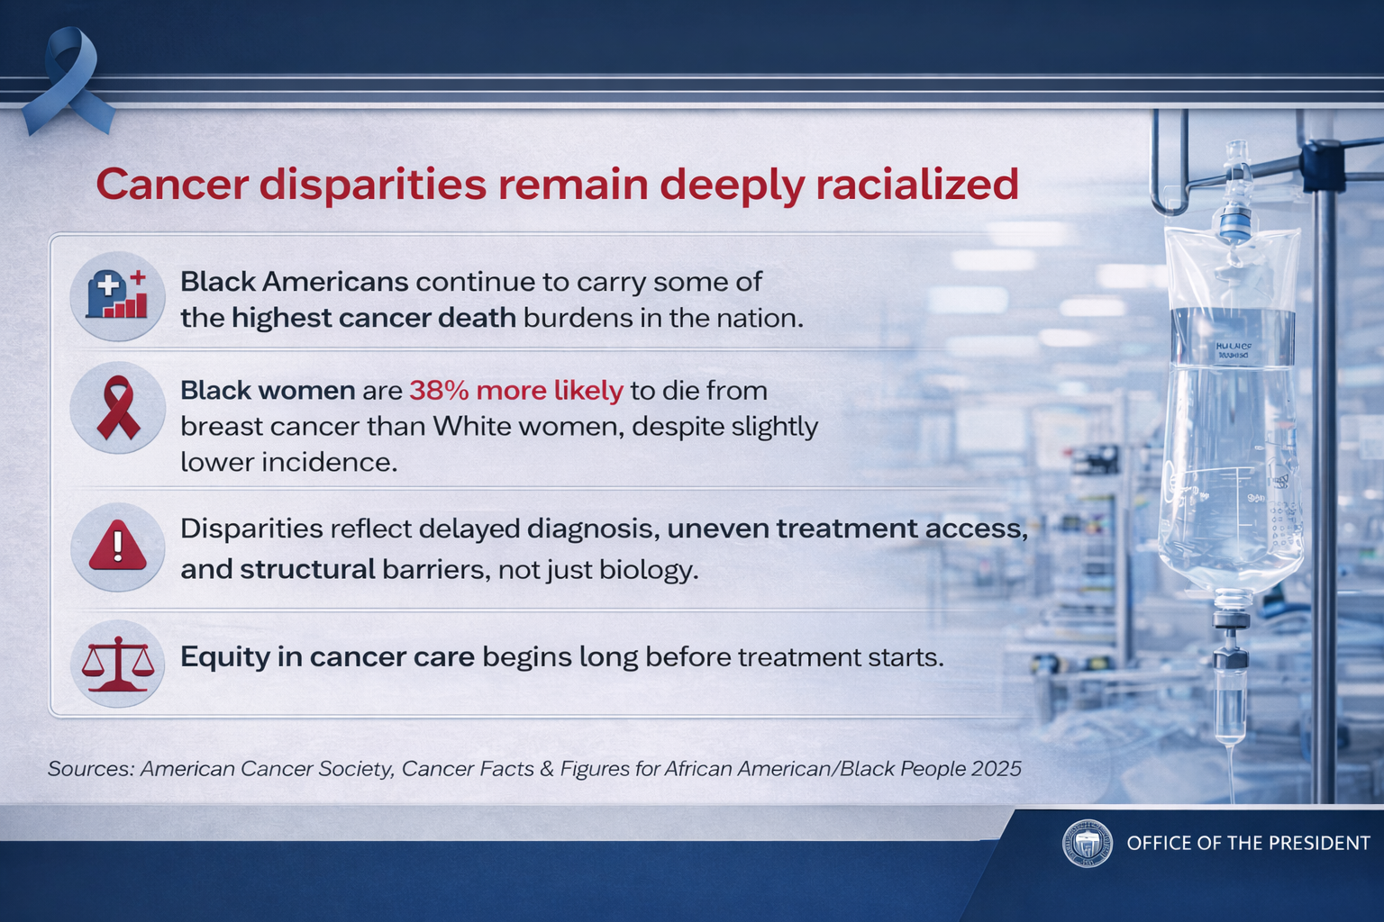
Sources: American Cancer Society, Cancer Facts & Figures for African American/Black People 2025.
Notes:
Delaware has made measurable progress—but disparities still persist.
This shows us two things: progress is possible, and progress is incomplete.
The question is not whether change can happen—it’s how we accelerate it.

Slide 7
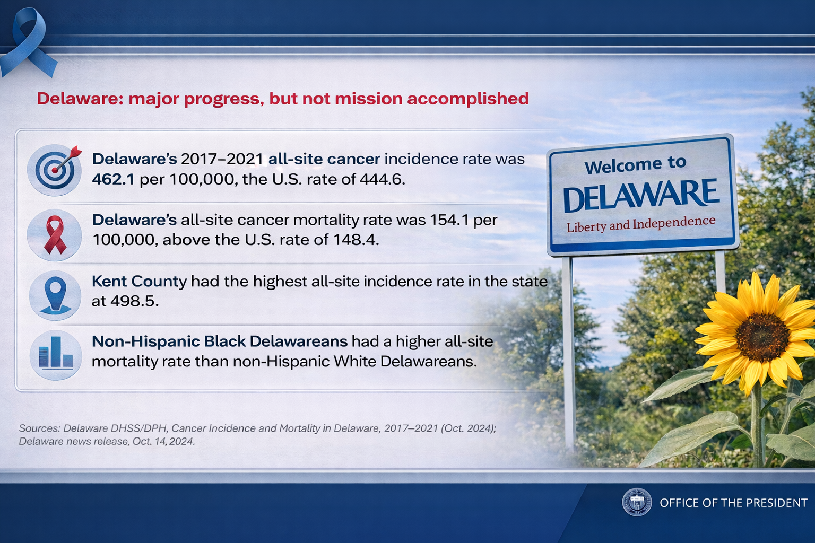
Sources: Delaware DHSS/DPH, Cancer Incidence and Mortality in Delaware, 2017–2021 (Oct. 2024); Delaware news release, Oct. 14, 2024.
Notes:
Where you live still significantly impacts your health outcomes.
Data at the neighborhood level gives us precision—it tells us where to act.
Equity work must be local, targeted, and accountable.

Slide 8
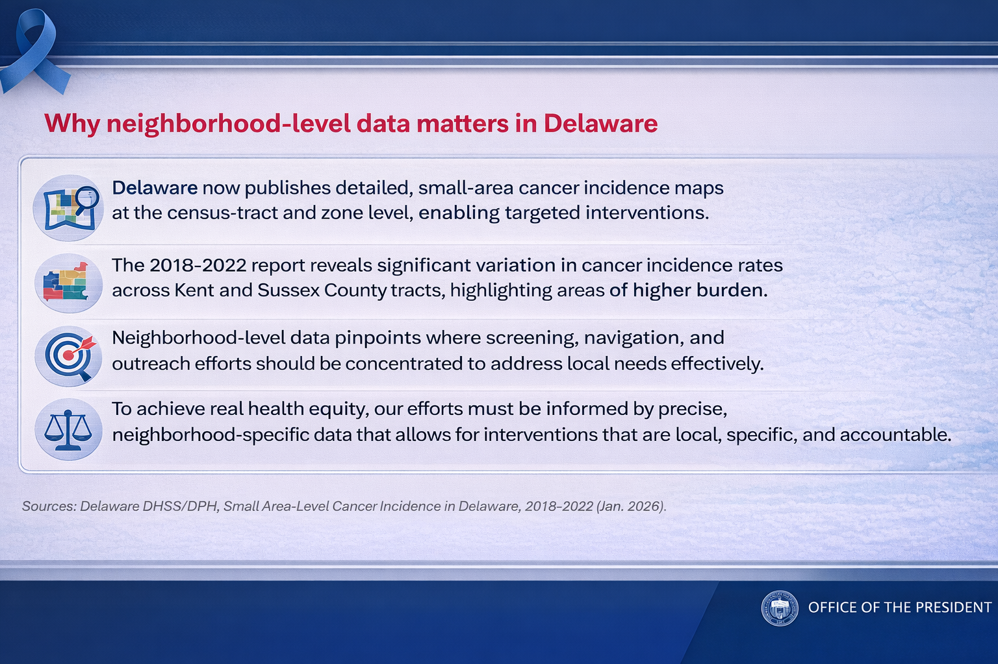
Sources: Delaware DHSS/DPH, Small Area-Level Cancer Incidence in Delaware, 2018–2022 (Jan. 2026).
Notes:
Delaware demonstrates that disparities can be reduced with intentional systems.
Screening access, navigation, and coordinated care matter.
This is not theoretical—this is operational success.

Slide 9
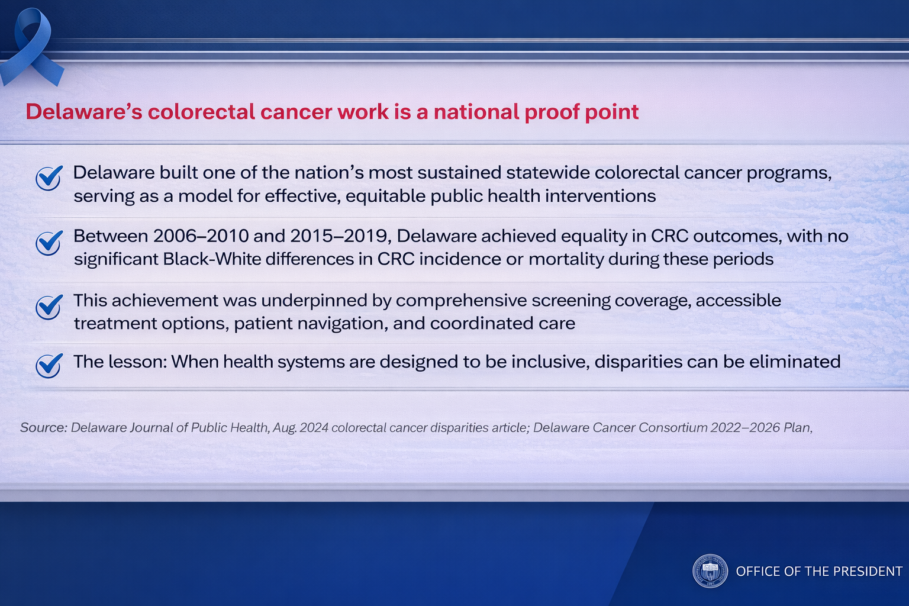
Source: Delaware Journal of Public Health, Aug. 2024 colorectal cancer disparities article; Delaware Cancer Consortium 2022–2026 Plan.
Notes:
One of the most important interventions is also one of the simplest: timing.
Screening must happen at first eligibility—not delayed.
Delays disproportionately impact underserved populations.

Slide 10
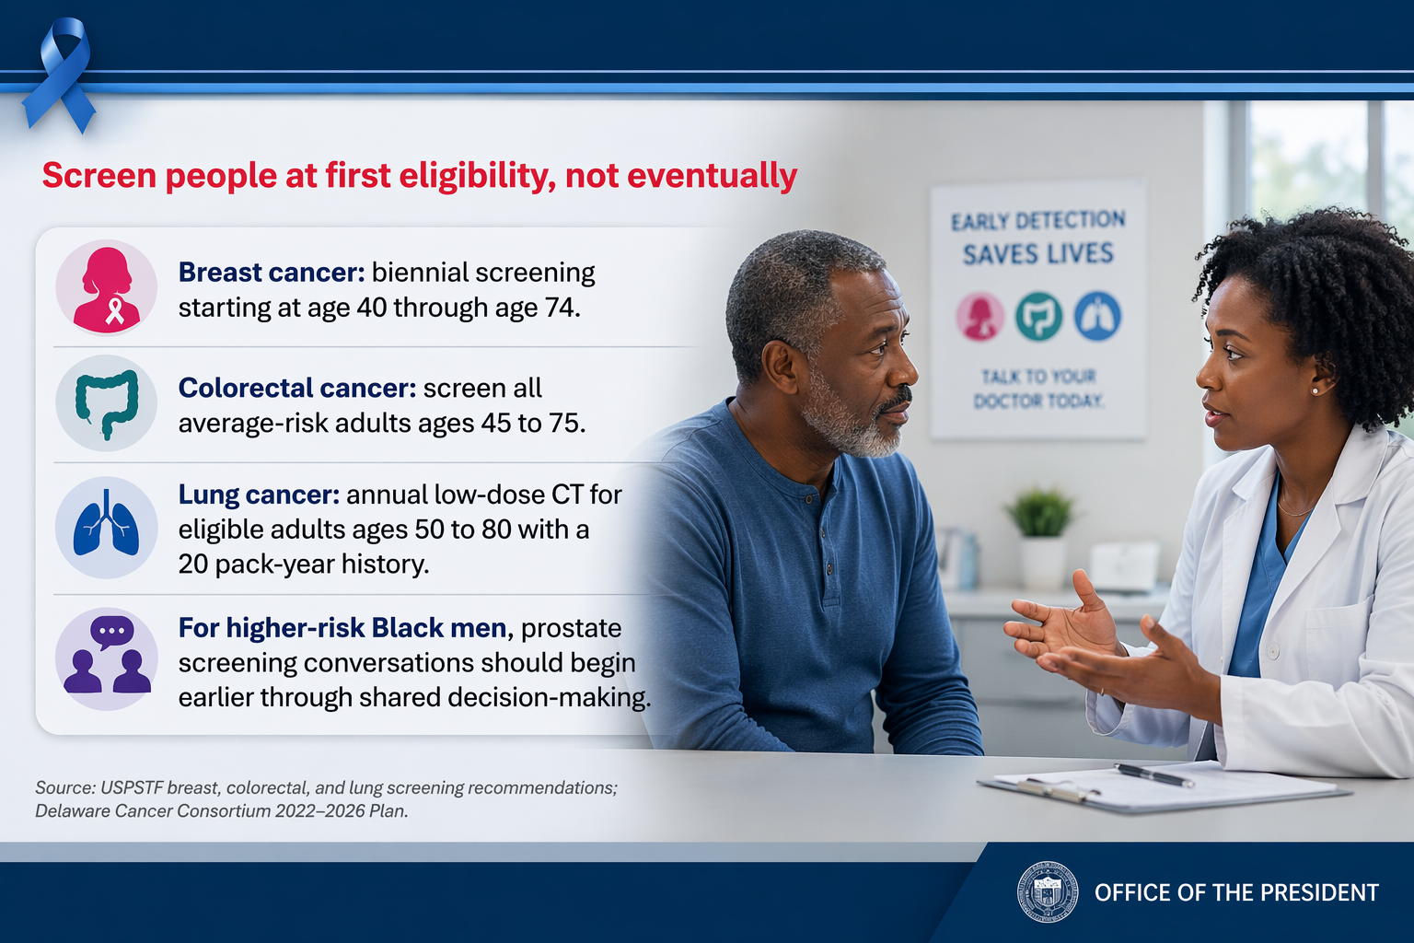
Source: USPSTF breast, colorectal, and lung screening recommendations; Delaware Cancer Consortium 2022–2026 Plan.
Notes:
We know what works: reminders, navigation, and removing barriers.
This is not a knowledge gap—it is an execution gap.
The challenge is scaling what we already know is effective.

Slide 11
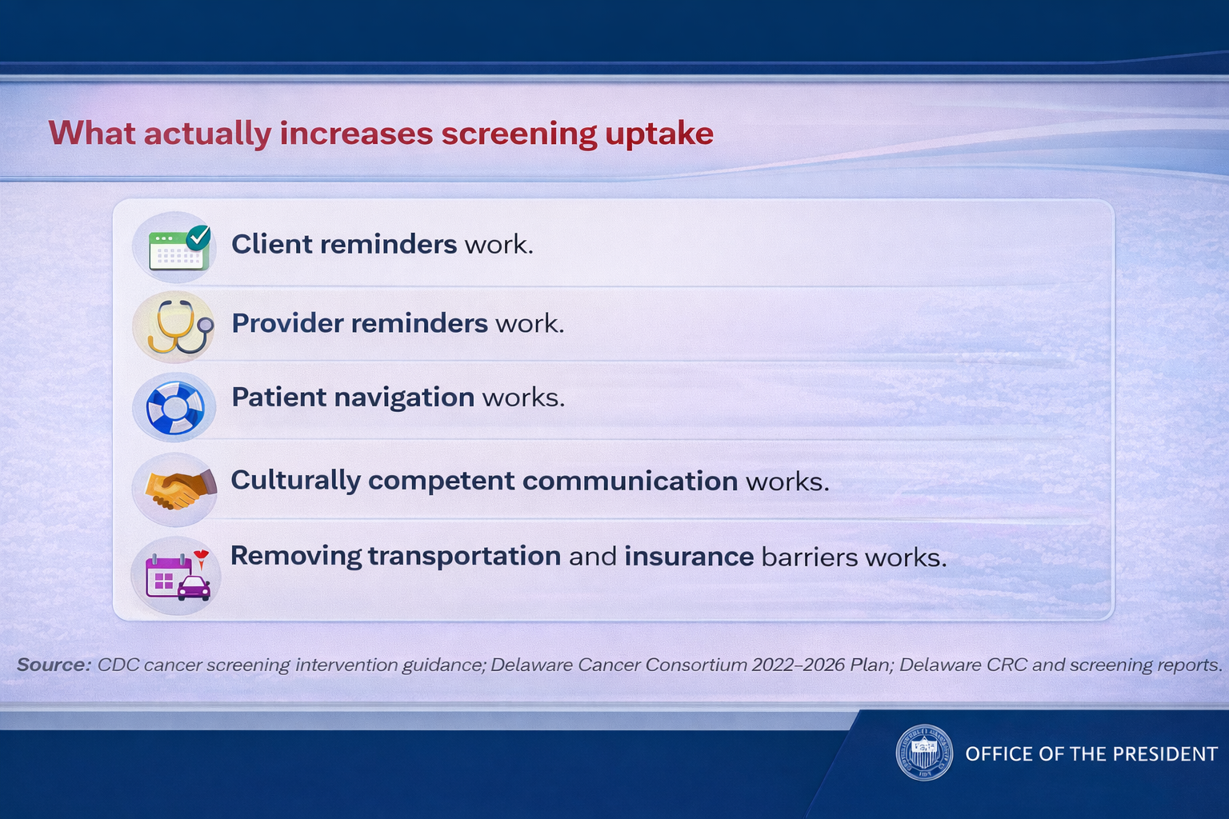
Source: CDC cancer screening intervention guidance; Delaware Cancer Consortium 2022–2026 Plan; Delaware CRC and screening reports.

Slide 12
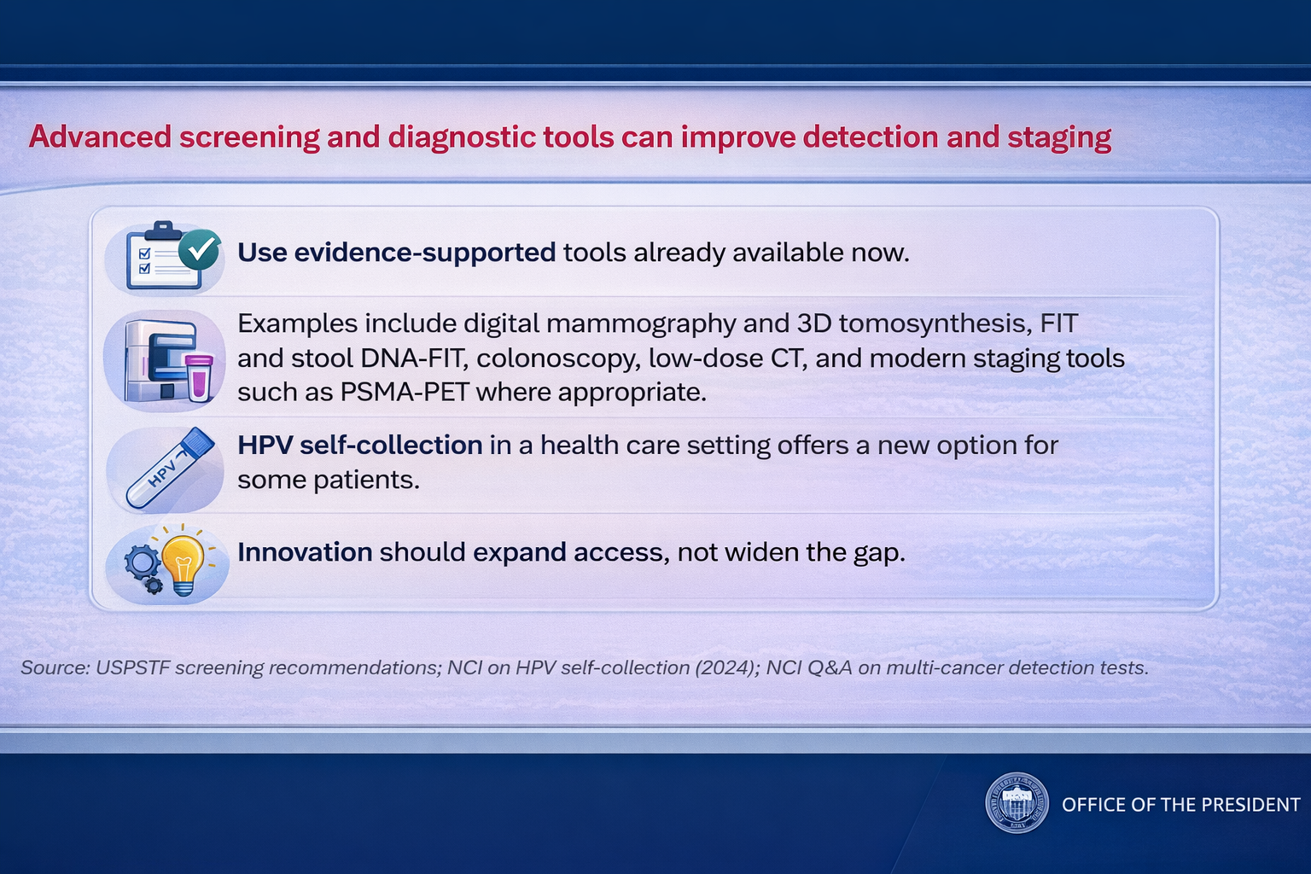
Source: USPSTF screening recommendations; NCI on HPV self-collection (2024); NCI Q&A on multi-cancer detection tests.
Notes:
We are now entering a new phase—where AI is shaping clinical decision-making.
The question is not whether AI will be used—but how it will be used.
And whether it will reduce or reinforce disparities.

Slide 13
AI & Medical Disparities

Slide 14
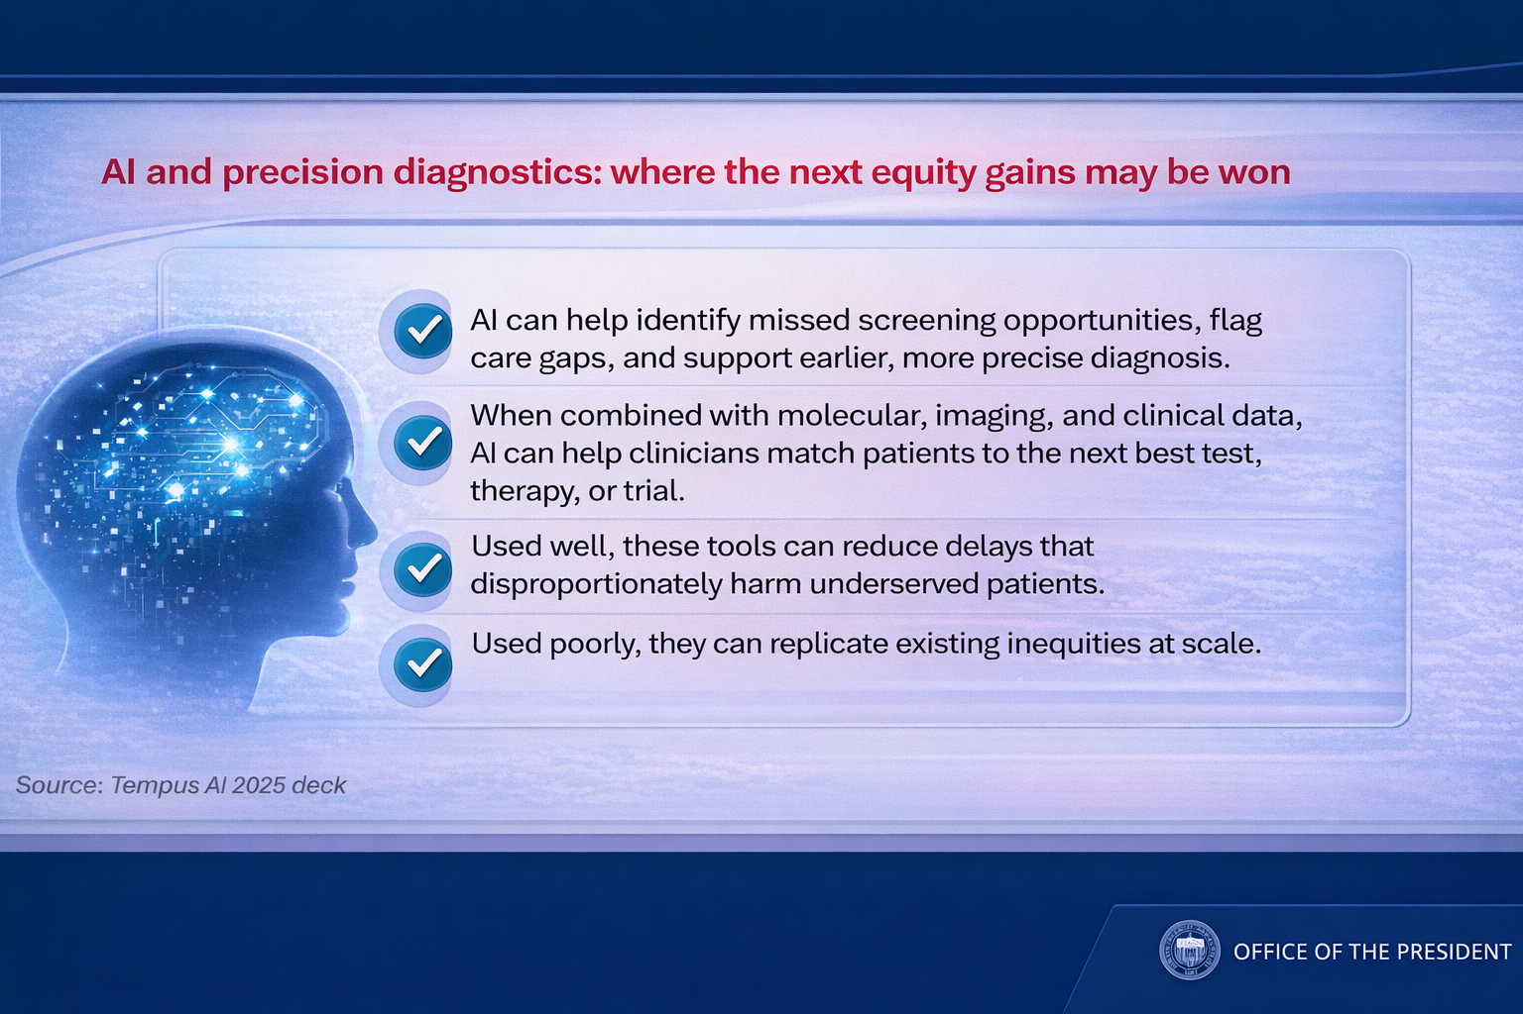
Source: Tempus AI 2025 deck
Notes:
AI reflects a broader shift toward data-driven medicine.
It enables earlier detection, better matching, and more informed decisions.
But equity depends on where and how these tools are deployed.

Slide 15
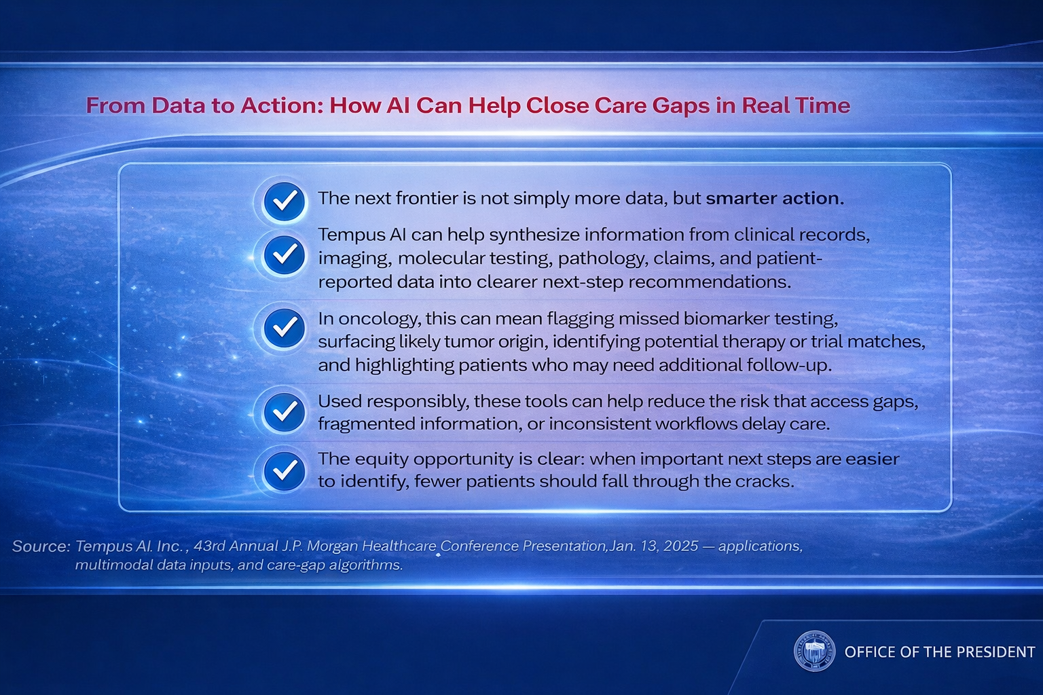
Source: Tempus AI, Inc., 43rd Annual J.P. Morgan Healthcare Conference Presentation, Jan. 13, 2025 — applications, multimodal data inputs, and care-gap algorithms.
Notes:
The opportunity is not just more data—but smarter action.
AI can help clinicians prioritize what matters most, in real time.
The goal is fewer missed opportunities and more timely care.

Slide 16
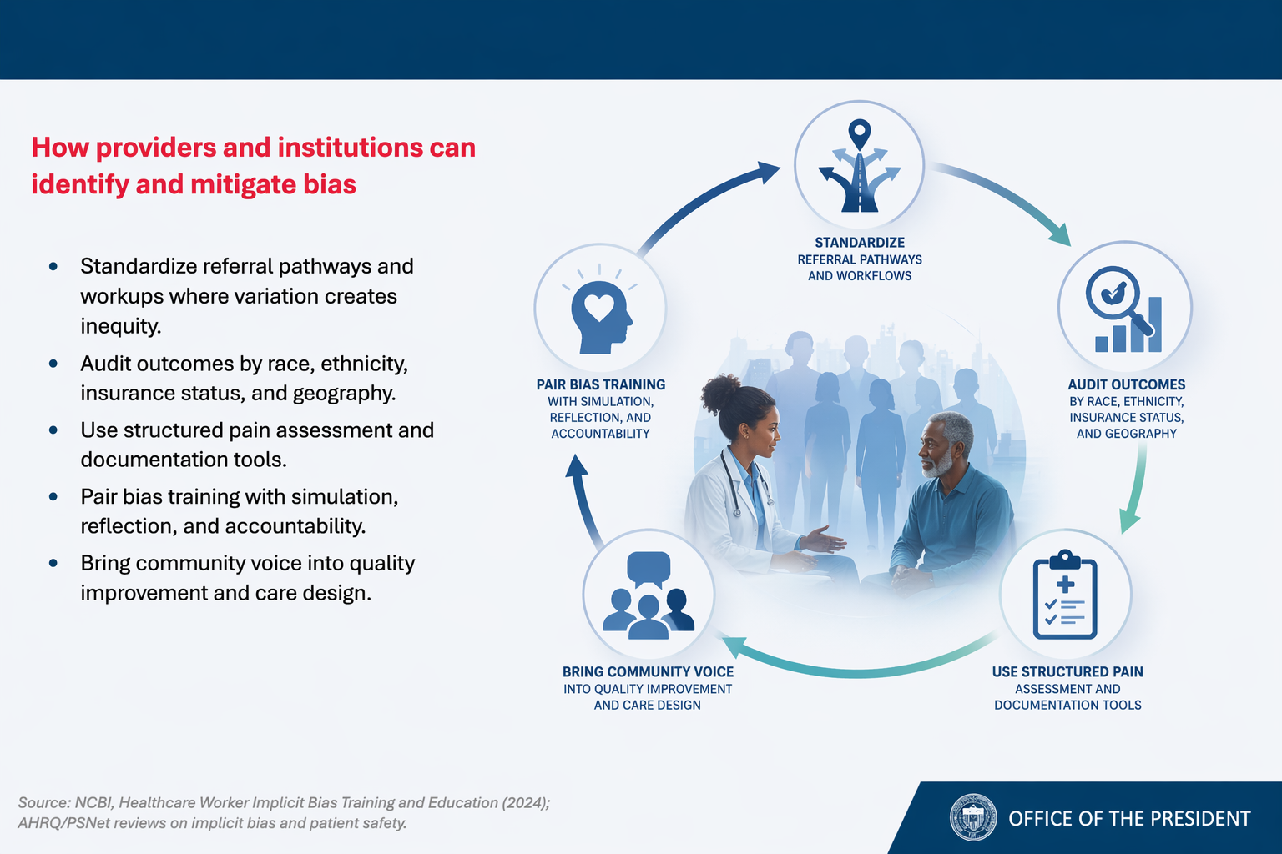
Source: NCBI, Healthcare Worker Implicit Bias Training and Education (2024); AHRQ/PSNet reviews on implicit bias and patient safety.
Notes:
Bias continues to influence clinical decisions—often unconsciously.
It affects referrals, communication, and access to care.
If equity is the goal, we must actively examine variation in practice.

Slide 17
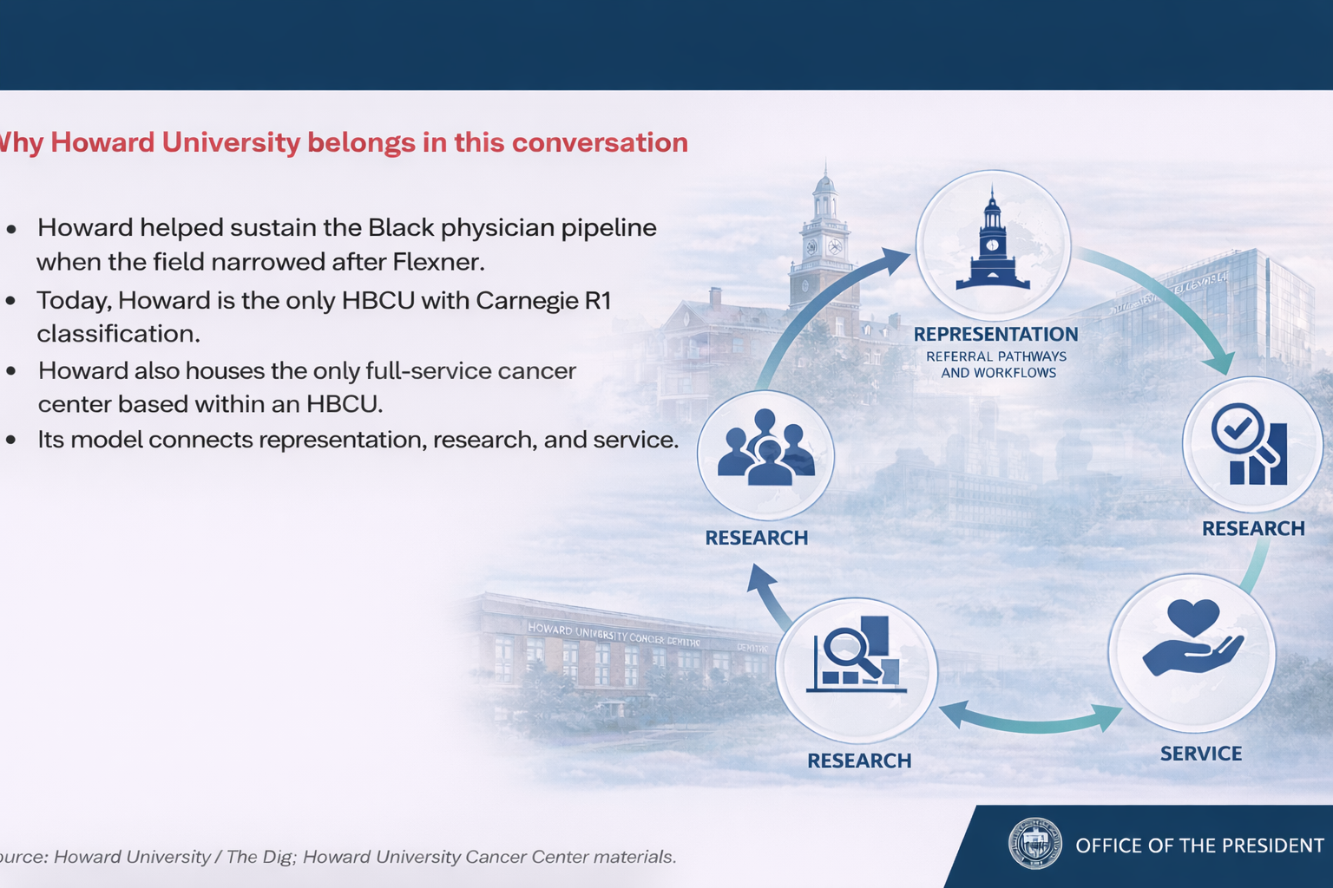
Why Howard University belongs in this conversation
Source: Howard University / The Dig; Howard University Cancer Center materials.

Slide 18
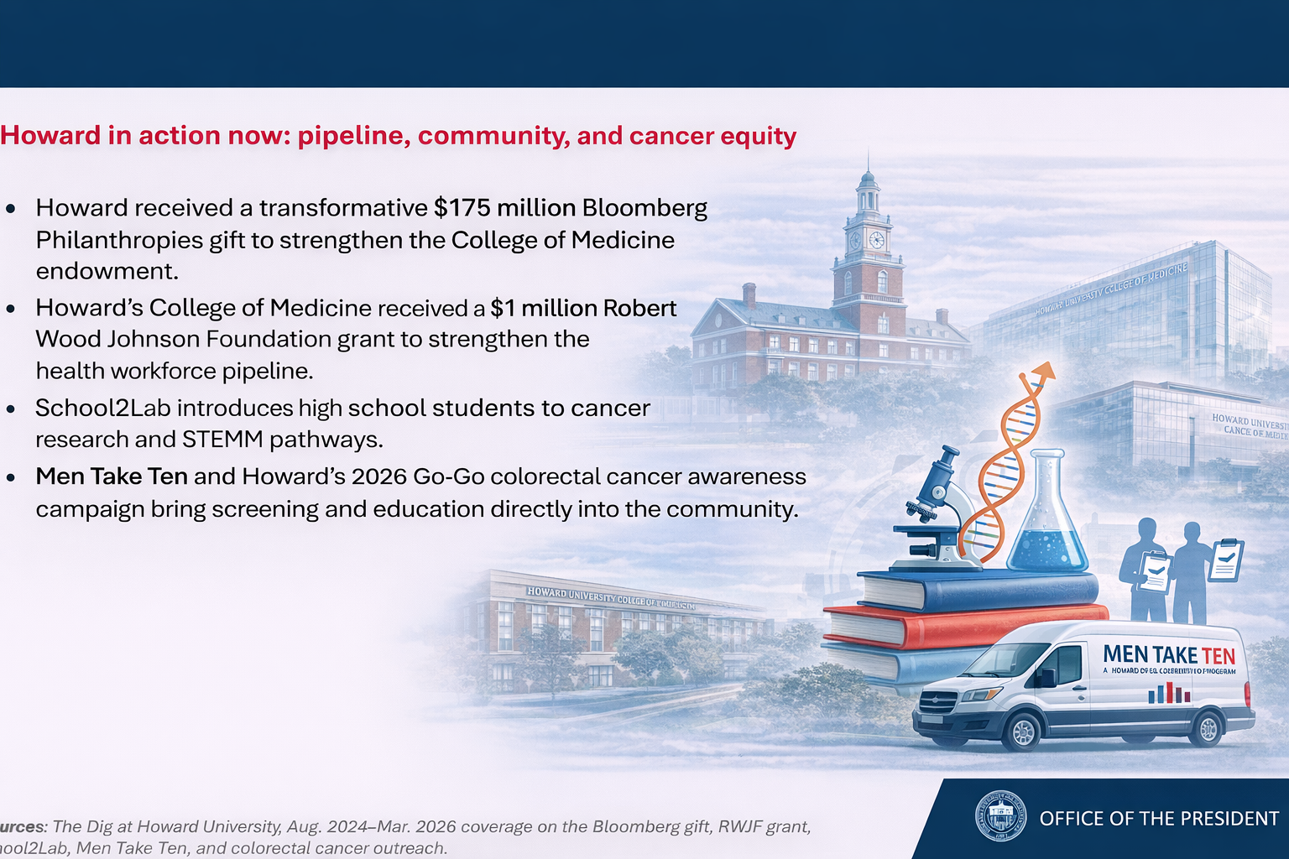
Sources: The Dig at Howard University, Aug. 2024–Mar. 2026 coverage on the Bloomberg gift, RWJF grant, School2Lab, Men Take Ten, and colorectal cancer outreach.
Sources: The Dig at Howard University, Aug. 2024–Mar. 2026 coverage on the Bloomberg gift, RWJF grant, School2Lab, Men Take Ten, and colorectal cancer outreach.
Notes:
We are not only part of the conversation—we are actively driving change.
Investments in education, research, and community engagement are central.
This is about building sustainable impact across generations.

Slide 19
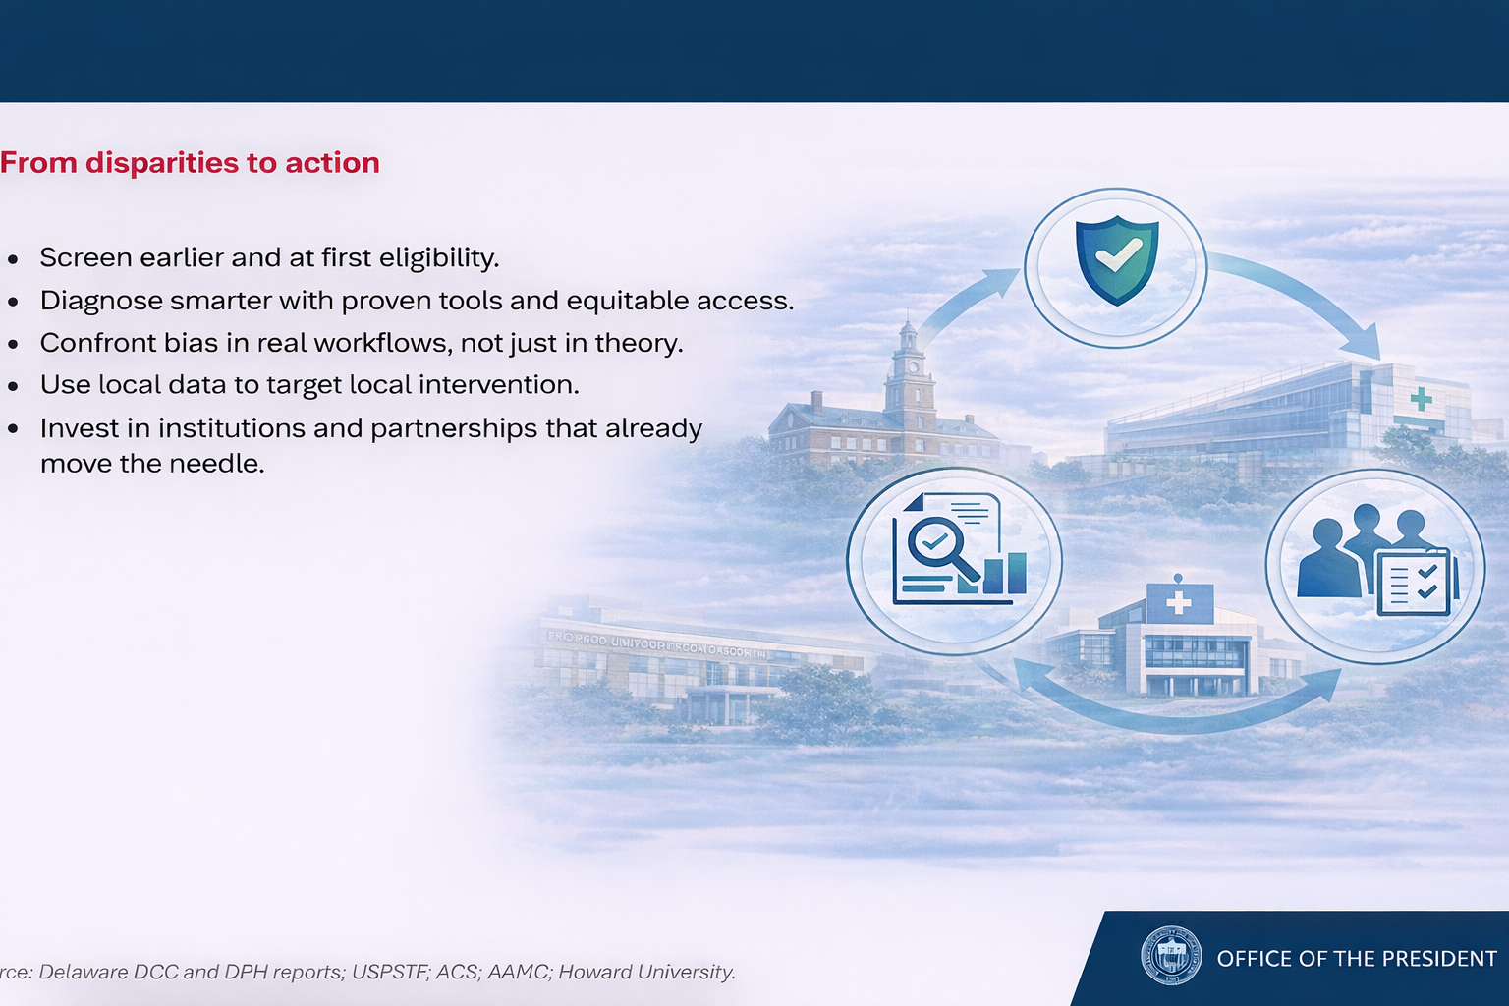
Sou Delaware DCC and DPH reports; USPSTF; ACS; AAMC; Howard University.
Source: Delaware DCC and DPH reports; USPSTF; ACS; AAMC; Howard University.
Notes:
The path forward is clear.
Screen earlier. Use data smarter. Confront bias directly.
And invest in institutions that are already moving the needle.
If we do this well, fewer patients will fall through the cracks.

Slide 20
Thank You!
Notes:
Thank you.
I look forward to continuing this conversation.

