Slide 1
KNOW THE RISKS OF VAPING.
A guide to the dangers of e-cigarettes.
Notes:
Today we are going to talk about the e-cigarette epidemic that is plaguing middle schools and high schools across the state of Delaware.

Slide 2
Some e-cigarettes are safe for youth.
TRUE
FALSE
Notes:
First, let’s get a sense of what you already know about e-cigarettes.
True or false? Some e-cigarettes are safe for youth.

Slide 3
Some e-cigarettes are safe for youth.
FALSE
Notes:
False. All e-cigarettes are unsafe for youth. We’ll talk about why today.

Slide 4
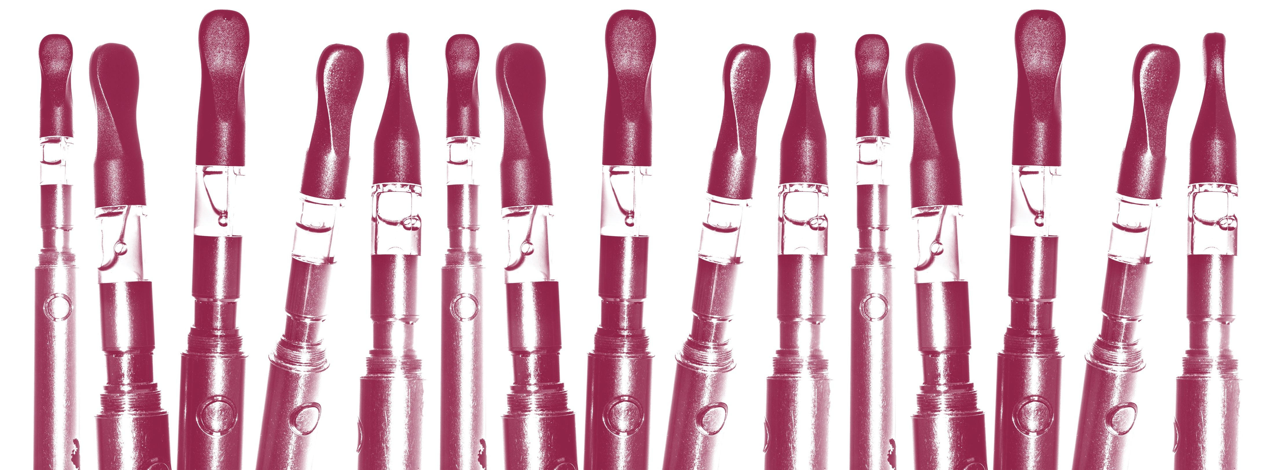
What are e-cigarettes?
What are the health risks?
What leads to e-cigarette use?
What can you do about it?
Notes:
Today’s presentation will cover four main topics.
First, we’ll talk about what e-cigarettes are.
Next, we’ll talk about why they are dangerous to the health of children, teens, and adolescents.
We’ll then look at the factors that lead to e-cigarette use in the first place.
Finally, we’ll talk about what you can do to convince youth to avoid all tobacco products, including e-cigarettes, and how you can get others involved in the fight against vaping in our schools.
Let’s start here: What is an e-cigarette?

Slide 5
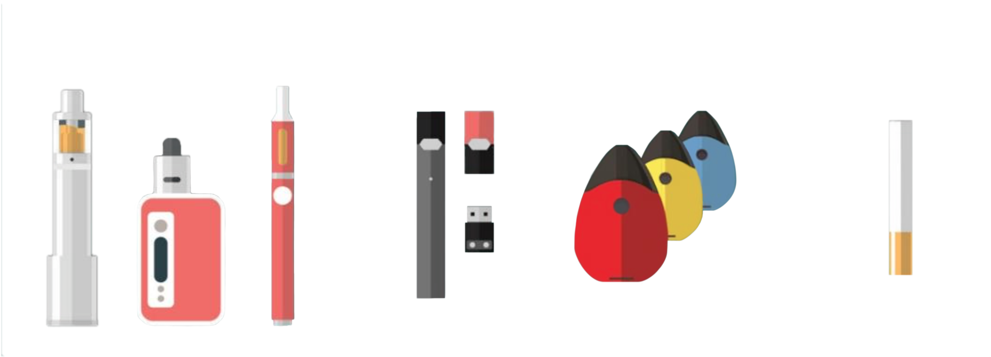
NO MATTER WHAT YOU CALL IT, IT’S AN E-CIGARETTE.
Tanks & Mods
Rechargeable e-cigarette
Disposable e-cigarette
Notes:
No matter what you call it, it’s still an e-cigarette. E-cigarettes are known by many different names. You’ve probably heard them called e-cigs, vapes, or Juuls. Juul is a brand of e-cigarette. Other brands you may have heard of include Halo, Mig Vapor, V2 Pro, Vapor-Fi, Blu, N-Joy, and White Cloud. Another brand, PAX, which looks like a flash drive, is used to deliver marijuana.

Slide 6
E-CIGARETTES COME IN MANY DIFFERENT SHAPES.
E-cigarettes are devices that heat a liquid into an aerosol that the user inhales.
Notes:
E-cigarettes come in lots of different shapes. Some look like regular tobacco products, such as cigarettes. But in recent years, we’ve seen e-cigarettes that look like other things, including USB flash drives, writing pens, and other everyday items. Disguising the devices makes them harder to recognize by parents, teachers, and other adults.
Regardless of what you call it, these are all e-cigarettes, and none of them is safe for young people to use.

Slide 7
Most e-cigarettes contain nicotine.
TRUE
FALSE
Notes:
OK, thinking about what’s in an e-cigarette, let’s check to see what you already know.
True or false? Most e-cigarettes contain nicotine.

Slide 8
Most e-cigarettes contain nicotine.
TRUE
Notes:
This is true. Most e-cigarettes contain nicotine, which is the addictive drug in regular cigarettes and other tobacco products. According to the Centers for Disease Control and Prevention (CDC), 99% of e-cigarettes contain nicotine. This is especially important for you to understand, because nicotine can harm the developing brains of adolescents. Development starts at birth and continues to about age 25.
We’ll talk more about that now.

Slide 9
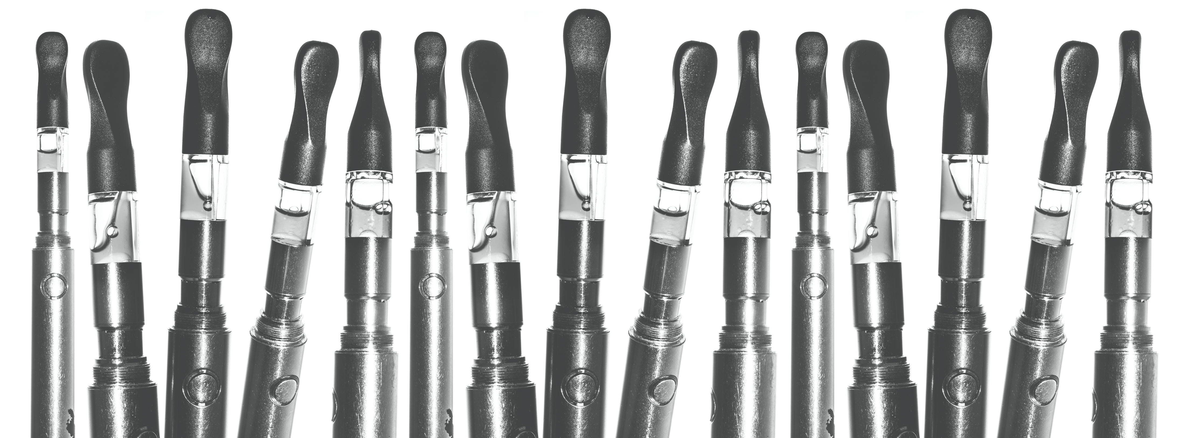
What are e-cigarettes?
What are the health risks?
What leads to e-cigarette use?
What can you do about it?
Notes:
So now we know what e-cigarettes are and that they contain nicotine. So what? Why does this matter?

Slide 10
WHAT IS NICOTINE?
nicotine
[nik-uh-teen, -tin, nik-uh-teen]
noun chemistry
a colorless, oily, water-soluble, highly toxic liquid alkaloid, C1OH14N2, found in tobacco and valued as an insecticide.
Notes:
Here you see the dictionary’s definition of nicotine. We don’t expect you to know what all these descriptive words mean, but it’s important to have a basic understanding of what nicotine is before you can understand why using an e-cigarette is risky for young people.
Nicotine is a drug found in tobacco plants. It’s the drug that makes tobacco addictive. It’s also frequently used in insecticides to kill bugs. What young person wants to take a puff of insecticide? If they knew, they wouldn’t. But, according to truthinitiative.org, 63% of youth nationwide do not know that e-cigarettes like Juul always contain nicotine.
When someone uses an e-cigarette, nicotine is quickly absorbed into the body and goes directly to the brain. Nicotine activates areas of the brain that make tobacco and e-cigarette users feel satisfied and happy. But nicotine is dangerously addictive and can prime the brain for other tobacco products — even harder drugs like cocaine, heroin, and methamphetamine.

Slide 11
NICOTINE COMES IN DIFFERENT TYPES.
What is the
pH scale?
Notes:
So we’ve told you what nicotine is, but did you know there are different types of nicotine?
Some of you may understand chemistry or may have heard about the pH scale, which measures what chemicals are in liquids, such as in a swimming pool or hot tub.
So, why are we showing you this? Well, pH matters when it comes to how harsh nicotine is on the body, particularly a person’s throat when they inhale.
Most nicotine in regular cigarettes and e-cigarettes is what we call free-base nicotine, which means it’s very blue on the pH scale. The more blue on the scale, the more volatile or crazy it’s going to be, which means that it will be harsher on your throat.
Nicotine salts are easier on your throat. This is of particular concern for young people, because it allows for nicotine to be used more easily, which increases the likelihood of trying an e-cigarette and getting hooked.
Juul’s nicotine salt formulation also increases the rate and amount of nicotine delivered into the blood, compared with other formulations. The manufacturer of Juul claims it delivers nicotine up to 2.7 times faster than other e-cigarettes.

Slide 12
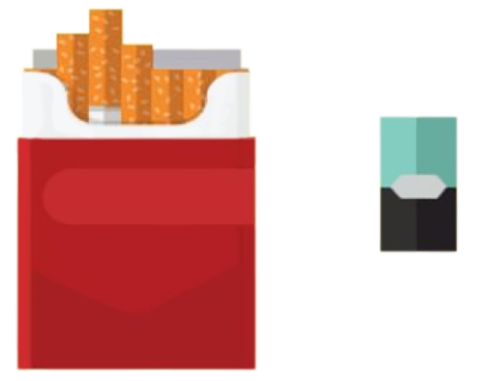
JUUL CONTAINS A HIGH AMOUNT OF NICOTINE.
=
All Juul e-cigarettes have a high level of nicotine. According to the manufacturer, a single Juul pod contains as much nicotine as a pack of regular cigarettes.
Notes:
All Juul e-cigarettes have a high level of nicotine — among the highest of all e-cigarettes on the market. When Juul was introduced in 2015, other e-cigarettes contained nicotine strengths of roughly 1% to 2.5%. Juul pods contain 5% nicotine strength — double the strength.
Juul’s nicotine liquid refills are called pods. A single Juul pod contains at least as much nicotine as a pack of 20 regular cigarettes. Some other brands contain even more nicotine.

Slide 13
Nicotine harms brain development.
TRUE
FALSE
Notes:
Now that we’ve learned about the risks of nicotine, let’s talk about why that matters to a young person’s health.
In this section, we’ll talk about a variety of risks from e-cigarette use. Let’s start with the brain.
True or false? Nicotine harms brain development.

Slide 14
Nicotine harms brain development.
TRUE
Notes:
The answer is true. Remember, most e-cigarettes contain nicotine, which is highly addictive and can harm brain development.

Slide 15
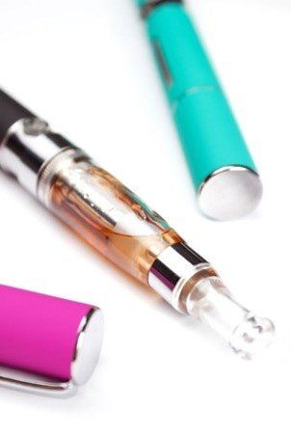
HOW DOES NICOTINE IN E-CIGARETTES IMPACT THE BRAIN?
Youth who use nicotine can harm the parts of the brain that control attention, learning, mood, and impulse control.
Notes:
Important growth happens continually in the adolescent brain from birth until about age 25. The brain is actually the last organ in the human body to develop fully. Exposing a young brain to nicotine during its development phase can harm the brain and result in addiction.
Why? Think about it like this: Each time a new memory is created or a new skill is learned, stronger connections — or synapses — are built between brain cells. Nicotine changes the way these connections, or synapses, are formed, which can harm the parts of the brain that control attention and learning.
Although adults may use nicotine products such as e-cigarettes to quit smoking, for youth, any exposure to nicotine is unsafe. Additionally, e-cigarettes and vaping devices are not approved by the FDA as smoking cessation devices.

Slide 16
NICOTINE CAN LEAD TO ADDICTION.
It’s not like you can buy a new brain.
The human brain is the last organ to fully develop, around the age of 25. The nicotine in e-cigarettes can harm the developing brain and promote addiction in youth and young adults. Let’s protect our kids. Learn how at e-cigarettes.surgeongeneral.gov.
Notes:
So let’s talk about addiction.
Because addiction is a form of learning, young people can get addicted more easily than adults.
The nicotine in e-cigarettes and other tobacco products can also prime your brain for addiction to other drugs, such as cocaine.
And as the ad here says, it’s not like you can just go out and buy a new brain, protect the one you have.

Slide 17
BEHAVIOR RISKS
Youth who use e-cigarettes may be more likely to smoke regular cigarettes in the future.
Notes:
Another risk for young e-cigarette users is that they are more likely to go on to smoke cigarettes, even if they think they never will.
Use of two or more tobacco products is common among middle and high school students. Many young people who use e-cigarettes also smoke cigarettes.
So the best thing to do to protect young people’s health is to convince them to not use any tobacco products at all. No matter how it’s delivered — whether via an e-cigarette or a cigarette — nicotine is harmful to the health of young people.

Slide 18
E-cigarettes create harmless water vapor.
TRUE
FALSE
Notes:
Let’s do another knowledge check. True or false? E-cigarettes create a harmless water vapor.

Slide 19
E-cigarettes create harmless water vapor.
FALSE
Notes:
The answer is false.
E-cigarettes allow the user to exhale clouds that may appear to be “harmless water vapor.” The tobacco industry prefers the word “vapor,” which implies that it’s harmless. But it is not harmless.
E-cigarettes create an aerosol, which is a mixture of particles in the air that can be harmful to young people’s health.

Slide 20
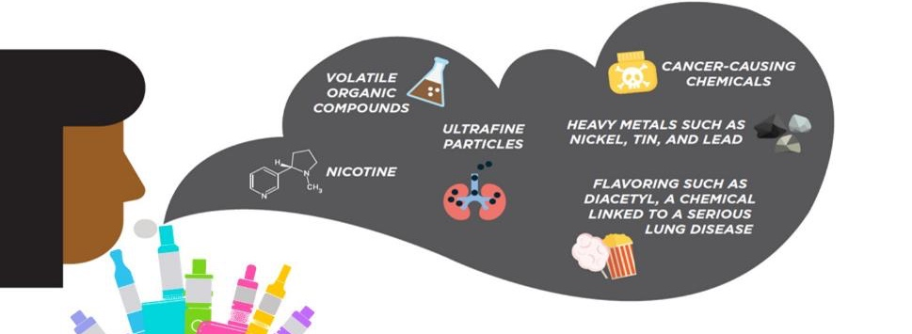
E-CIGARETTES MAKE AEROSOL, NOT VAPOR.
The e-cigarette aerosol that users breathe in from the device and then exhale contains harmful and potentially deadly substances:
Notes:
Do you know what gets inhaled into the body when someone uses an e-cigarette?
Besides nicotine, e-cigarette aerosol can contain cancer-causing chemicals, heavy metals, and ultrafine particles that can be inhaled deeply into the lungs and can harm the body.
And even though e-cigarette aerosol generally contains fewer harmful chemicals than regular cigarettes, safer doesn’t mean safe. This applies to both e-cigarette users and those who may be exposed to secondhand aerosol from others’ e-cigarettes.
By the way, those flavorings in e-cigarettes aren’t necessarily safe either. A person’s gut can handle a lot more than their lungs, and flavorings in e-liquids or pods may not be safe when inhaled.

Slide 21
AN EPIDEMIC: VAPING-RELATED LUNG DAMAGE.
2,561
The CDC reported that e-cigarette or vaping-related product use was associated with lung injury (EVALI) in 50 states.
cases
20
in Delaware
Notes:
People’s lungs are paying the price of vaping. As of December 27, 2019, the CDC reported 2,561 cases of lung illness hospitalizations in 50 states, including 20 cases in Delaware.

Slide 22
A DEADLY EPIDEMIC LINKED TO VAPING THC.
55
The CDC reported deaths associated with vitamin E acetate, a thickening agent in THC-containing e-cigarettes.
deaths
1
in Delaware
Notes:
People are also dying from vaping. CDC findings suggest that THC-containing e-cigarettes are the root cause of 55 deaths nationwide, including one death in Delaware, as of December 27, 2019. But evidence is not yet sufficient to rule out other e-cigarette chemicals as contributors.

Slide 23
SO, WHAT SHOULD DELAWAREANS DO?
The CDC recommends that people, especially young people:
Do not use THC-containing e-cigarettes or vaping products.
Do not buy any type of e-cigarette, particularly those containing THC, from informal sources such as friends, family, or in-person or online dealers.
Do not modify or add any substance to e-cigarettes or vaping products that is not intended by the manufacturer.
Notes:
Now that you know the truth about the high levels of nicotine in e-cigarettes, and the additional danger of THC-containing e-cigarettes, here’s what you should say to young people who vape or are considering starting.
First, do not use THC-containing e-cigarettes or vaping products. Second, don’t buy any e-cigs, especially those containing THC, from friends, family, or in-person or online dealers. And finally, do not modify or add any substance to e-cigarettes or vaping products that was not intended by the manufacturer.
Bottom line, no e-cigarette or vaping device of any kind is safe for use by young people, under any circumstances.

Slide 24
WHAT KIDS DON’T KNOW.
Visit thedirtytruth.com to learn about the dangers that e-cigarettes pose to our children and teens.
Notes:
Our website, thedirtytruth.com, was created to help children, teens, and parents learn the facts about e-cigarettes — from the toxic chemicals and ingredients contained in e-liquids to the effects of nicotine addiction and more.

Slide 25
E-CIGARETTE POISONINGS
Source: American Association of Poison Control Centers
Notes:
And if that’s not scary enough, children and adults have been poisoned by swallowing, breathing, or absorbing e-cigarette liquid through their skin or eyes.
Just look at the increase in calls to poison control centers across the country, where people call for help when they’ve been exposed to poisons or other harmful things. There are nearly 4,000 calls per year from e-cigarettes alone! And it’s increased over time.

Slide 26
DEFECTIVE E-CIGARETTE BATTERIES CAN CAUSE FIRES AND EXPLOSIONS.
Notes:
In addition to potential poisoning from e-cigarettes, defective e-cigarette batteries have caused fires and explosions, some of which have resulted in serious injury. Most explosions happen when e-cigarette batteries are being charged.
Here are some real-life examples. Don’t assume any e-cigarette device is safe.

Slide 27
What are e-cigarettes?
What are the health risks?
What leads to e-cigarette use?
What can you do about it?
Notes:
So, what leads to e-cigarette use among youth?

Slide 28
SURGE IN E-CIGARETTE USE AMONG YOUTH
78%
20.8%
Increase among high school students
11.7%
Source:
Centers for Disease Control and Prevention
2017
2018
Notes:
We know that e-cigarette use has risen among youth, particularly in the past few years. Since 2014, e-cigarettes have been the most commonly used tobacco product among youth.
In the United States, youth are about seven times more likely to use e-cigarettes than adults!

Slide 29
IN DELAWARE ALONE
13.6%
37.9%
of high school students report vaping regularly.
report having tried an e-cigarette.
Notes:
According to the results of Delaware’s 2017 Youth Risk Behavior Survey, 13.6% of our school students reported vaping regularly, and a whopping 37.9% reported having tried an e-cigarette in the last 30 days. And we expect to see these numbers increase when the 2019 survey comes out.
But why is this happening?

Slide 30
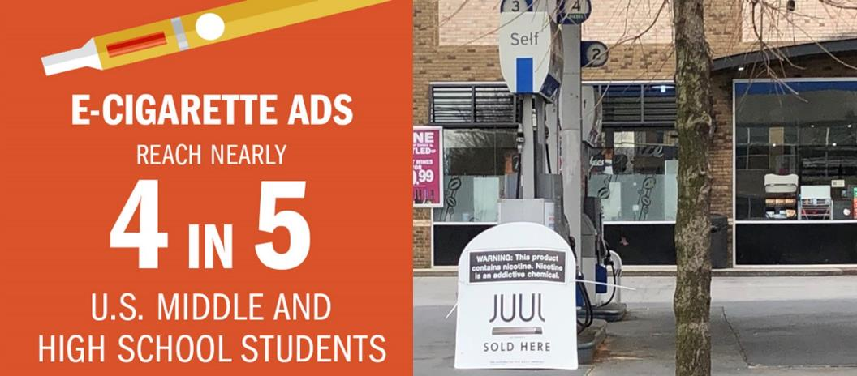
YOUTH EXPOSURE TO E-CIGARETTE ADVERTISING IS INCREASING.
Notes:
Youth exposure to e-cigarette marketing in increasing. One of the main reasons is advertising.
And these messages come in many different forms — store signs, television ads, movies, the internet, social media ads, magazines with cool images, newspapers. It’s all around us.
E-cigarette ads reach nearly 4 in 5 middle and high school students, and youth exposure to these ads has increased in recent years.

Slide 31
EXAMPLE OF E-CIGARETTE ADVERTISING
Sources: Marlboro ad on Google images , Vintage cigarette ads on Google images, JUUL billboard in NYC, blu eCig ad
Notes:
Here are a few examples of how they’re doing it.
E-cigarette ads are using themes that include sexual content, independence, and rebellion, as well as celebrity figures, to appeal to youth and young adults. Signs like this one in the middle, “Juul sold here,” are popping up at gas stations and convenience stores, making e-cigarettes seem easily accessible.
Delaware passed Senate Bill 25, which increased the age to legally purchase e-cigarettes and vape products to 21, on July 16, 2019.
In December 2019, the federal government passed legislation to raise the age to legally purchase e-cigarettes and vaping products to 21, nationwide.

Slide 32
The tobacco industry is in the e-cigarette game.
TRUE
FALSE
Notes:
Let’s do another knowledge check: True or false? The tobacco industry is in the e-cigarette game.

Slide 33
The tobacco industry is in the e-cigarette game.
TRUE
Notes:
The answer is true. Big tobacco companies are moving to e-cigarettes to target a new generation of users, and that includes middle and high school students.

Slide 34
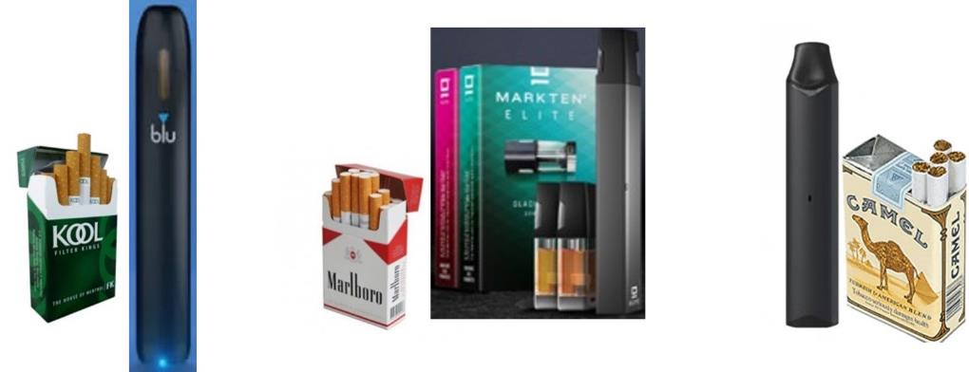
SAME PLAYERS, NEW PRODUCTS
Notes:
Some of the brands behind these new products are actually the same companies that produce traditional cigarettes.
For example, the company that sells Kool also sells Blu; Marlboro sells Mark Ten; and Camel sells Vuse. Tobacco giant Altria, maker of Marlboro cigarettes, paid $13 billion to get in on Juul.

Slide 35
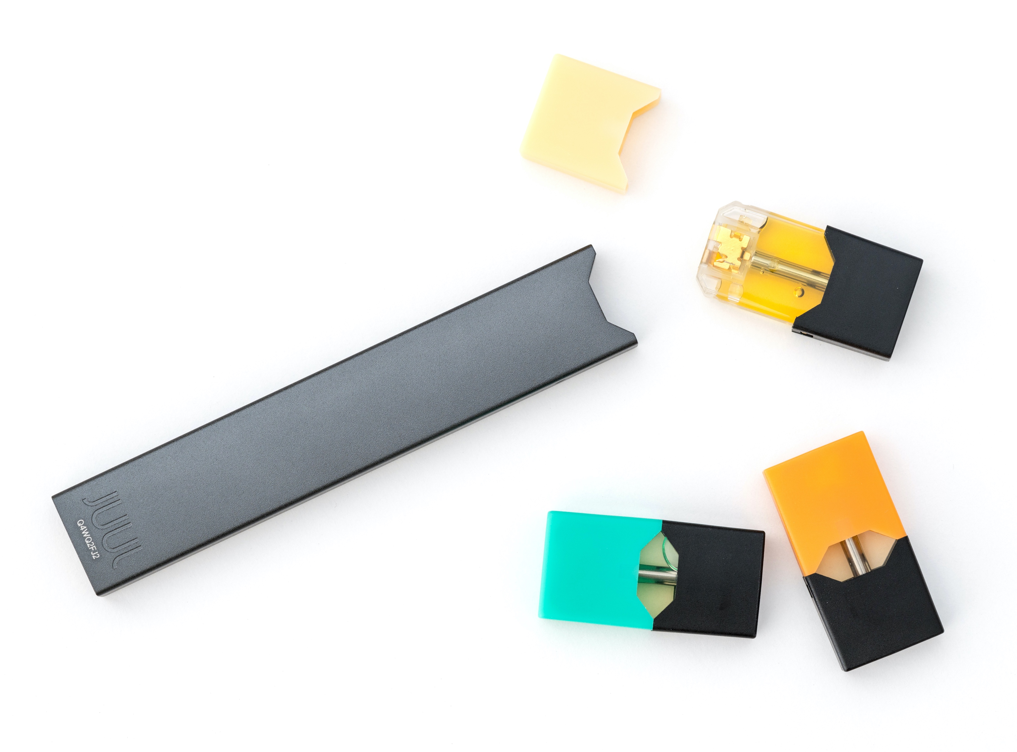
USE OF FLAVORS IS PROMINENT AMONG YOUTH.
Menthol
Alcohol
Candy
Fruit
Chocolate
Sweets
Source: U.S. Department of Health and Human Services.
E-Cigarette Use Among Youth and Young Adults: A Report of the Surgeon General—Executive Summary.
Notes:
In addition to advertising, we also know that flavors influence youth use. For example, many e-cigarettes contain fruit, candy, alcohol, or other flavors that youth find attractive and interesting.
Most kids who use e-cigarettes do so because of the appeal of the flavors. But as of January 2020, the U.S. Food and Drug Administration (FDA) has taken a stand against certain unauthorized flavored e-cigarette products, including fruit and mint flavors. If manufacturers do not cease making, distributing, and selling unauthorized flavors (other than tobacco or menthol), they risk FDA enforcement action within 30 days.

Slide 36
What are e-cigarettes?
What are the health risks?
What leads to e-cigarette use?
What can you do about it?
Notes:
So, finally, what can you do about the problem of youth e-cigarette use in Delaware?

Slide 37
HELP KIDS BE TOBACCO-FREE!
Have them contact the Delaware Quitline for help to quit vaping.
Youth as young as age 13 may now call to enroll.
1-866-409-1858
Notes:
If your kids have not begun using tobacco or e-cigarettes, encourage them to stay tobacco-free. Most teens still don’t use e-cigarettes or tobacco products. And for those who do, the sooner they quit, the better. And the Delaware Quitline is here to help them, at 1-866-409-1858.

Slide 38
HOW THE DELAWARE QUITLINE HELPS KIDS
Phone
Online
Notes:
Kids in Delaware as young as 13 can now make a confidential call and speak candidly with a compassionate quit support specialist. Or they can go online to QuitNow.net/Delaware.
There, kids can find Quit Coaches® who’ll help them conquer their vaping urges at their own pace, with helpful tips, action plans, and more.

Slide 39
KIDS DON’T HAVE TO GO IT ALONE.
Asking for help is smart.
Slip-ups are normal. Keep trying.
Help increases their chance of success.
Notes:
Most importantly, with help to quit, kids don’t have to go it alone.
Asking for help isn’t weak. It’s a smart move. Teens can feel comfortable speaking to friends or adults they trust about quitting.
It’s also normal for people to slip up when they’re trying to quit. A slip-up is not a failure. It just means they might want to try quitting another way.
Plus, research shows that having support to quit can triple a person’s chances of quitting successfully.

Slide 40
AVOID SECONDHAND EXPOSURE.
Notes:
Advise kids who don’t vape to avoid secondhand aerosol, which we know can contain harmful ingredients.
Also suggest that they not be around anyone who vapes or smokes, young or old, in the first place.

Slide 41
ENCOURAGE THE ADOPTION AND ENFORCEMENT OF TOBACCO-FREE, VAPE-FREE POLICIES.
Notes:
When it comes to our children’s schools — and even our cars and our homes — we want to ensure these environments are smoke-free and vape-free, if they aren’t already.
Check with your child’s school administrators to ensure they’re providing learning environments that are completely tobacco-free, including being free of e-cigarettes, even after hours.

Slide 42
SPREAD THE WORD AND GET INVOLVED.
Talk with community leaders about e-cigarettes.
Talk with teens who vape about quitting.
Become an ambassador with parentsagainstvaping.org.
Notes:
You can also get involved!
Talk with peers and community leaders about ways you can further educate your community about the dangers of e-cigarettes.
If you know teens who use e-cigarettes, talk to them about quitting.
If you’re a concerned parent, consider becoming an anti-vaping ambassador with organizations such as parentsagainstvaping.org.

Slide 43
What are e-cigarettes?
What are the health risks?
What leads to e-cigarette use?
What can you do about it?
Notes:
Let’s recap what we learned today.

Slide 44
What are e-cigarettes?
What are the health risks?
What leads to e-cigarette use?
What can you do about it?
Notes:
E-cigarettes are a tobacco product that produces an aerosol by heating a liquid that typically contains nicotine, flavorings, and other chemicals. They can come in many shapes and sizes.

Slide 45
What are e-cigarettes?
What are the health risks?
What leads to e-cigarette use?
What can you do about it?
Notes:
E-cigarettes typically contain nicotine, a highly addictive and toxic chemicals that can harm adolescent brains during development, from birth until about age 25. Health risks include addiction, behavior issues, and exposure to the harmful ingredients in e-cigarette aerosol.

Slide 46
What are e-cigarettes?
What are the health risks?
What leads to e-cigarette use?
What can you do about it?
Notes:
Advertising and flavors make young people use e-cigarettes.

Slide 47
What are e-cigarettes?
What are the health risks?
What leads to e-cigarette use?
What can you do about it?
Notes:
Live tobacco-free, get involved, and quit if you or your child are currently using any type of tobacco product, including e-cigarettes.

Slide 48
Most important takeaway:
The use of e-cigarettes is unsafe for kids, teens, and young adults.
Notes:
Don’t forget the most important takeaway from this presentation: E-cigarette use is a significant and avoidable health risk to Delaware kids, teens, and young adults. Thank you! Questions, anyone?

